Slide 1
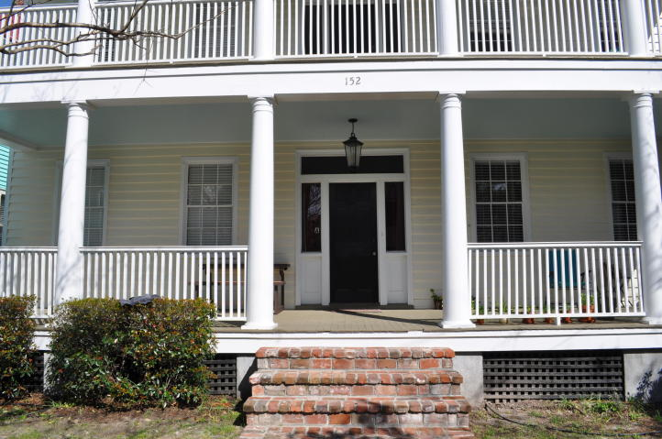
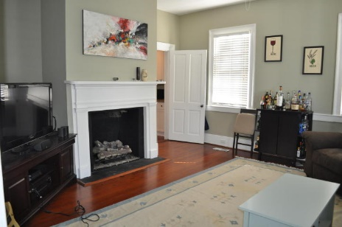
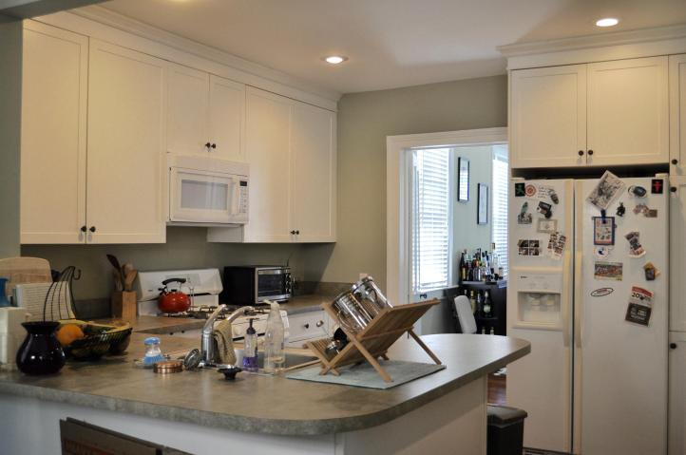
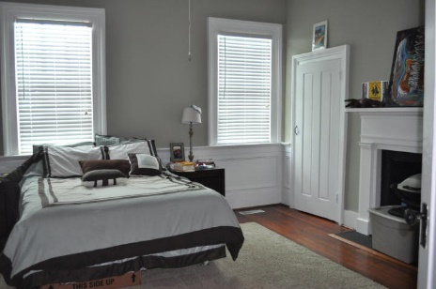
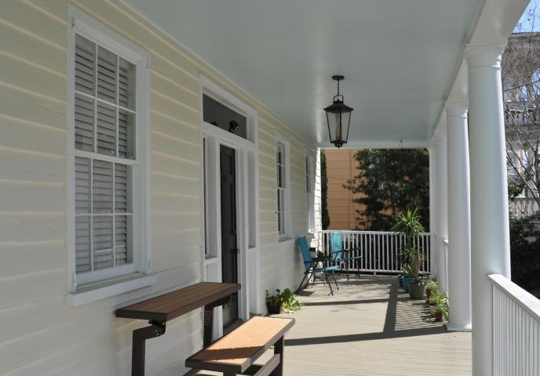

152 Spring Street A Elliottborough ~ Charleston ~ MLS# 16008612 ~ $2,750
Downtown Charleston Condo Rental Great location in the heart of the city.
Full Front Porch
Hardwood Floors, High Ceilings, Washer & Dryer, 3 Bedrooms.
One Bedroom Has A Large Walk-in Closet.
2 Off Street Parking Places.
A Good Size Front Yard To Enjoy.
Lawn Maintenance Is Included In Lease
Walking Distance To MUSC, C of C, Restaurants & Bars.
1 year or long term lease. No smokers/no pets. Available 5/1/16
Donna Landry
Mobile - (225) 921-2111
donna.landry@cbunited.com
Betsy Sarsfield
Mobile - (843) 608-1048
betsysarsfield23@gmail.com
Coldwell Banker United of Charleston | 35 Broad St | Charleston, SC 29401 | www.thebestincharleston.com

