Slide 1
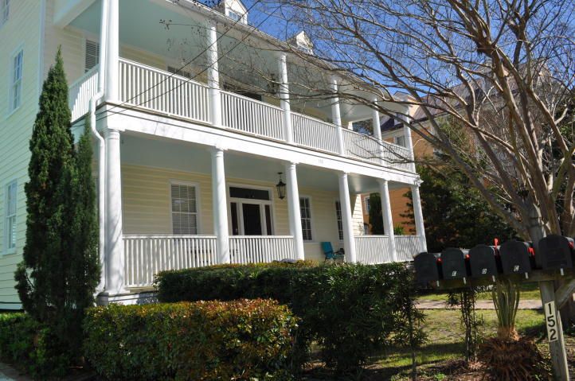
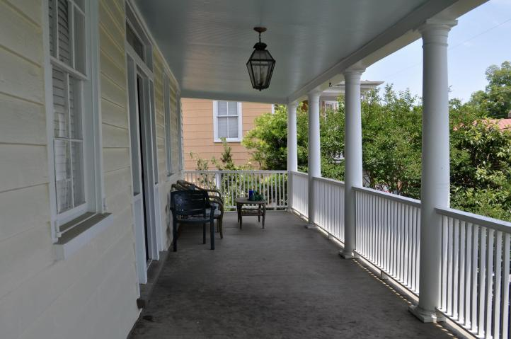
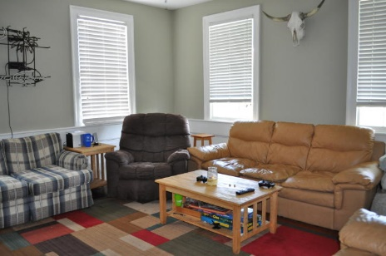
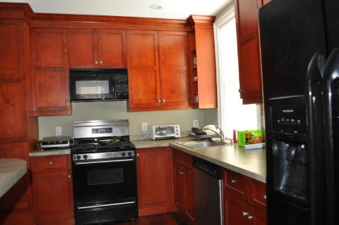
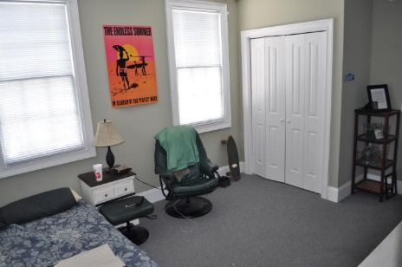

152 Spring Street B Elliottborough ~ Charleston ~ MLS# 16014463 ~ $3,200
Downtown Charleston Condo Rental Great location in the heart of the city.
Your chance to lease in a great location. This 4 BR, 3 BA condo is in the heart of Charleston.
This unit has lots to offer including:
Hardwood floors
High ceilings
Washer & dryer
Private balcony
1 BR & BA are on the 3rd floor
Walking distance to MUSC, College Of Charleston & numerous restaurants & bars
Unit has 3 OFF-STREET PARKING SPACES
1 year or long term lease. No smokers, no pets. Available 7/15/16.
Donna Landry
Mobile - (225) 921-2111
donna.landry@cbunited.com
Betsy Sarsfield
Mobile - (843) 608-1048
betsysarsfield23@gmail.com
Coldwell Banker United of Charleston | 35 Broad St | Charleston, SC 29401 | www.thebestincharleston.com

