Slide 1
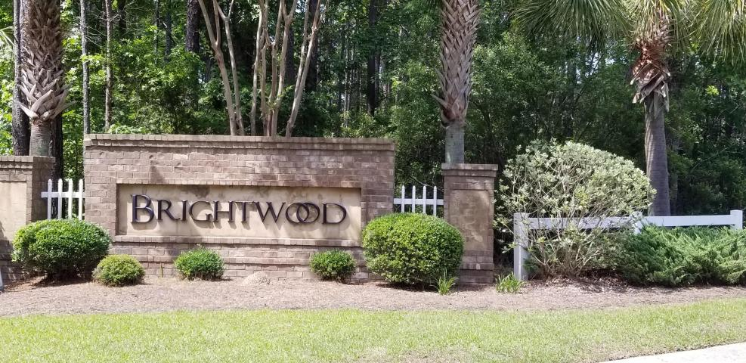
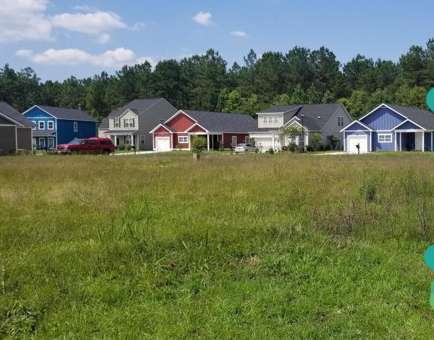
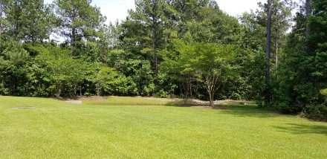
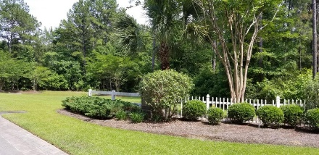


152 Brightwood Drive Lot 33
Brightwood :: Huger, SC 29450
MLS# 18016251
$49,000
Build Your Dream Home
2.67 Acres!
Build the home of your dreams in a quiet, peaceful setting.
Brightwood Plantation is a planned subdivision in the growing area near I-526 and Hwy 41. Lot is graded, cleared and builder ready.
Amenity center with clubhouse and pool are ready for your enjoyment. Close to Nucor and BP. Quimby Creek public landing is about 5 miles away. Buyer to verify any and all information deemed necessary.
Connie White, Broker
843-532-3356
conniesyouragent@gmail.com
Charleston Homes · 597 Old Mt. Holly Road · Suite 301 · Goose Creek, SC 29445

