Slide 1
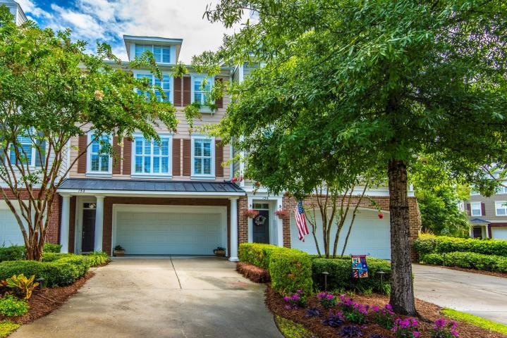
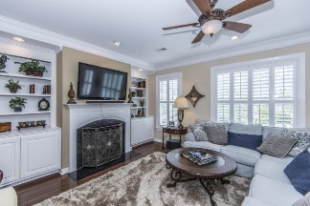
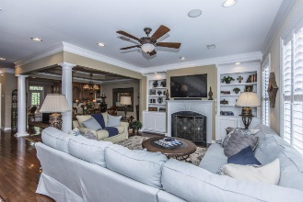
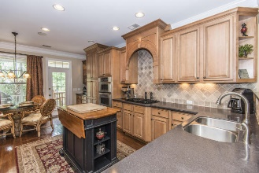
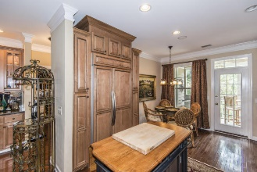
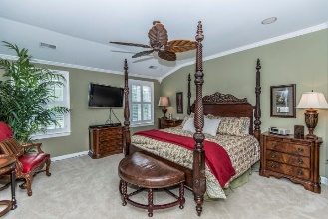
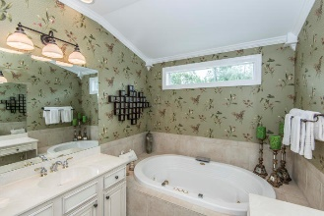
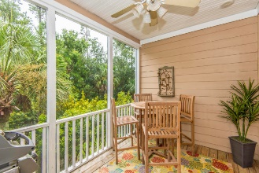
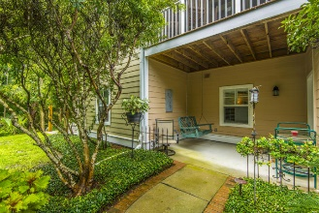
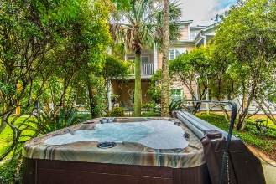


152 Palm Cove Way Dunes West | Mount Pleasant, SC 29466 MLS# 17022156 | $425,000
The Only Deep Water Home On Daniel Island
Just Listed!
Open House Saturday 1pm - 4pm
Most beautiful townhouse in Mt Pleasant!! Over $100,000 in upgrades: gourmet kitchen with gas cook top, wood paneled fridge, custom maple cabinetry, island with extra storage, under-lighting, granite countertops, tile back splash, and built in stainless appliances. Plantation shutters and crown moulding throughout home, beautiful oak hardwood flooring and brand new carpet, sound system with flush mounted speakers throughout for entertaining, garage has custom shelving and carpet to keep it nice and organized, the backyard is an oasis escape with palm trees, landscape lighting for night entertaining, a brand new hot tub to relax and gaze at the stars. There is a first floor bonus room that can be used as a large den, office or additional suite with full bathroom. The 3rd floor has an alcove off the master suite that can be used as an office or sitting area. The master suite has double door entrance and two separate walk in closets. The spacious master accommodates a king size bed with plenty of room to spare. A pocket door encloses the master bath that has two separate counter/sink spaces offering plenty of storage. Also in the master bath you can relax in a deep jacuzzi jetted tub. There is a laundry room off the master suite with lots of cabinets. Across from the master suite is an upstairs guest room with full bathroom. Also off the kitchen on the main level / 2nd floor is another guest bedroom that has screened porch access and full bathroom.
Helen Hudson
843-991-9875
helen.hudson@carolinaone.com
Carolina One Real Estate
2713 Highway 17 North
Mt. Pleasant, SC 29466

