Slide 1
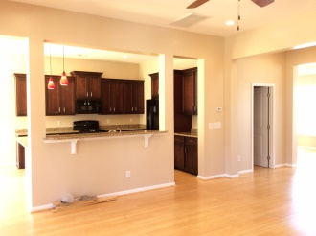
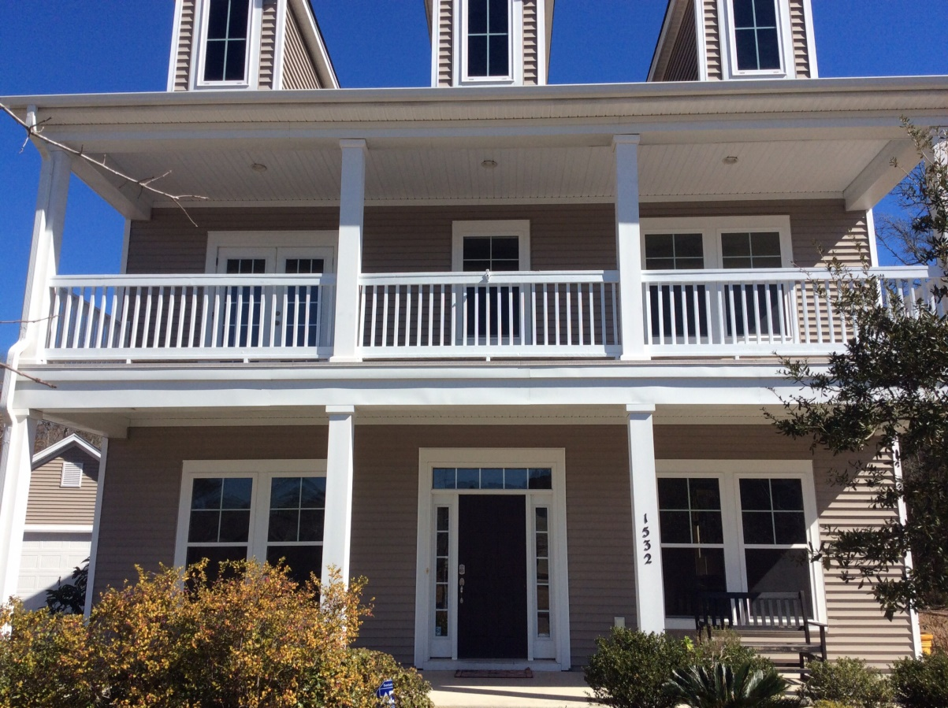
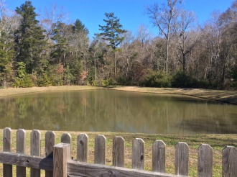
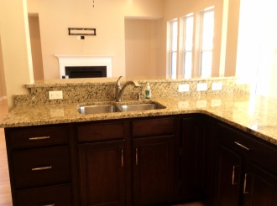
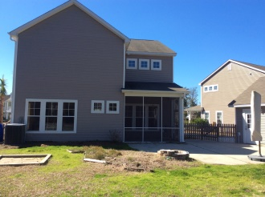
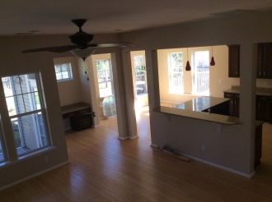
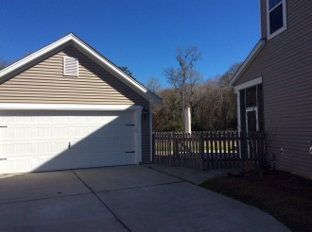
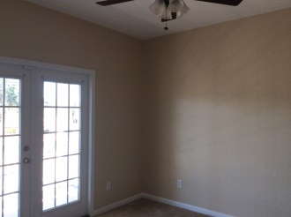
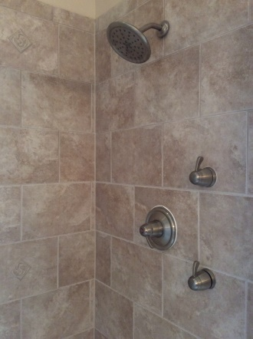


New Listing & Price Just Reduced!
1532 Nautical Chart Drive
Boltons Landing :: Charleston :: MLS# 15003871 :: $359,320
Beautiful one owner home is freshly painted and move in ready! Lot's of room with 4 large bedrooms and 2 1/2 bathrooms. Very roomy master suite with tray ceiling and oversized tile shower with dual shower heads and 2 huge walk in closets. This is a gorgeous home that has a very open layout and lots of upgrades including raised ceilings, lovely lighting fixtures, granite counter tops, built in desk, butler's pantry and cozy gas fireplace. The walk out porch upstairs has a sweeping view of the neighborhood so you can watch the sunset and wind down after a hard day! Downstairs there is a nice sized screened in porch that overlooks the fenced in back yard, large patio and peaceful and private pond... Also a 2 car detached garage.
Lolie Ward
O (843) 763-1211
M (843) 725-9639
lolie.ward@gmail.com
www.LolieWard.com
Carolina Real Estate Connection, LLC | 1529 Sam Rittenberg Blvd | Ste. 1-A | Charleston, SC 29407

