Slide 1
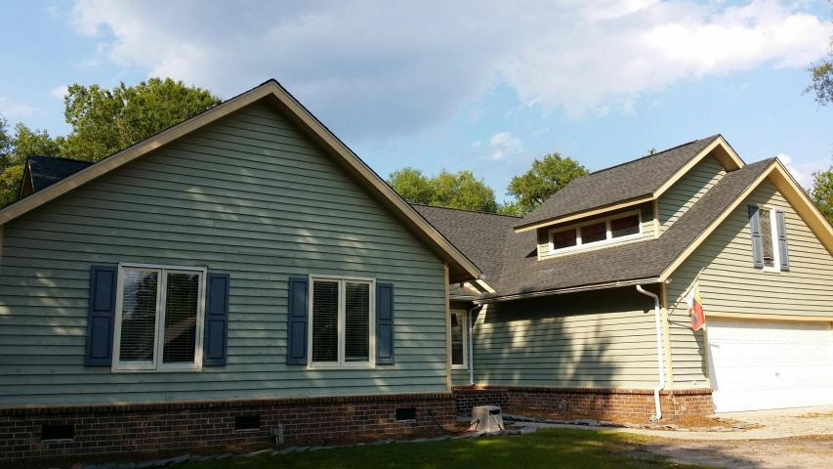
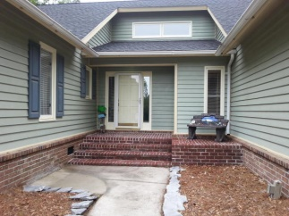
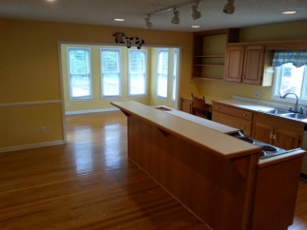
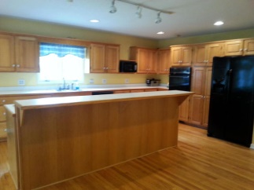
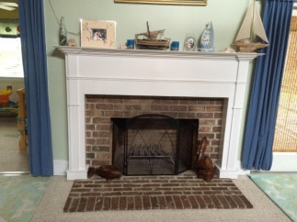
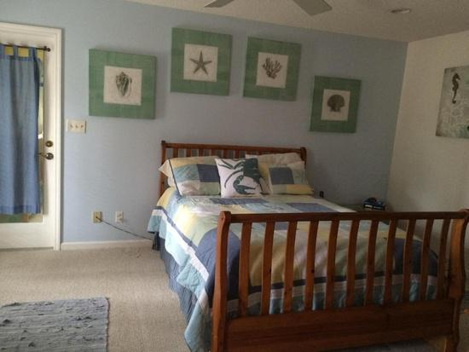
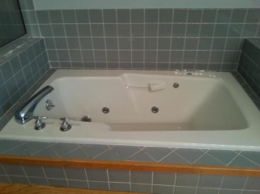
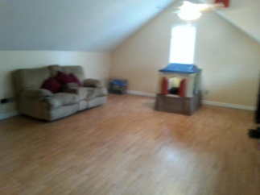
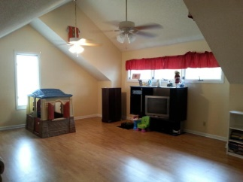
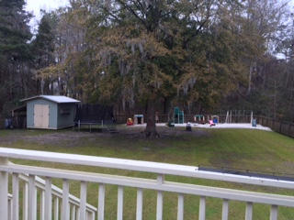
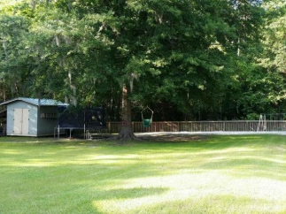


*** Price Reduced ***
1532 Sterling Oaks Drive
Sterling Oaks
Moncks Corner, SC 29461
MLS# 15004290
$265,000
Huge family home!! 4 bedrooms, 2.5 baths with bonus room/FROG and a office, located just off the cozy family room with real fireplace, cathedral ceilings and plant shelf.
Large open gourmet kitchen with separate eating nook & lots of cabinet space. All kitchen appliances convey. Also the plantation blinds stay. The roof is only 4 years old. Exterior of home painted 3 years ago. AC units replaced 2.5 yrs ago. Most of interior painted in the past 6 months.
Has a deck and screen porch on the back of the home, they overlook massive back yard, lot is 1/2 acre. Also has a matching shed with electricity,& it also conveys. Back yard has enough room for in-ground pool & already has the outdoor shower. Plenty of room to play, or lounge on the back deck
Danielle Cook (843) 425-9357 danielle.cook@agentownedrealty.com
Angela Anderson
Mobile - (843) 934-9351
Office - (843) 761-8176
angela.anderson.aor@gmail.com
AgentOwned Realty Co.
Premier Group 141 A N. Main Street
Summerville, SC 29483

