Slide 1
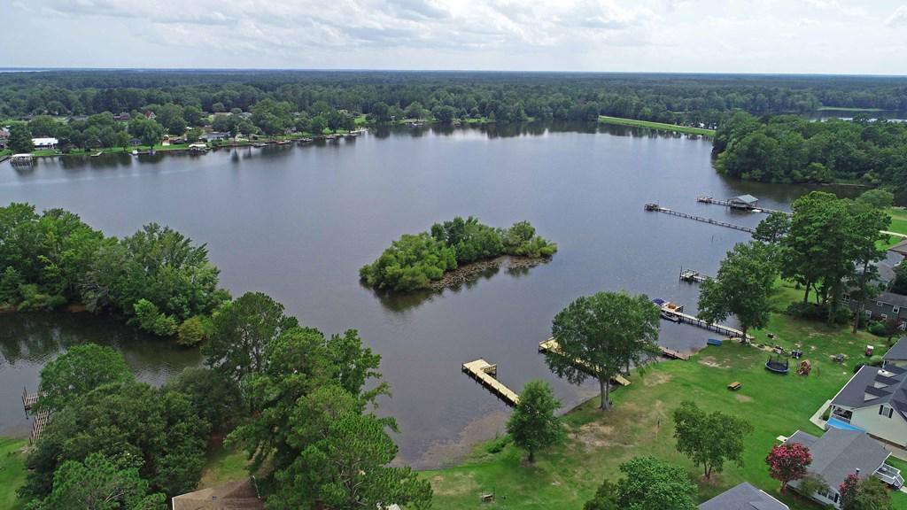
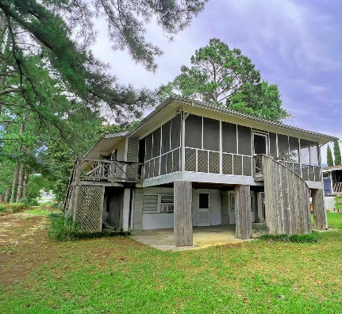
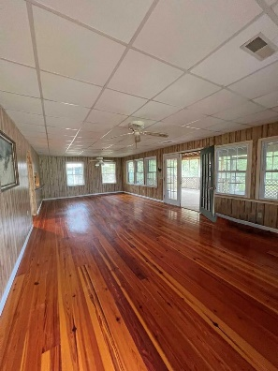
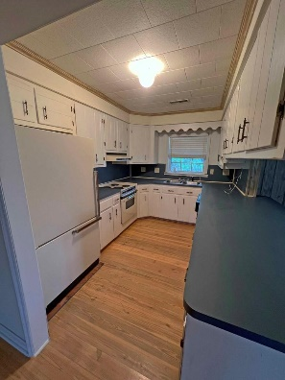
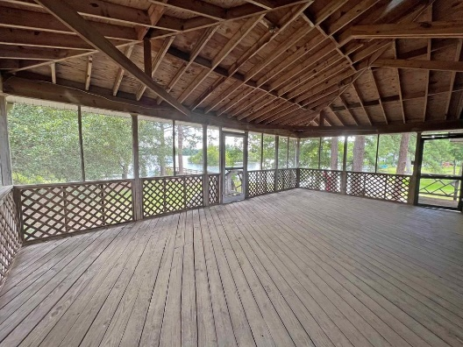

Lake Marion Waterfront
1533 Taw Caw Dr
Summerton, SC 29148 ~ MLS# 152231 ~ $275,000
Sitting Waterfront on Lake Marion in Summerton off exit 108 on I95. This lot has a buy out of $147,500 in addition to house price of $300k and will be deeded at closing. The home as 3 bedrooms and 2 baths on main level (2nd story) a large living room with huge screened in porch. The hardwood floors are a show stopper. The downstairs has the making of MIL suite or guest quarters with a little TLC. The lot is host to mature live trees, magnolia trees and azalea bushes. With a little TLC and elbow grease this home can be a Bright start on Lake Marion. Home is as is.
Lake Homes Realty, LLC
Elloree, SC 29047
www.SCLakeLife.com
Kristie Anderson
(803) 387-9459
kristie@sclakelife.com

