Slide 1
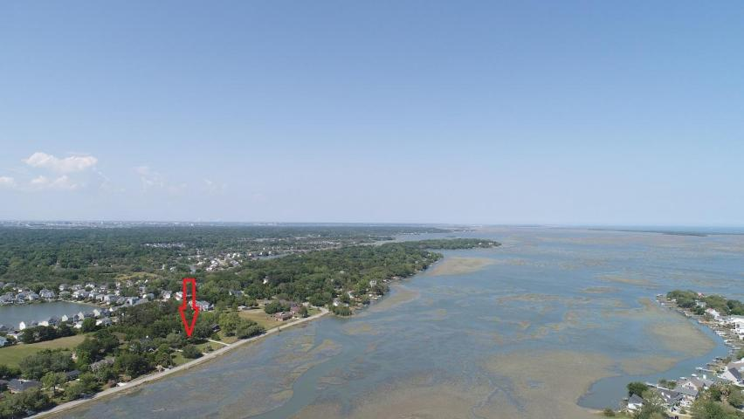
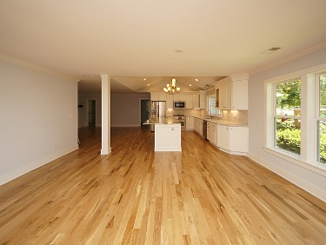
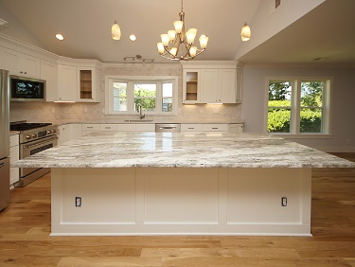
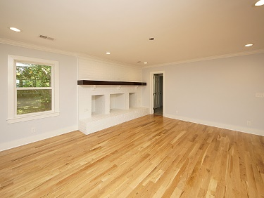
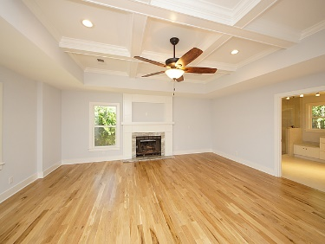
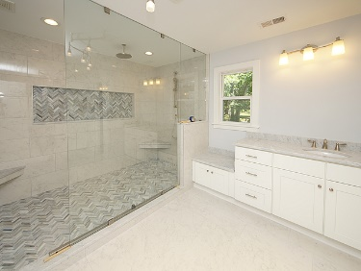
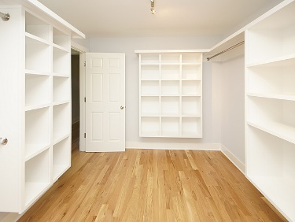
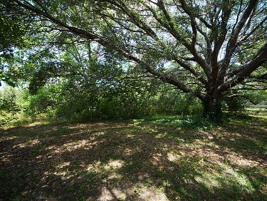
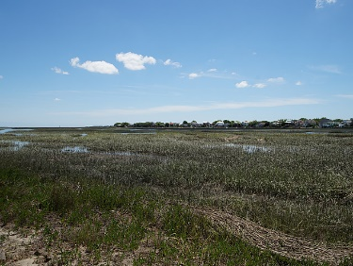



1534 Battery Island Drive Artillery Point ~ Charleston, SC 29412 MLS# 18013407 ~ $780,000
Appraisal for $805k = INSTANT EQUITY!
Go And Show!
$5,000
AGENT BONUS
HUGE one-story home on James Island that has been entirely renovated while overlooking Secessionville Creek and just a stone's throw away from the beach! Everything in this gorgeous brick ranch is new: architectural roof, HVAC, plumbing, electric, tankless water heater, stunning site finished hardwood flooring, custom tiled bathrooms, gourmet kitchen with crisp white cabinets and rich fantasy brown granite on the island, top of the line stainless steel appliances and more. The layout is open making it perfect for entertaining yet each room is defined so it feels like the grand home that it is. The yard is enormous at just over an acre. One can walk to The Barrel and Tattooed Senorita Cantina, and it is a quick run or bike ride to Folly.
Schedule your showing today, as a home like this will not last:
New Architectural Roof
New Windows
New HVAC
New Tankless Water Heater
New Kitchen ~ Cabinets, Granite, Stainless Appliances Including Refrigerator
New Flooring Throughout ~ Site Finished Hardwood and Custom Tile
New Plumbing
New Electric
Gorgeous Coffered Ceiling in Master with Granite Fireplace
Custom Super-Showers with Rain Head
Triple Vanities in Master Bathroom
Custom Closet Systems
Walk-up Attic Storage and Access
Garage
NO HOA
Over an acre
Stunning Creek Views
Walk to Popular Restaurants
Moments to Folly Beach
Short Commute to Downtown Charleston
Beth Moore
M (843) 532-4892
bmoore@carolinaone.com
Meg Kandik
M (843) 814-5137 | O (843) 603-4659
Meg@HolyCityRE.com | www.holycityre.com
Bennett Construction & Realty | 804 Tennent Dr | Charleston, SC 29412

