Slide 1
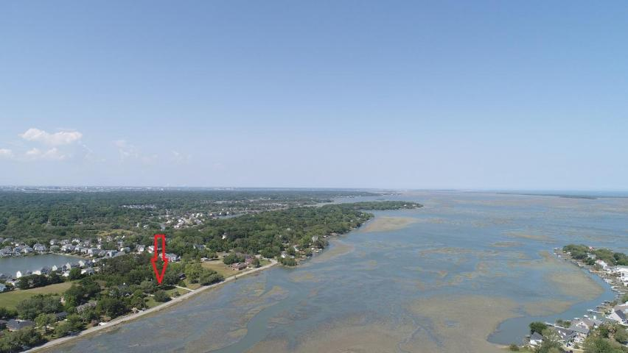
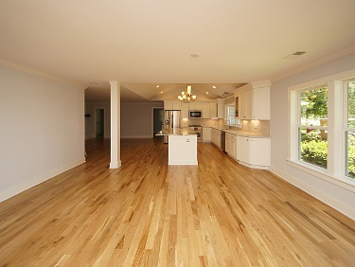
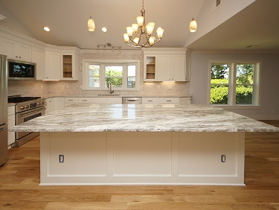
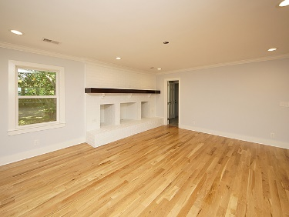
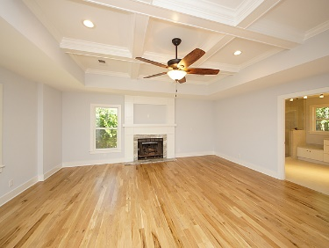
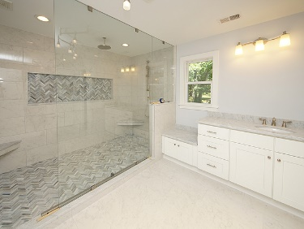
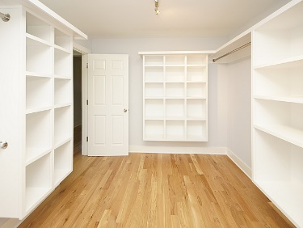
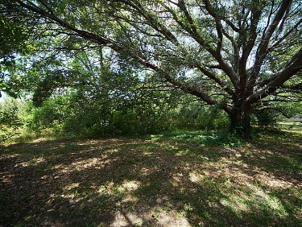
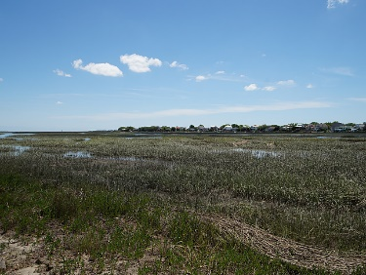



1534 Battery Island Drive
Artillery Point ~ Charleston, SC 29412
MLS# 18019666
Appraisal for $805k = INSTANT EQUITY!
Go And Show!
$5,000
AGENT BONUS
Custom renovation ~ gorgeous one-story brick home on James Island overlooking the creek with glimpses of Morris Lighthouse and just a stone's throw away from the beach! Everything in this home is new: architectural roof, HVAC, plumbing, electric, tankless water heater, stunning site finished hardwood flooring, custom tiled bathrooms, gourmet kitchen with crisp white cabinets and rich fantasy brown granite on the island, top of the line stainless steel appliances and more. The layout is open making it perfect for entertaining yet each room is defined so it feels like the grand home that it is. The yard is enormous at just over an acre. One can walk to The Barrel and Tattooed Senorita Cantina, and it is a quick run or bike ride to Folly.
Schedule your showing today, as a home like this will not last:
*New Architectural Roof
*New Windows
*New HVAC
*New Kitchen ~ Custom Cabinets, Granite, Custom Tile Backsplash, Stainless Appliances with Five-Burner Gas Range and Refrigerator
*New Flooring Throughout ~ Site Finished Hardwood and Custom Tile
*New Plumbing
*New Electric
*Gorgeous Coffered Ceiling in Master with Granite Fireplace
*Custom Super-Showers with Rain Head
*Triple Vanities in Master Bathroom
*Custom Closet Systems
*Walk-up Attic Storage and Access
*Garage
*NO HOA
*Over an acre
*Stunning Creek Views
*Walk to Popular Restaurants
*Moments to Folly Beach
*Short Commute to Downtown Charleston
Beth Moore
M (843) 532-4892
bmoore@carolinaone.com
Meg Kandik
M (843) 814-5137 | O (843) 603-4659
Meg@HolyCityRE.com | www.holycityre.com
Bennett Construction & Realty | 804 Tennent Dr | Charleston, SC 29412

