Slide 1
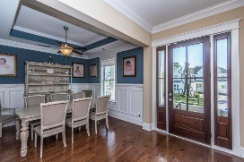
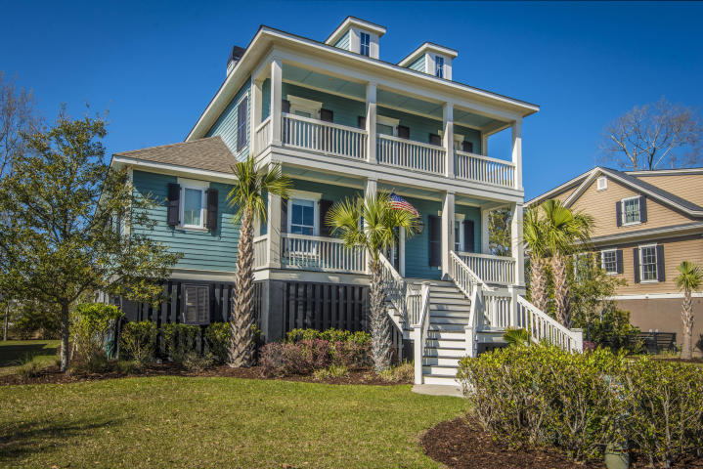
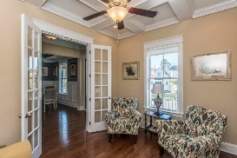
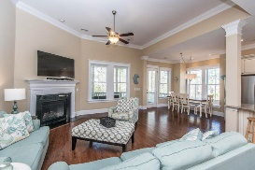
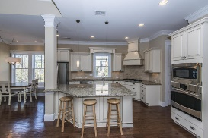
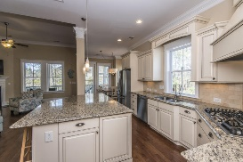
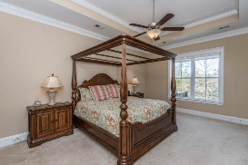
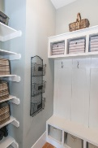
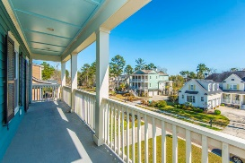
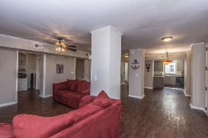
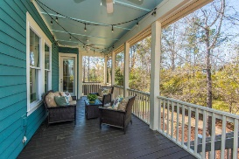
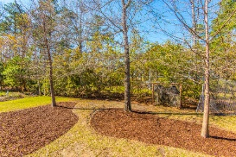


1535 Capel Street
Mt Pleasant, SC 29466
MLS# 18006946
$825,000
$70,000+
Price Reduction
Best Mother-in-law suite in Mt Pleasant!
Over 5000 sf for $825,000!
Don't miss out on this beautiful low country home in the highly desirable section of Masonborough! You won't find a better deal! Built in 2012 this home has the open concept buyers are looking for plus a huge finished MIL suite on the ground floor complete with a second kitchen! It features double front porches that greet you as you arrive...the perfect place for your rocking chairs or porch swing. Upon entering you will find the study with gorgeous coffered ceiling to your left and dining room to the right. Thick moldings give each room a custom feel. Straight ahead you'll find an open concept kitchen and family room with separate breakfast area with custom banquet seating. This gourmet kitchen boasts a large center island with room for seating, a gas cooktop, and granite countertops. Off the kitchen is the large screened porch perfect for entertaining. The family room fireplace with marble surround helps create a cozy atmosphere for cool fall/winter evenings. There is also a large pantry and laundry room with built in cabinets. Completing the downstairs is the spacious master suite with tray ceiling, garden tub, oversized shower and separate vanities with Cambria countertops and upgraded fixtures. Upstairs via wood stair treads you will find 4 bedrooms, one with it's own bath plus a second bath for the other rooms to share. These bathrooms both have granite countertops. One of these rooms steps up from the hall, has french doors and can also serve as a media or play room. In addition to all this space, head down to the first level and you will find an entirely finished ground floor. No expense was spared here and you will enjoy a second family room, sunroom, bedroom/study with built in desk, and the 6th bedroom with a HUGE closet and room for a second set of washer/dryers. This room also has it's own full bath. It doesn't end there there as you will also find an additional half bath, dining space and complete kitchen area. This could be the perfect mother-in-law suite, teen hangout or a place for your company to stay and have plenty of privacy. This addition is fully permitted, insurable, and is over a foot above flood (see elevation certificate). Garage has built in storage and an access door to outside. Park West offers wonderful amenities including two pools, tennis courts, a club house, play parks, and of walking/jogging trails. Public schools are within the neighborhood as well as shopping, dining recreational fields, professional offices and a gym. Downtown Charleston and the beaches are only 20-25 min away! Come see this awesome deal for yourself and welcome home!
Melodie Smith
(843) 408-5067 M
melodie.smith@carolinaone.com
www.melodiesmithrealestate.com

