Slide 1
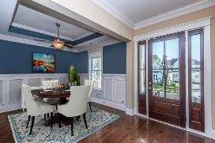
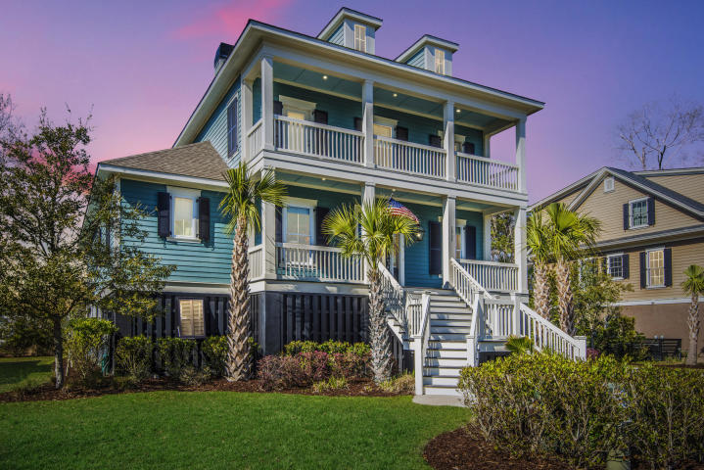
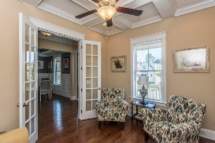
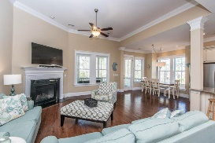
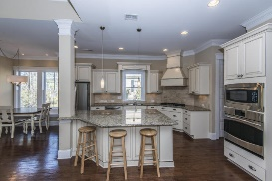
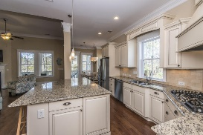
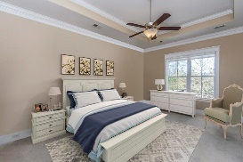
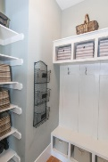
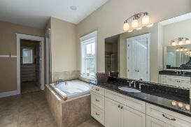
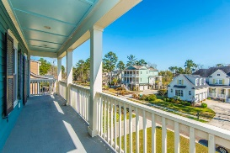
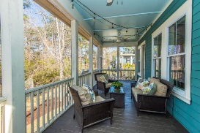
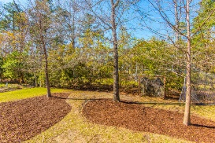


1535 Capel Street Mt Pleasant, SC 29466 MLS# 19000156 $739,000
$70,000+
Price Reduction
Huge Price Improvement!
Welcome to your new low country style home in prestigious Masonborough. You won't find a better deal for the square footage! This home has the open concept buyers are looking for plus a huge finished MIL suite on the ground floor complete with a second kitchen! It features a classic double front porch…perfect for your rocking chairs or swing! Upon entering you will find the study with gorgeous coffered ceiling to your left and dining room to the right. Thick moldings give each room a custom feel. Straight ahead you'll find an open concept kitchen and family room with a separate breakfast area and built in banquet seating. This gourmet kitchen boasts a large center island with plenty of room for casual seating, a gas cooktop and granite countertops. Off the kitchen is the large screened porch, perfect for outdoor entertaining. The family room fireplace with marble surround creates a cozy atmosphere for those cooler fall and winter evenings. There is also a large pantry and laundry room with built in cabinetry. Completing the main level is the spacious master suite with tray ceiling, garden tub, oversized shower and separate vanities with Cambria countertops.
Wood steps lead you upstairs where you will find 3 additional bedrooms and a fourth bonus space/media room which is currently being used as a bedroom. One room has its own private bath and the others share a hall bath. New carpeting has been installed throughout all the bedrooms.
Down on the ground level you will find an entirely finished and potentially separate MIL suite complete with its own full kitchen. No expense was spared here and you will enjoy a second family room, sunroom, and a large bedroom with full bath as well as a half bath in the main area. There is also a huge closet inside the bedroom with a hook up for a second set of washers/dryers. Use this space together with the main level for unlimited entertaining, loads of company or a private retreat for grandma! This space is fully permitted, insurable and is a foot over flood. The garage has 2 garage bays as well as a bonus space for a golf cart/bikes/workshop etc. There is also extra storage under the front porch. The driveway is deep and can accommodate multiple cars. Just inside the garage is a drop zone area ready to store your backpacks, shoes and jackets.
Park West offers wonderful included amenities including two pools, tennis courts, club house, play parks and miles of walking/jogging trails. Public schools are within the neighborhood as well as dining, recreational facilities, professional offices and gym. Downtown Charleston and the beaches are only 20 min away! Come see this beautiful and unique home for yourself!
Melodie Smith (843) 408-5067 M
melodie.smith@exprealty.com
www.melodiesmith.exprealty.com

