Slide 1
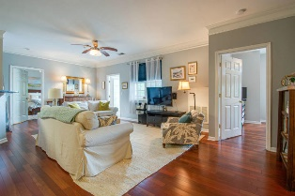
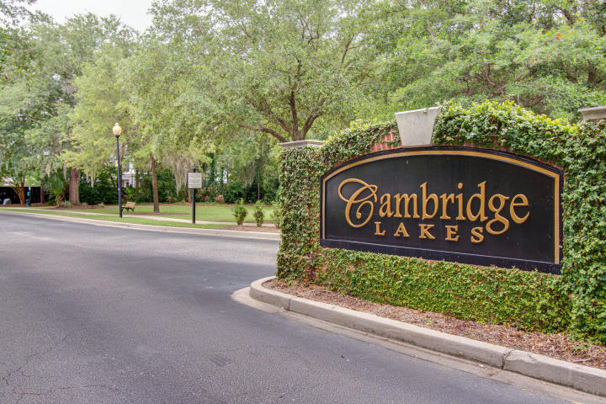
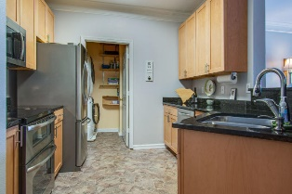
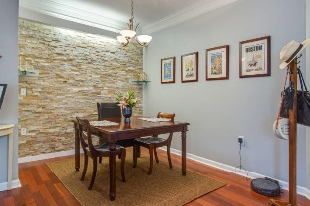
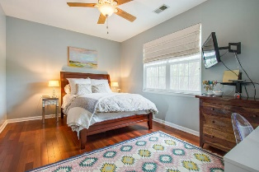
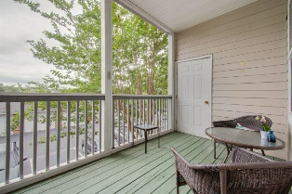
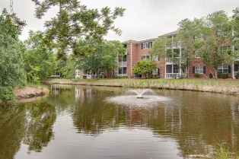

William S. Smith, Broker wssmith@hartnettrealty.com
843-906-5620
Convenient Location in the Heart of Mt Pleasant
Setup your showing today!
1535 Cambridge Lakes Drive 205D
Cambridge Lakes | Mount Pleasant, SC 29464
MLS# 20015333 | $239,500
This three-story brick condominium complex is secluded on a campus-like setting yet is only minutes away from major arteries. Second floor, two bedroom, two bath unit, offers hardwood floors, granite countertops, stainless appliances and a screened-in terrace. A rock wall and light bar accent the dining alcove. Sophisticated lifestyle is supported by Club House, workout room, swimming pool, and plenty of parking. Owner installed new 2 ton SEER HVAC in April, 2017. New built-in microwave also installed by current owner. All appliances, including refrigerator and washer and dryer, convey.
1156 Bowman Road, Suite 200
Mt. Pleasant, SC 29464

