Slide 1
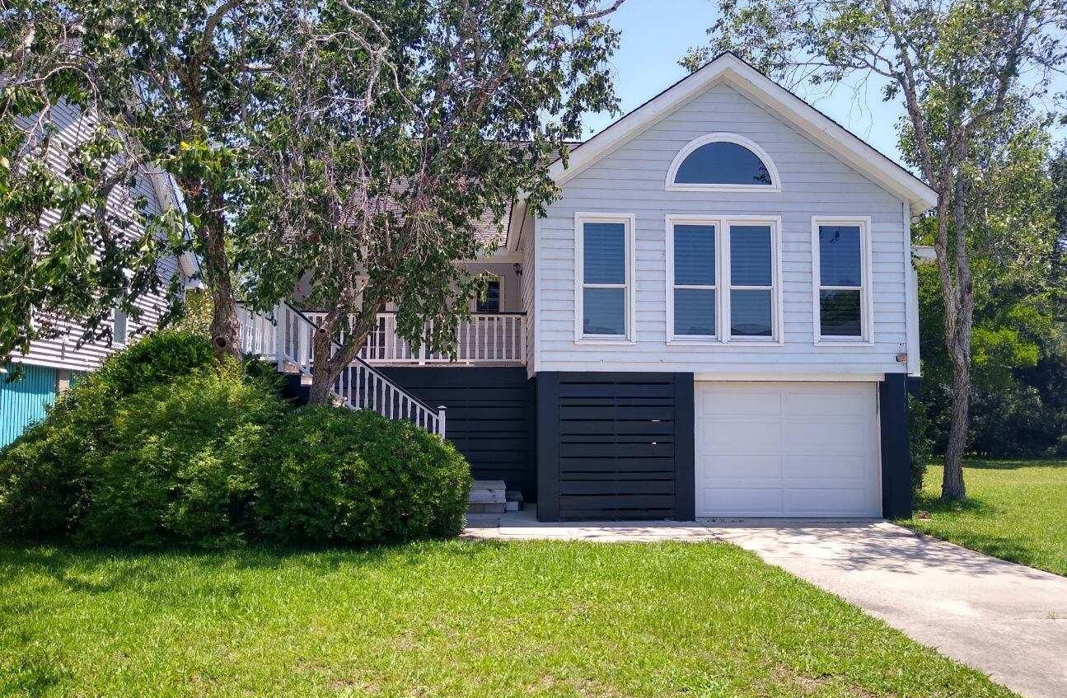
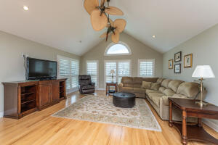
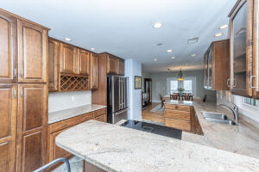
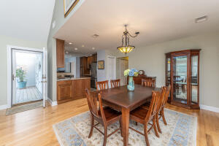
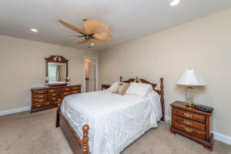
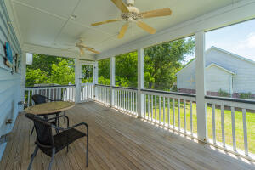
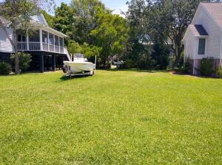
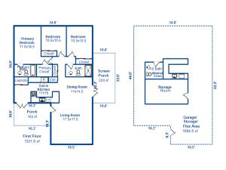


1536 Privateer Drive
Pirates Cove | Mount Pleasant, SC 29464 | MLS# 22015440 | $735,000
Open House - Old Mount Pleasant
Saturday & Sunday
12pm to 2pm
Charming raised Coastal Cottage in the center of Old Mt. Pleasant! LOCATION!! Walk to award winning elementary school, Mt. Pleasant Academy. The livability factors are tremendous; walk, bike or golf cart to the Old Village and Pitt Street shops and restaurant, beautiful Alhambra Hall, and minutes to Sullivan's Island. Lovingly updated over the years with granite countertops in kitchen, stainless steel appliances and beautiful custom cabinets. Both bathrooms have been updated with tiled in showers and granite countertops. Underneath the home owners have built a bar and a half-bath.
The storage areas are unbelievable, the drive under garage could hold up to 3 cars potentially, definitely 2 and a golf cart! Owners are listing the VACANT LOT next door MLS 22015451. THE OPPORTUNITY to own the lot next door creates all kinds of potential. The Lot is on MLS # and can be bought separately from the home or buy both and own a double lot to build new or add-on to existing home or live in one and build another or just keep your view open from your screened-in-porch.
The home will be open to showings on Friday, June 17th. Multiple offers expected SELLER IS ASKING FOR HIGHEST AND BEST BY MONDAY, JUNE 20th AT 6 PM with EXPIRATION DATE for 6:00 P.M. June 21st. LOT OFFERS TO BE CONSIDERED AT THE SAME CUT-OFF.
Cindy Elenberger
O 843-884-1622 | M 843-696-6701
cindy.elenberger@carolinaone.com
Carolina One Real Estate | 628 Long Point Rd | Mt Pleasant, SC 29464-3032

