Slide 1
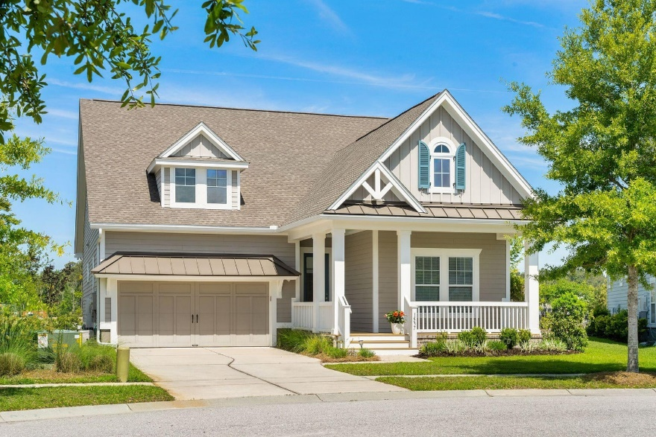
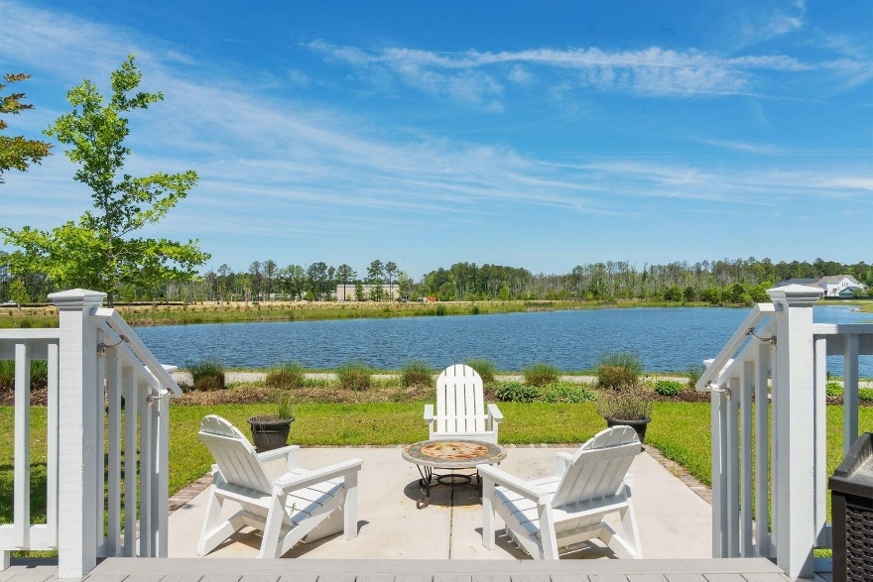
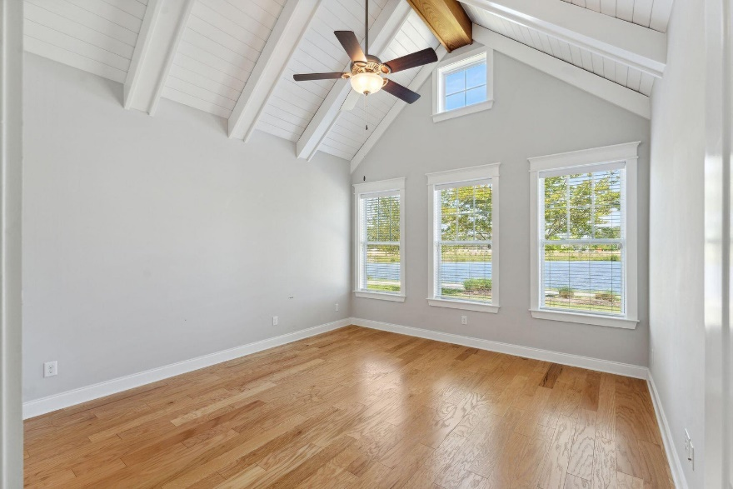
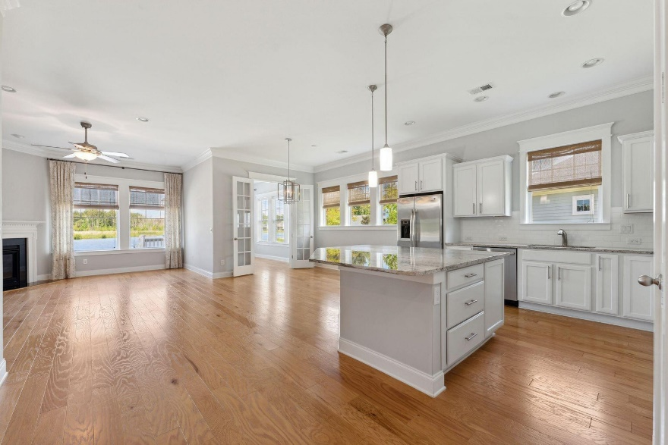


Gorgeous Water Views
Like New
1537 Billington Drive
Carolina Park | Mount Pleasant, SC 29466
MLS# 23008382 | $789,000
Chrissy Strickland 843-906-5553
chrissyresiderealestate@gmail.com www.residerealestatellc.com
Water VIEWS and One level living at its finest!! Are you looking for a high-quality low maintenance property with gorgeous water views located in a peaceful, cul-de-sac setting? Well, look no further! Welcome to 1537 Billington Dr. , located in the well planned neighborhood of Carolina Park. As you enter this beautiful well designed open concept property, you will immediately notice the lovely wide plank hardwood floors throughout this bright and airy floor plan! After entering the welcoming foyer, there are two guest bedrooms rooms that are joined by a shared bath. Continuing through the property, you are greeted by high ceilings, and an open concept kitchen/den, perfect for entertaining guests! The tasteful kitchen features an oversized island, granite countertops, upgraded cabinets, stainless appliances and a gas cooktop range. You can easily enjoy the cozy gas log fireplace or watch television from your kitchen. Just past the den is an additional sunroom perfectly situated for reading your favorite book and enjoying nature and the peaceful relaxing pond views.
Reside Real Estate LLC
155 Wingo Way Unit 421 Mt. Pleasant, SC 29464

