Slide 1
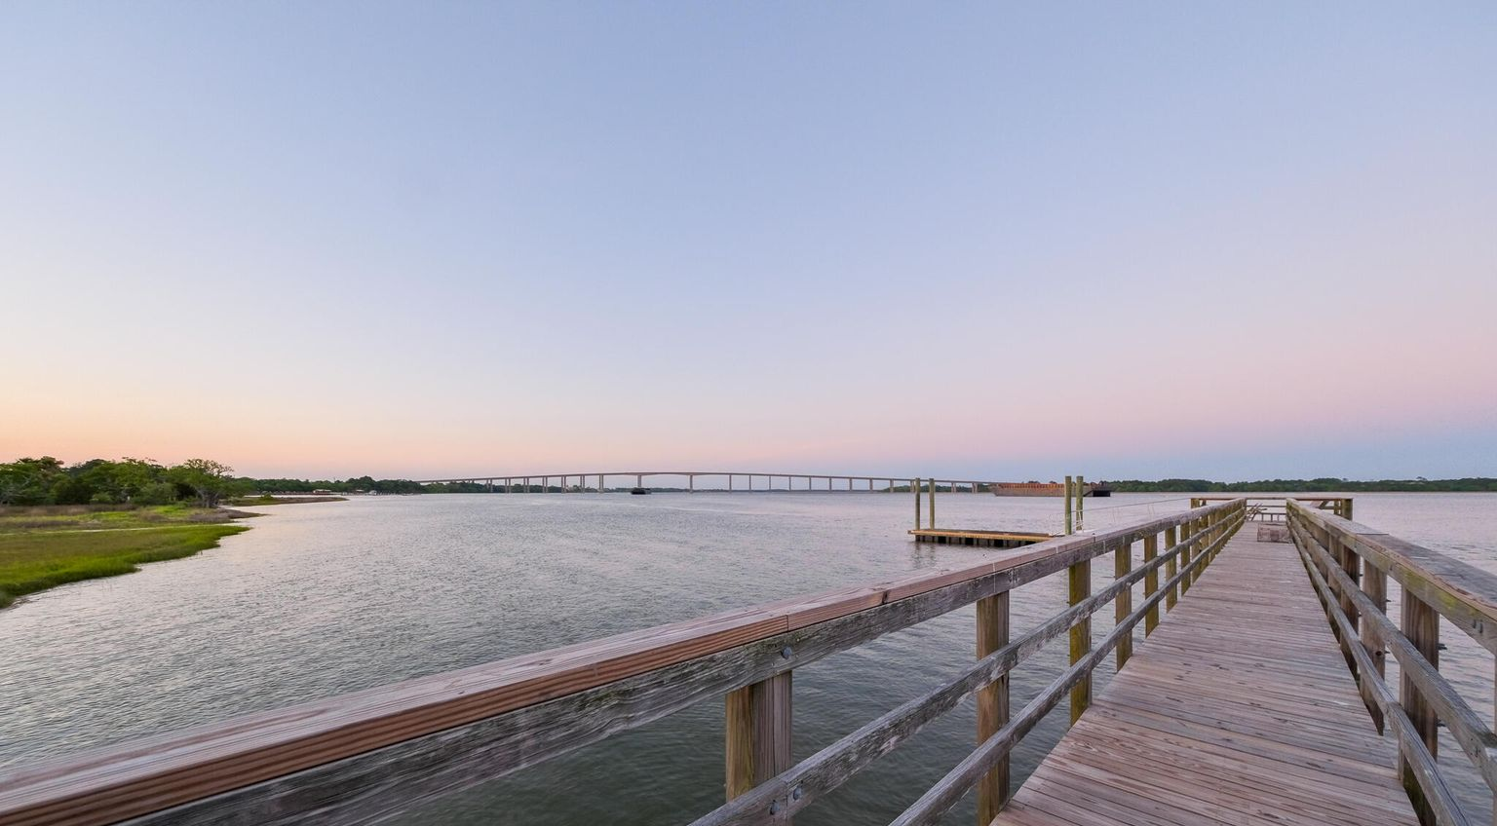

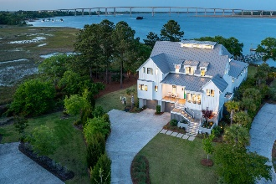
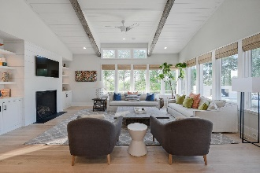
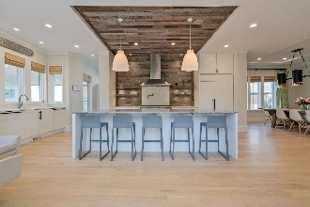
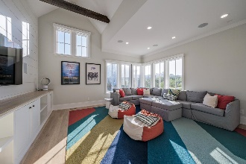
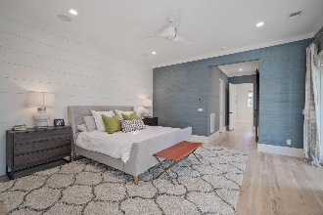
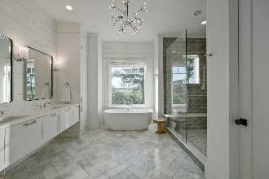
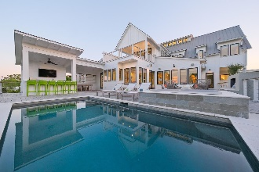
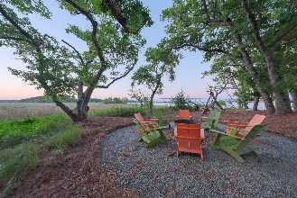
Why Build When You Can Live The Dream Now
1538 Wando View Street Daniel Island | Charleston, SC 29492 | MLS# 21011392 | $5,995,000
Spectacular 5500 sq ft custom Shelter built and Damien Busillo designed coastal chic home on the Wando. Private deep water dock. This elevated masterpiece boasts a master suite on the main floor and 4 beds, all en-suite on the second floor. Private office, Flex Space, 2 laundry facilities, mega mudroom, media room and elevator make this the perfect oasis. There is a view from every room with 280 degree unobstructed views of the water and marsh. This home has a raised elevation heated Gunite pool/spa, expansive multi- level decking, outdoor gas fireplace and storage galore. On the lowest level enjoy a multi-car garage and temperature controlled space for gym or playroom. Do not miss the private white sand beach and huge yard. This won't last!
Take a video tour: https://vimeo.com/543241725
Jacquie Dinsmore 973-886-0357 jacqueline.dinsmore@carolinaone.com
Clarice Cawood 865-776-2252 clarice.cawood@carolinaone.com
The Cawood Dinsmore Group | Carolina One Real Estate | 1101 St. Thomas Island Dr. | Charleston, SC 29492

