Slide 1
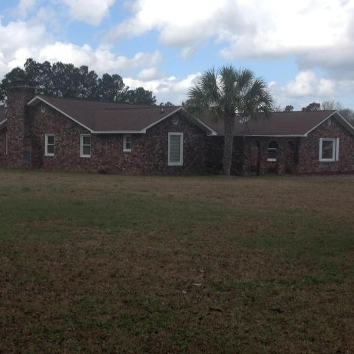
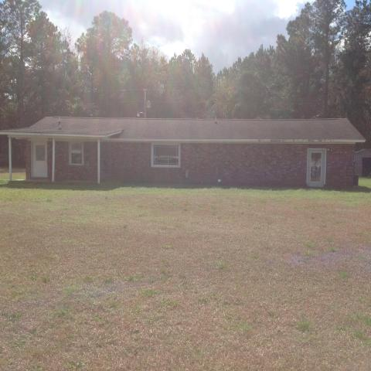
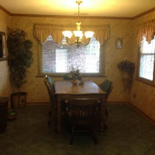
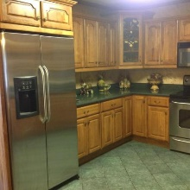
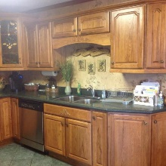
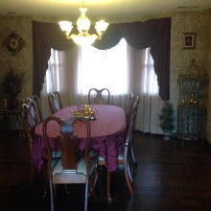
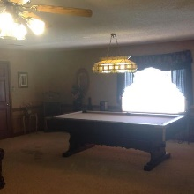
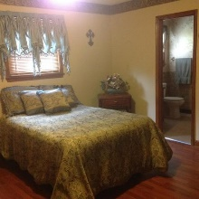
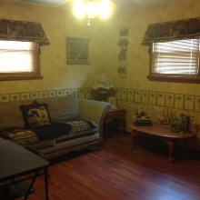
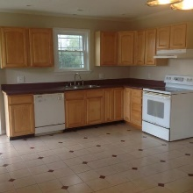
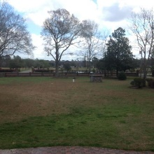
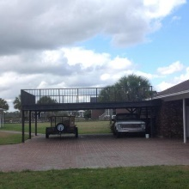
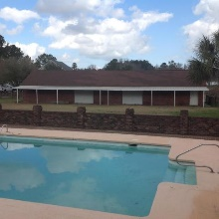
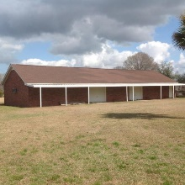
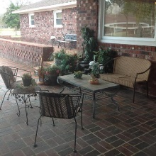
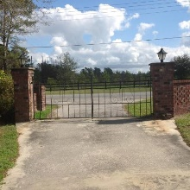
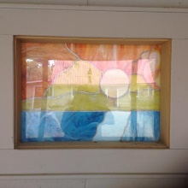

Great opportunity for property with two homes!
Too many amenities to list!
1539 & 1543 Old Whitesville Road
Moncks Corner, SC 29461 | MLS# 18004595 | $485,000
Wonderful opportunity!!! Big house is 3057 sq ft with 4 bedrooms and 3.5 baths. Small house is 2/2 with third bed option. Garage has been converted to master not included in sq ft (small house). Live in one and rent the other or mother in law residence. Large 3.02 lot close to Hwy 17A and Hwy 6. In-ground pool (up to 13 ft) with raised deck and covered patio. Workshop/3 car garage (with full bath) and covered parking for 5 additional autos. Workshop/garage is 20x80 and alarmed. Mature landscape with fig, pear and pecan trees. Fig trees from Italy. Private drive for each house. Homes are metered separately.
Must see so make your appointment today!
Carla C Davis
Mobile - (843) 437-4873
gaweber@tds.net
AgentOwned Premiere Group
141 A N. Main Street
Summerville, SC 29483

