Slide 1
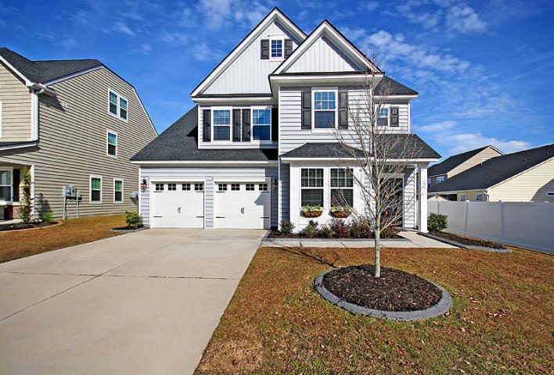
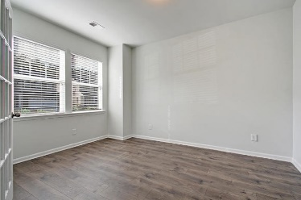
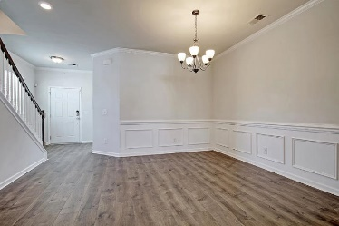
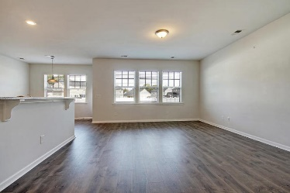
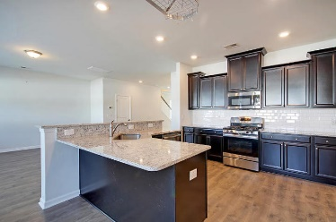
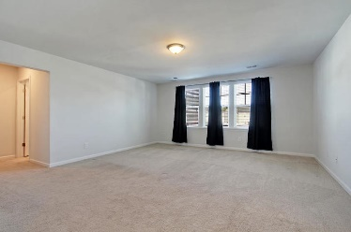
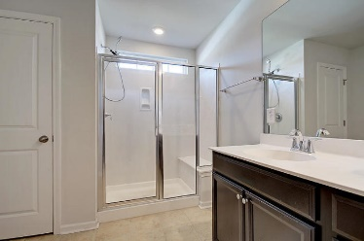
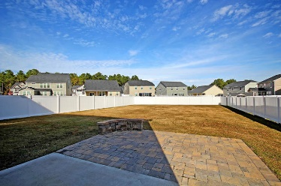
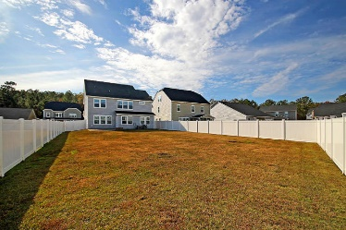

153 Blackwater Way Fairmont South · Moncks Corner, SC 29461 MLS# 19032446 · $325,000
Gorgeous Listing
New Listing!
Only $325,000!
Beautiful and inviting 2 year old 6 BR 4.5BA, 3-story home with upgrades galore! When driving up you are greeted with wonderful curb appeal. Upon entering the home to the left is a flex space with gorgeous French doors that is perfect for an office/living room/play room. Next is the exquisite dining room with wainscoting, and eye-catching lighting. The large family room has an abundance of natural light and is open to the chef-inspired kitchen with stainless steel appliances, gas stove, subway tile backsplash, granite countertops, breakfast bar, stunning cabinets, eat-in area and pantry. Next is a guest bedroom with a private bath and walk-in closet. The grand master bedroom suite is on the second floor with French doors, wall of windows, HUGE walk-in closet and spa-like master bath with oversized shower, large vanity with dual sinks, and linen closet. There are 3 additional bedrooms that share a full bath with a dual sink vanity and a walk-in laundry room on this level. The third floor is perfect as a teen or mother-in-law suite with a living area, bedroom, private bath, and walk-in closet. The outside has a large fenced in back yard and gorgeous paver patio. This almost new home has everything! Call today to be first to see!
Stan Huff
843-670-2835 stan.huff@agentowned.com
Jill Marcacci
843-297-5590 jill@agentowned.com
www.agentownedrealty.com
AgentOwned Realty Co. Preferred Group, Inc. | 824 Johnnie Dodds Blvd | Mt Pleasant, SC 29464

