Slide 1

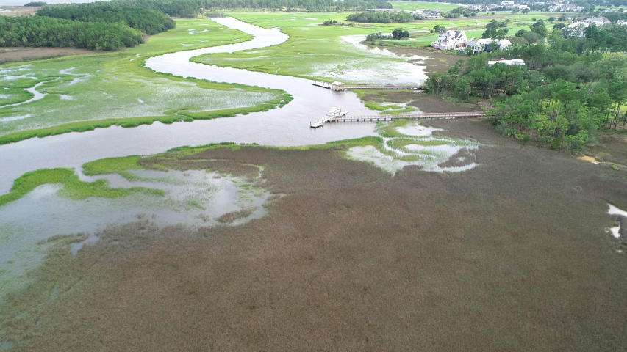
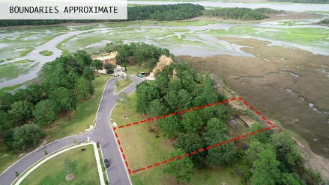
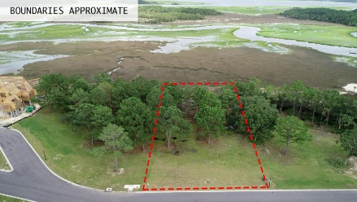
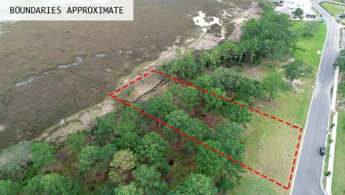
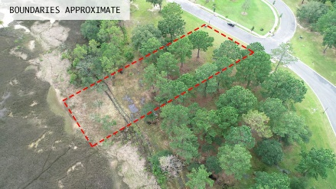

PRICED TO SELL!
153 Nobels Point Street
Daniel Island ~ Charleston, SC 29492 ~ MLS# 18020978 ~ $825,000
With sweeping marsh views, this is truly A MUST SEE LOT! This is the perfect setting to build your dream home! Go stand at the back of this very large homesite (.65 acres) in the Nobels Point subsection of Daniel Island Park, and see why it was the most desired property during the original sales lottery. You'll find stunning, expansive and unobstructed marsh views of Ralston Creek. Directly across the street will be open green space, and the 13th hole of the Ralston golf course is just beyond that. This lot is situated on a peaceful street near the cul-de-sac with convenient access to the gated deep water community dock just six lots away.
Fish off the end of the dock, go kayaking or paddle boarding, or tie your boat up for the day at the community dock. Includes Daniel Island Club social membership privileges, with the opportunity to upgrade to a sports membership, or a transferable full golf membership. Convenient to schools, the many neighborhood parks, and trails. Daniel Island is a short drive to local beaches and a quick commute to the airport and downtown Charleston.
Andrew Tackitt
(843) 437-8726
andrew@radekopf.com
1205 Two Island Court, Suite 201 Mount Pleasant, SC 29466 Phone: (843) 579.2217 Fax: (843) 971-0281
Erin Quinn Hanhauser
(843) 743-8204
erin@radekopf.com

