Slide 1
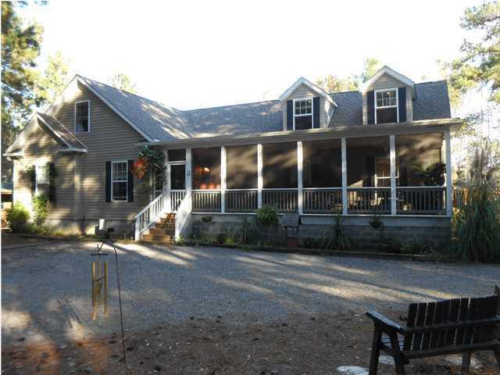
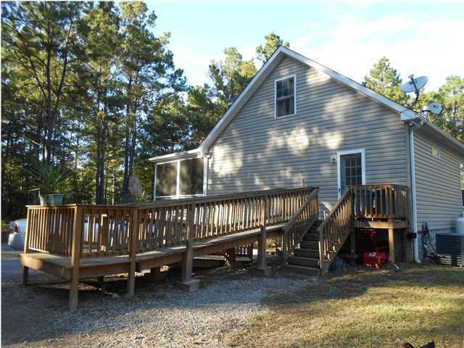
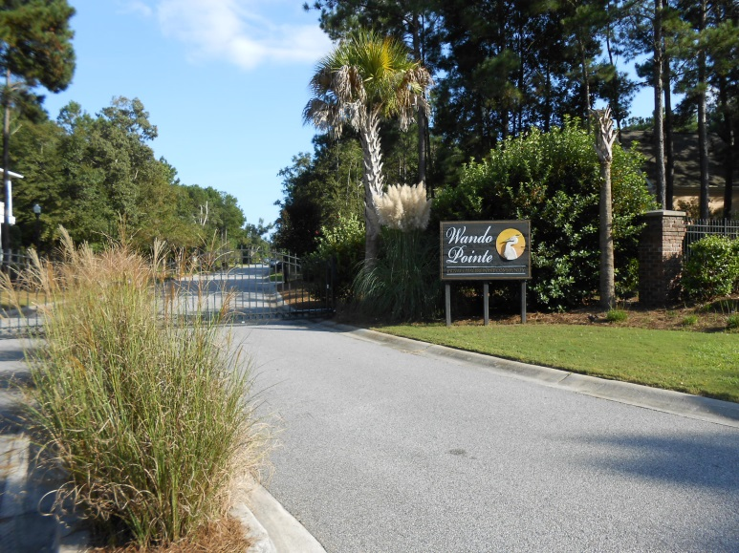
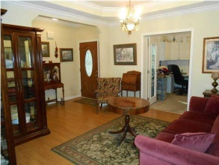
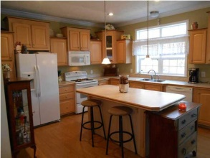
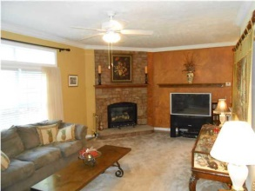
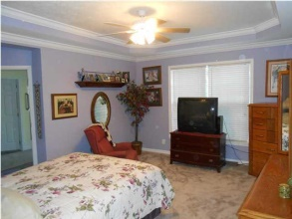
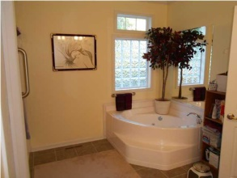
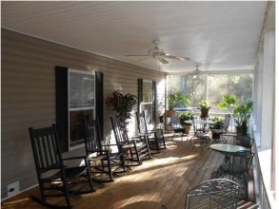
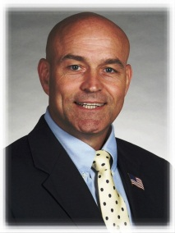

20+ Acres…Price Adjusted!
One offered at $200K or less with fast closing! The other two are competitively priced in the lower $200Ks.
153 Willow Brook Way
Cordesville
MLS# 1412785
$321,000
Spacious home tucked away in private Cordesville area location off Old Church Rd, about 8 miles to Moncks Corner. Over 2000SF downstairs with 3BR/2BA, eat-in kitchen, comfortable family room with fireplace, separate laundry/utility, foyer/sitting room, a flex room (formal dining or living room), and office. MBR has a nice walk-in closet. Over 1000SF upstairs with 1 or 2 BR, 1BA, and additional flex space. And oh, what a nice front screened porch! Home has its own well, and a separate septic system/field. There is a small pond on the property. Separate 10x14 shed near house. This property is being sold with approximately 20+ acres of a 26.5 acre total spread. The other acreage is available separately and has a currently-rented double-wide manufactured home w/its own separate well and septic system/field. See separate MLS listing for that property; it is contingent at this time. More info provide upon request.
STEVE A. ROWE
Retired Military, Active Realtor®
(843) 303-7438
srowe@carolinaone.com
www.SteveRoweHomes.com

