Slide 1

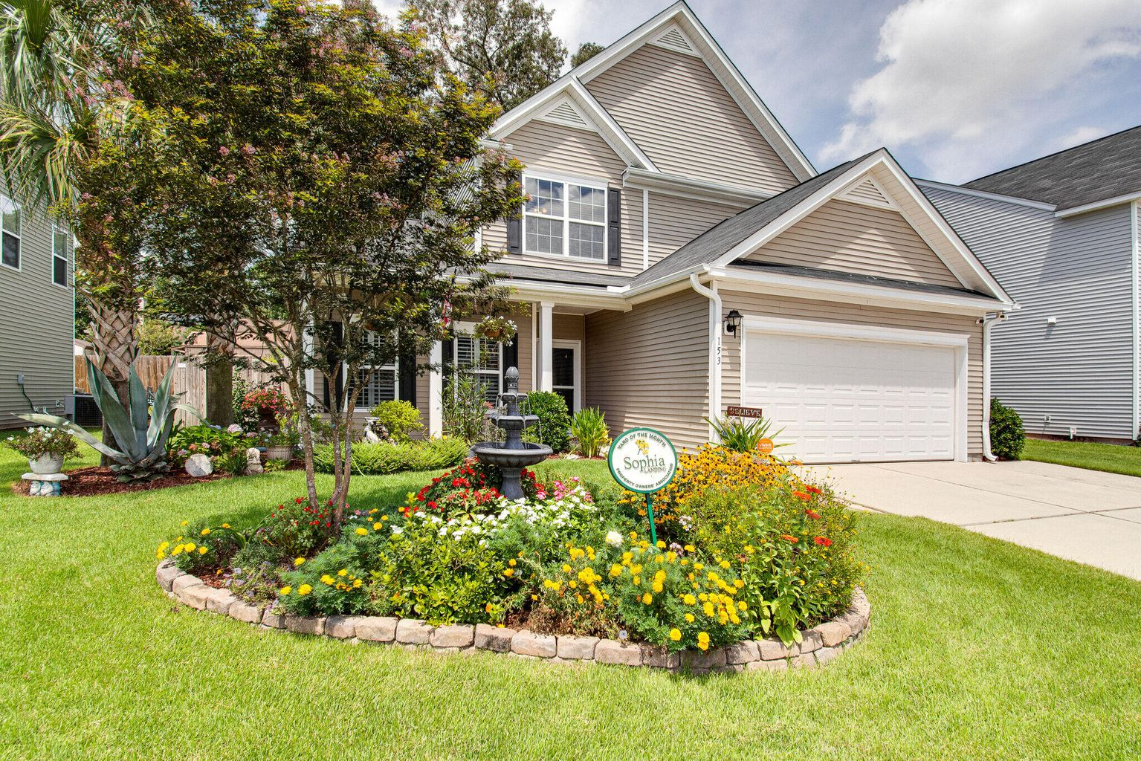
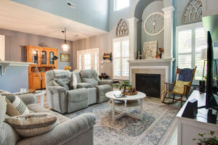
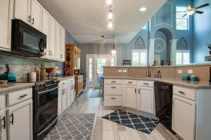
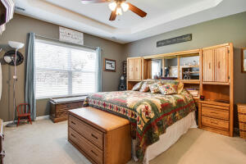
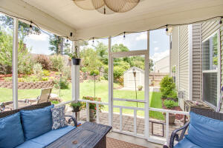
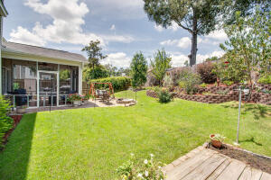
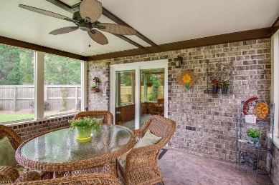
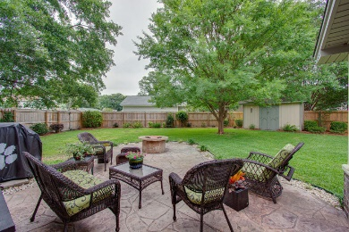
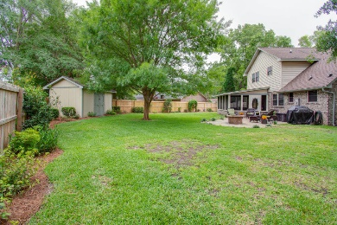


Motivated Sellers! Lovely Home Inside & Out!
153 Marinella Drive
Sophia Landing | Goose Creek
MLS# 22020190 | $399,900
Lots of pressure to keep up this Yard of The Month! The backyard is worthy of a title also. Nicely landscaped and lots of outdoor living spaces with a screened porch, to enjoy this lovely open floor plan home. Three bedrooms, with a loft, has an owner suite on the first floor, all other bedrooms are upstairs. Lots of natural light, large kitchen with many cabinets and a pantry closet. Beautiful paint colors throughout. The upper windows in living area have remote control blinds. The front room could be dining room is currently used as an office, has Plantation Shutters. Entry foyer and powder room for guest. These owners did so many things to this home, come see the pride in ownership here. Owners are building and would consider renting back if that is of interest to a buyer. Easy to see.
Virtual Tour: https://tour.showcasephotographers.com/mo2207251
Jan Miller Cell (843) 345-9719 | Jan.Miller@nvrealtygroup.com
NV Realty Group | 91 Broad St, Ste A | Charleston, SC 29401
janmiller.nvrealtygroup.com

