Slide 1
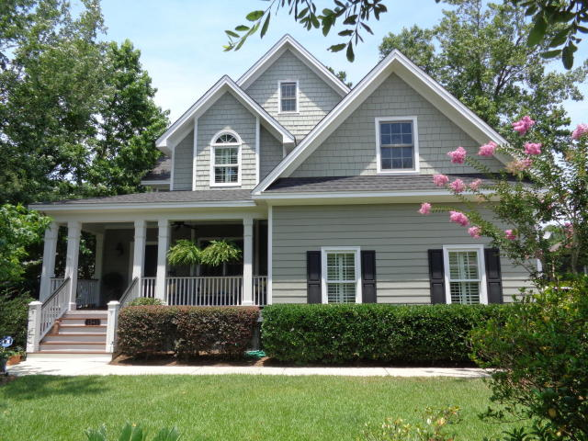
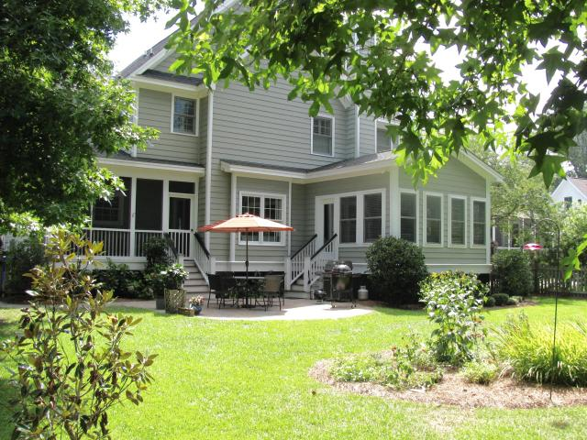
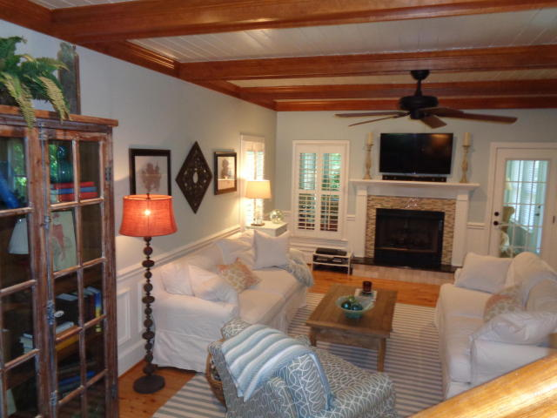
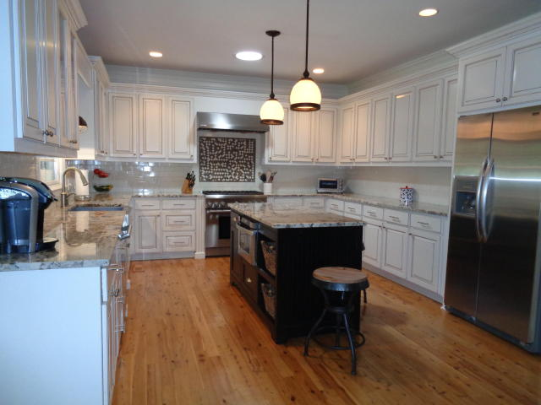
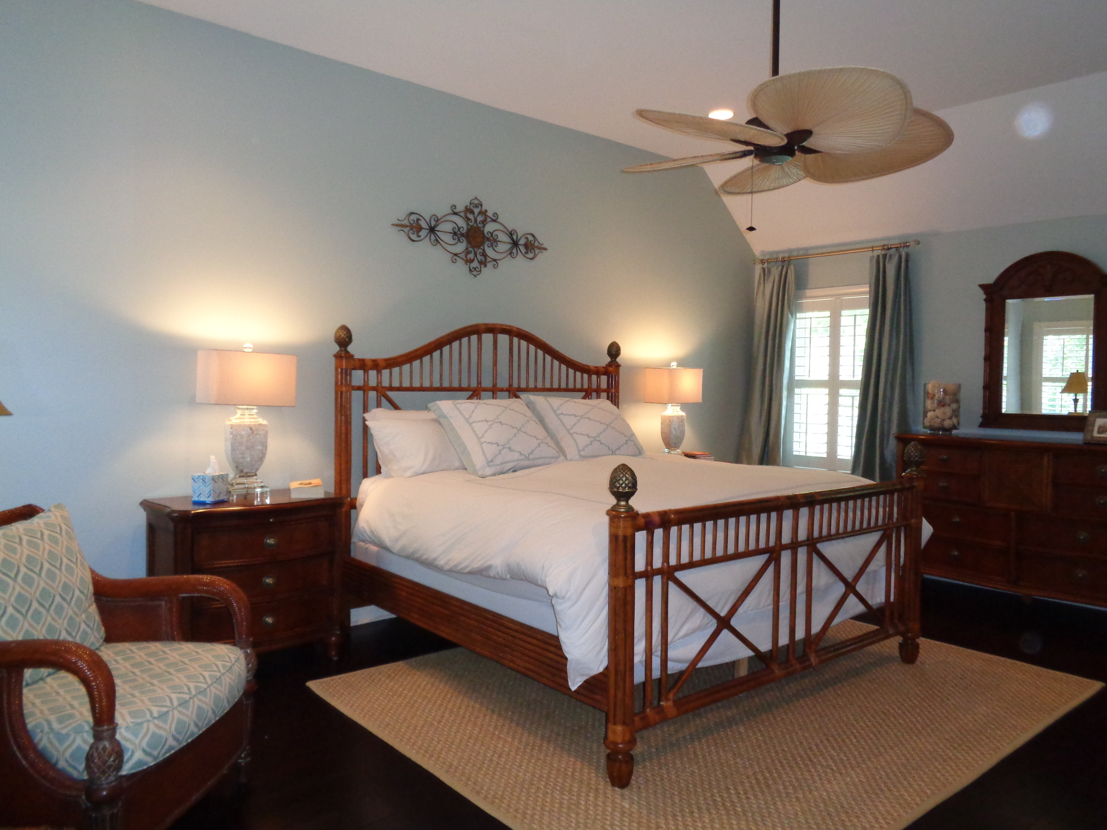


1541 Appling Drive
Shell Point
Mount Pleasant, SC 29464
MLS# 16017194
NEW PRICE! $649,900
Location! Location! Location!
5 miles to IOP and Sulllivans beaches
7 miles to historic downtown Charleston
Southern Charm best describes this 3BR, 2 1/2 bath custom built home with many lovely details including crown molding, built-ins, wainscoting, & beamed ceiling. Owners have given meticulous care to this home from the lawn and garden areas to the huge updated chef's kitchen, plantation shutters, Australian Cypress wood floors, and so much more. Large master bedroom with tall ceiling, his and her walk-in closets; updated master bath featuring jetted tub and separate tiled shower, dual sinks with marble counter tops. Bonus room can be used as an office/bedroom/playroom. The sunroom off the family room creates a relaxed, light and airy atmosphere with it's many windows. Situated on a 1/3 acre fenced lot with mature landscaping, irrigation system & patio for outdoor entertaining this home is truly move-in ready. Call me today!
Teresa Porter
Realtor/Certified Negotiation Expert
(843) 300‐5822
Teresa.Porter@AgentOwnedRealty.com
www.AgentOwnedRealty.com
The AgentOwned Realty Co.
824 Johnnie Dodds Blvd.
Mt. Pleasant, SC 29464

