Slide 1

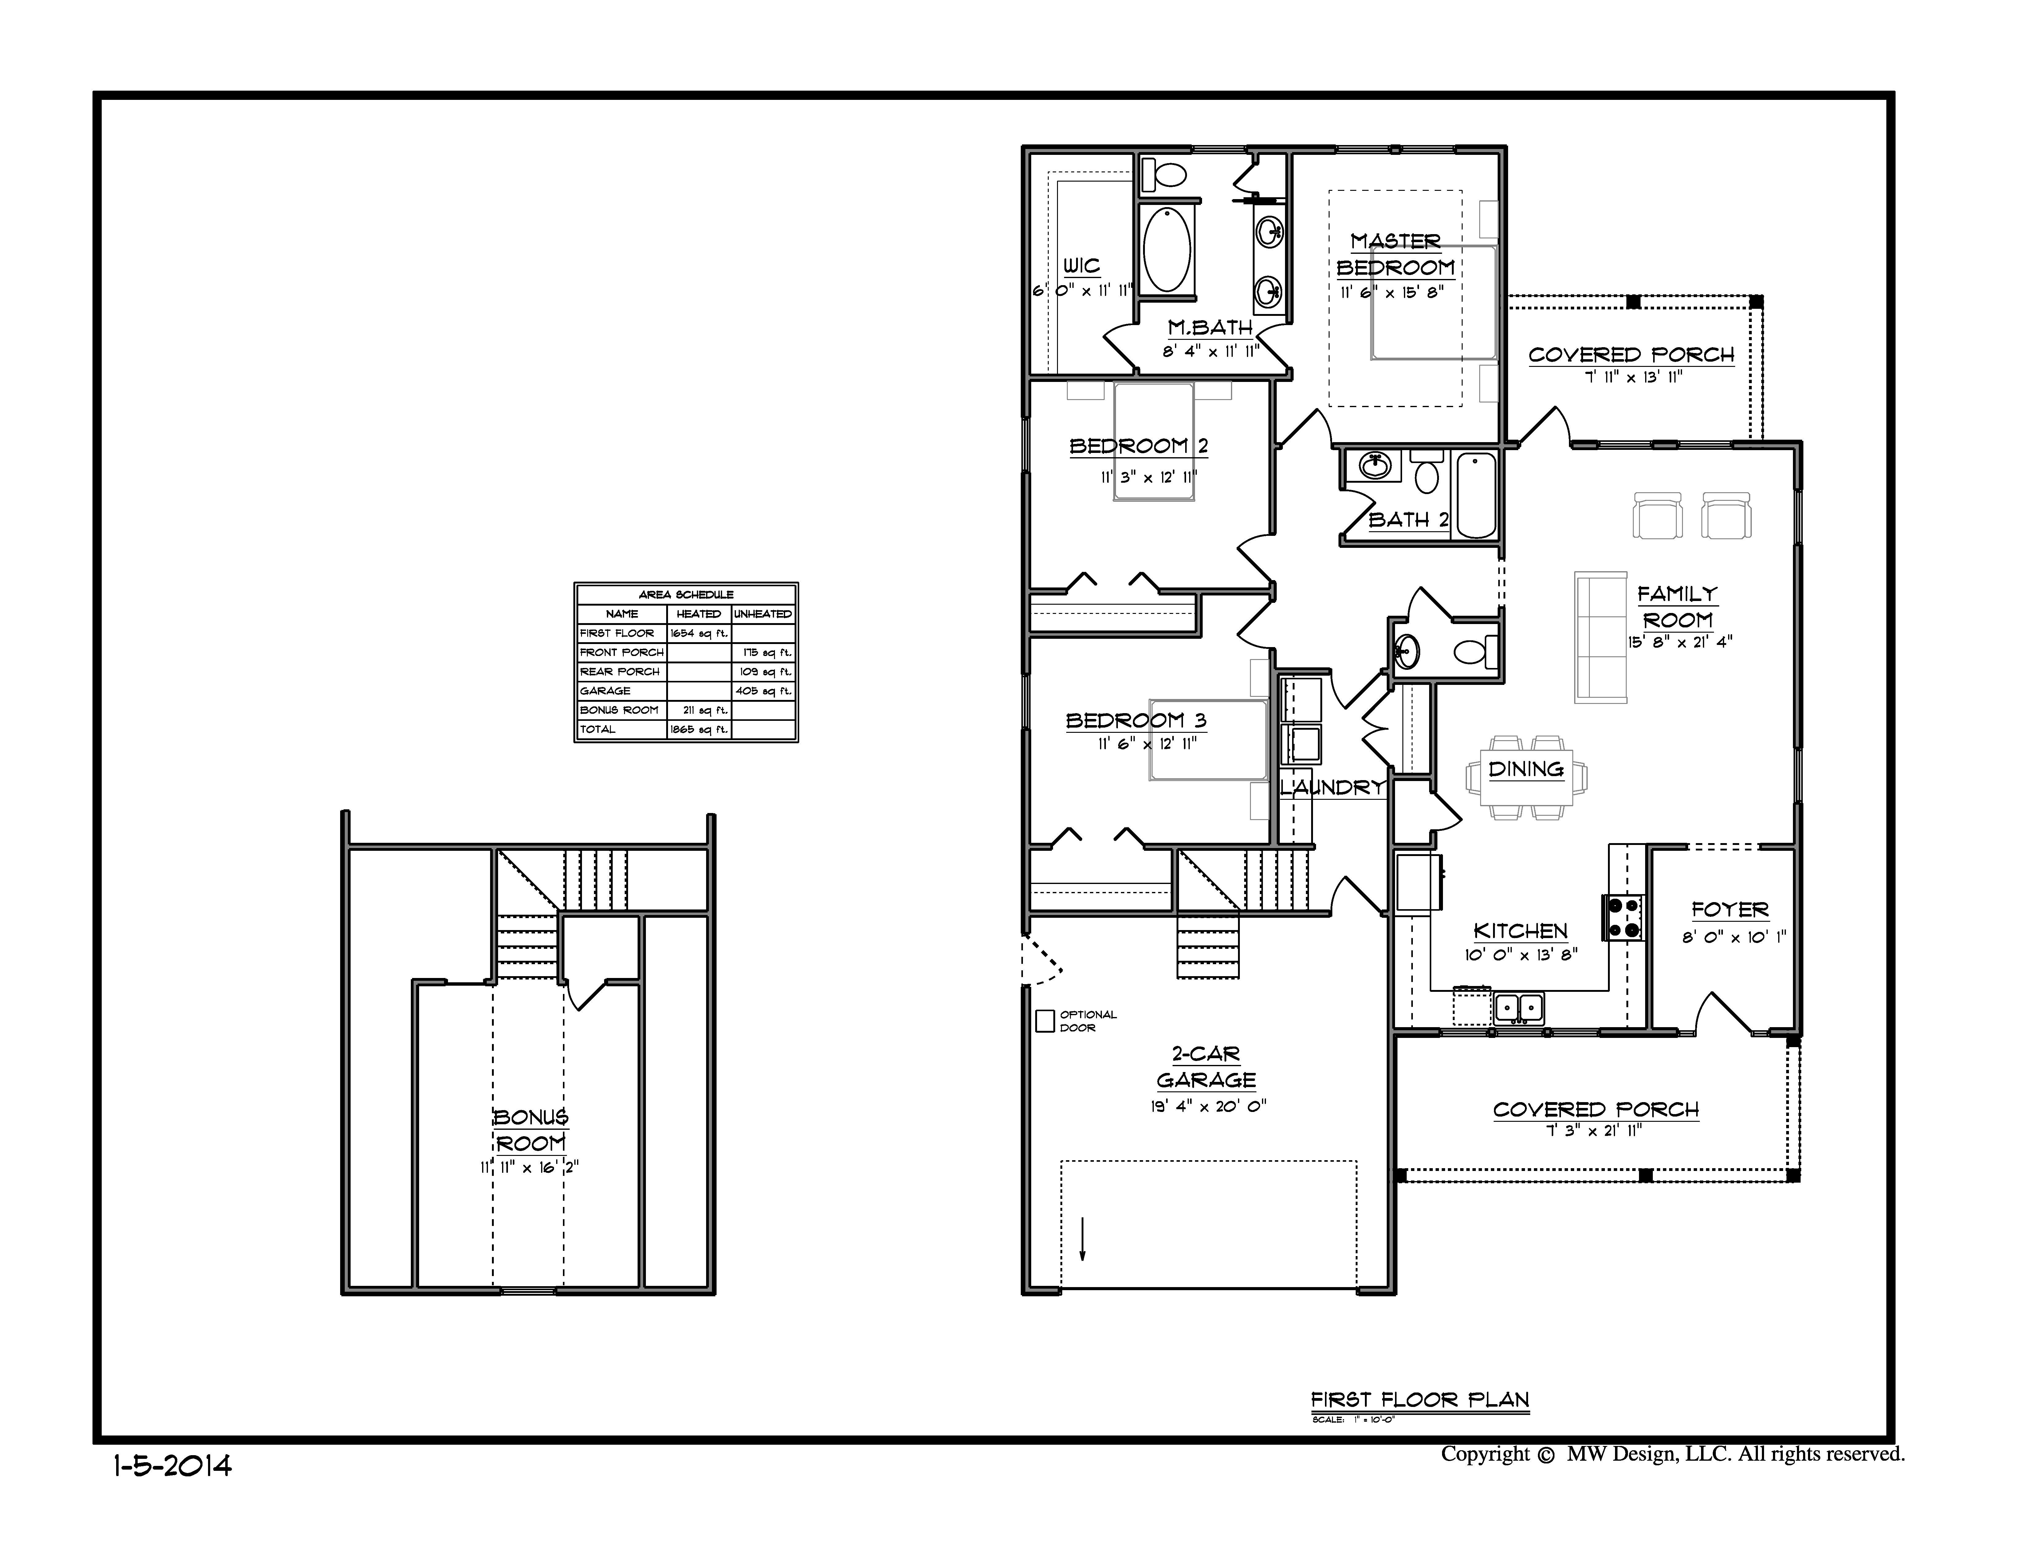
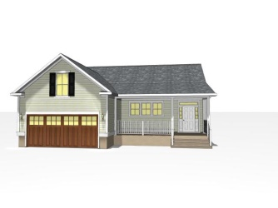
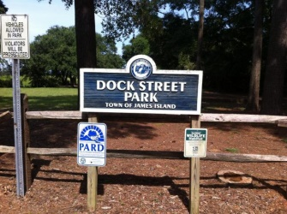
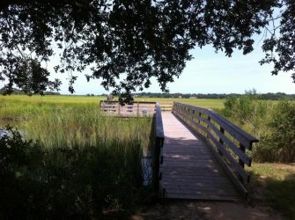
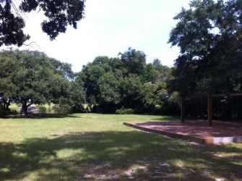
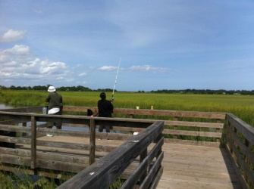
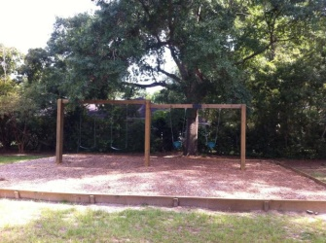
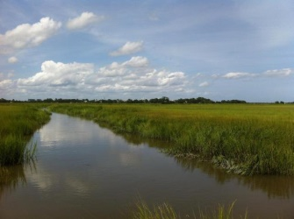
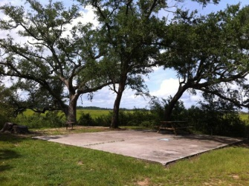



James Island New Construction…
Minutes to downtown or the beach!
1541 Inland Ave
Bayfront
James Island, SC 29412
MLS# 15001018
$275,000
1,865 SF
4 Bedrooms :: 2/1 Baths
New Construction tucked away on James Island 3 beds 2.5 baths, 2 car garage, w/GRANITE counter tops, STAINLESS appliances, HARDWOOD floors throughout, carpet in the bedrooms & frog, 30 year architectural shingles, Semi custom ''NO SLAM'' wood cabinets, fully sodded front yard,
STRUCTURED WIRING, 5'' baseboard. Professional custom engineered plans for exceptional structural integrity, above required code compliant insulation for excellent energy efficiency. Home will be built 1 foot higher than required by current 2015 FEMA flood laws.
Did I mention the neighborhood PARK with fishing DOCK, swings, and picnic area? Downtown is 5 minutes away, Folly Beach is 10. Near the newer Harris Teeter and Super BI-LO. Zoned for the new, award winning Harbor View Elementary! FROG is 4th bedroom.
Lizzie H Ray
(843) 452-9298
lizzieray1122@gmail.com
Eric Draper
(843) 442-7118
eric.draper@gmail.com
www.charlestonrealestategroup.com
Charleston Real Estate Partners. LLC | 792 Folly Rd. C1 | Charleston, SC 29412

