Slide 1
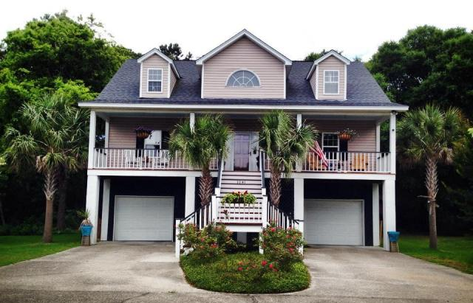
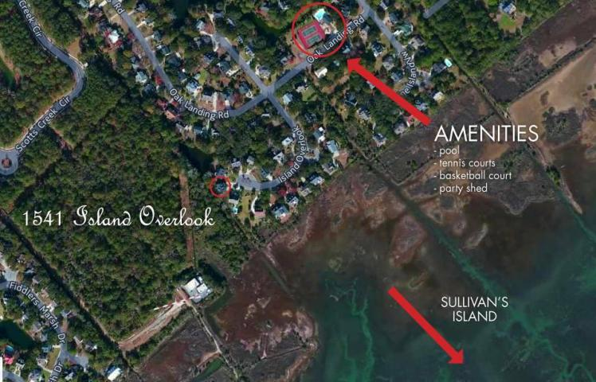
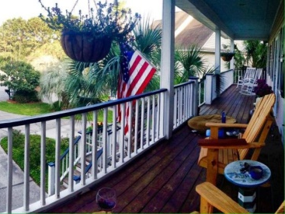
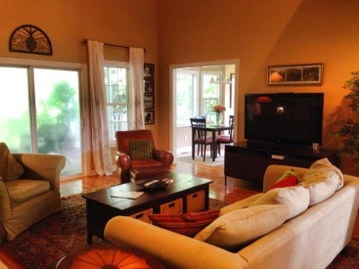
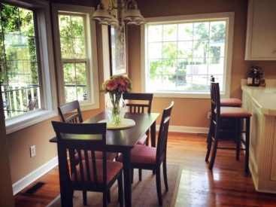
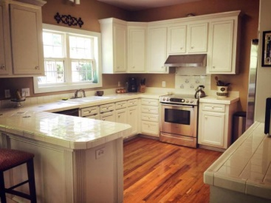
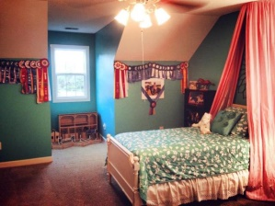
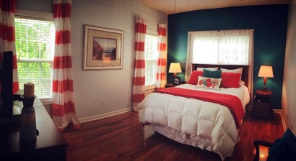
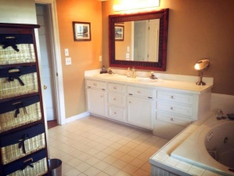
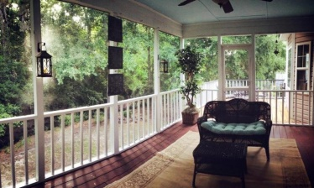
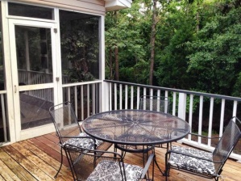


Great Opportunity - Quiet Cul-de-sac Location
1541 Island Overlook
Oakhaven Plantation | Mount Pleasant | MLS# 15014256 | $535,000
Wow!! Great opportunity to own a home in the highly sought out neighborhood, Oakhaven! Located right off Rifle range rd...1541 Island Overlook is nestled in the back of the subdivision in a quiet cul-de-sac. Great floor plan with hardwood floors throughout, master bedroom on the 1st floor with large walk in closet and master bath. The living room offers vaulted ceilings, gas fireplace, and sliding glass doors out to your oversized screen porch. The kitchen has lots of counter and cabinet space with updated appliances. Upstairs has 2 large bedrooms, laundry, and full bath. You can enjoy sitting on your front porch, back porch or deck! If you are looking for privacy this home offers a wooded backyard with a small creek that runs through it. Lots of beautiful mature trees, plants, and flowers.
Kristen Kern-Whitehead
Mobile - 843-670-1671
kwhitehead@kwchs.com
www.charlestonislandagents.com
Keller Williams Realty
Charleston Islands
1304 Palm Blvd
Isle Of Palms, SC 29451

