Slide 1

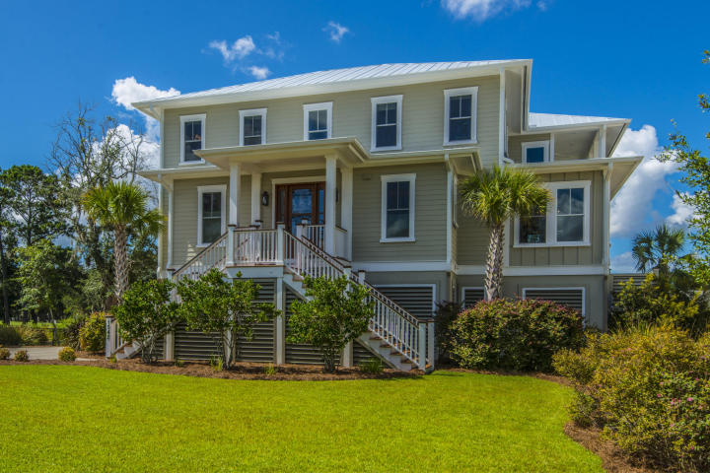
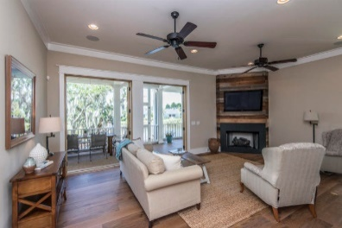
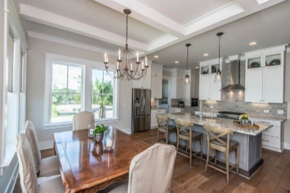
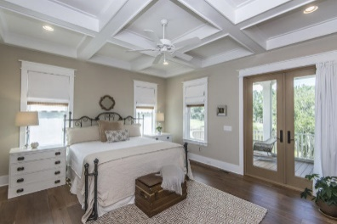
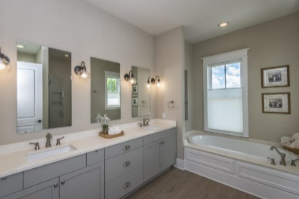
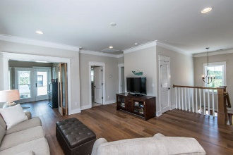
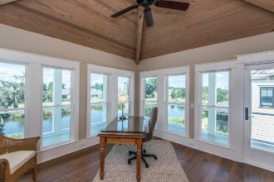
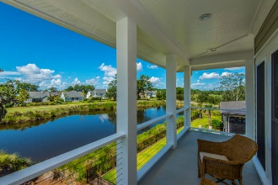
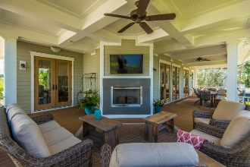
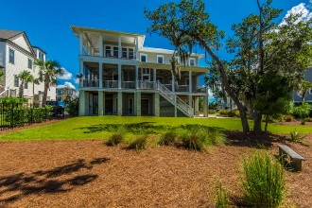
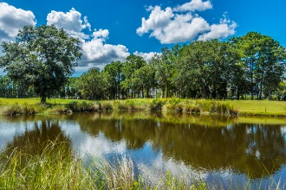


1542 Sea Pines Drive
Mount Pleasant, SC 29464
Amazing Home in Rivertowne Country Club
Shows Like A Model Home
Situated amidst mature, lush landscaping with Live Oaks and Palmettos, positioned to take advantage of the gorgeous water and golf course views, this custom masterpiece is a study in the marriage of sophisticated yet clean and simple design. A fine example of true craftsmanship, you'll fall in love with this home before you even enter! From the standing seam metal roof to the Trex composite decking, the exterior finishes are second to none and are indicative of the quality materials and thoughtful design choices present in this home.
Lowcountry living means plenty of time spent outdoors and this home does not disappoint. With over 650 square feet of space spanning the entire back of the home, this porch boasts a fireplace with tv mounted above. Just imagine the parties you could host on this one-of-a-kind outdoor haven! Gather friends around the fireplace on a cool evening to cheer on your favorite football team while the fire roars and warms you or serve your family dinner alfresco on a warm Spring evening.
This home possesses a casual elegance that is synonymous with the Lowcountry lifestyle and it is apparent that all fixtures and finishes were hand selected with no detail too small or left unattended. This magnificent residence is located in the prestigious Rivertowne Country Club, one of Mount Pleasant's most sought-after neighborhoods. Enjoy golf at Rivertowne Country Club's Arnold Palmer Signature Course then meet friends at the club for dinner. Additional amenities include neighborhood pool, tennis courts, walking trails and play park all conveniently located to beaches and the world class dining and shopping of historic downtown Charleston.
Asking $765,000
MLS# 18025074
2,821 SqFt
3 Bed/3½ Baths
Designed for Family & Entertaining Friends
Don Dawson
843-514-0452
ddawson@carolinaone.com
Carolina One Real Estate • 2713 Highway 17 North • Mount Pleasant, SC 29466
www.TeamDawsonSC.com

