Slide 1

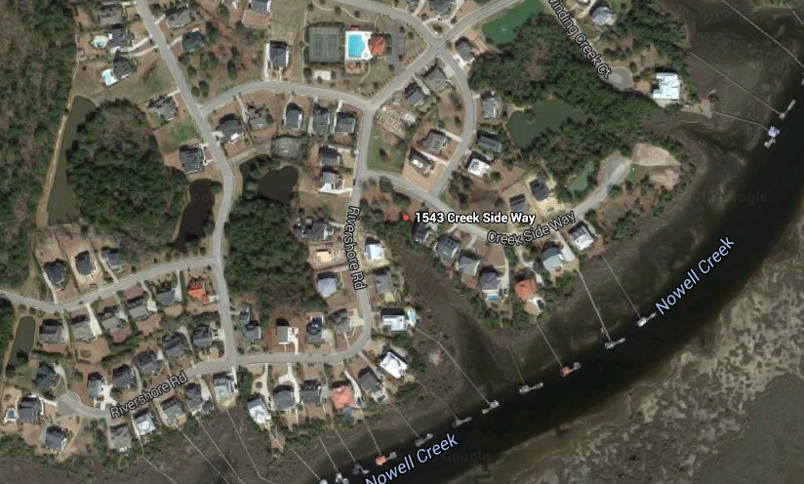
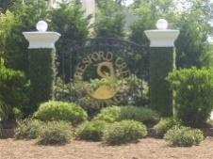
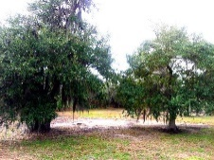
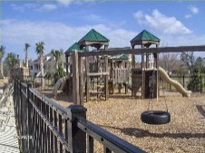
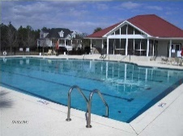
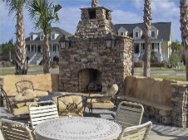
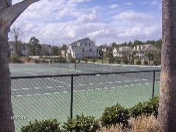
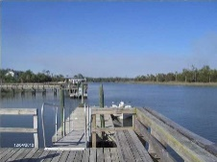

1543 Creek Side Way
Beresford Creek
Charleston, SC 29492
MLS# 15013252 :: $189,900
.34 acre lot with great marsh and water views. One of the few lots left to build on in popular Beresford Creek Landing. Great location centrally located in the middle of Charleston. Just off I-526 exit minutes to Boeing, BCL offers winding streets, sidewalks, marsh, palm trees, neighborhood ramp for boats/kayaks/crabbing, or just relaxing, onsite boat and RV storage, semi-Olympic pool, clubhouse with gas grill and fire-pit, volleyball court, tennis court and play park. According to tax records property is Flood Zone AE. Minimum sq ft for house is 2400. Information deemed to be true, but may not be exact, buyer to verify. Bring an offer! Seller says sell!
Brigitte McElroy
CRS, GRI, REALTOR
O (843) 708-5353 |M (843) 708-5353
brigitte@brigittemcelroy.com
Keller Williams Realty
Charleston Islands
1304 Palm Blvd
Isle Of Palms, SC 29451

