Slide 1
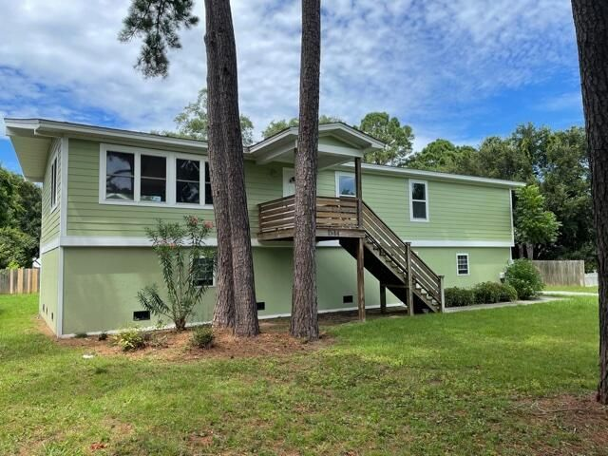
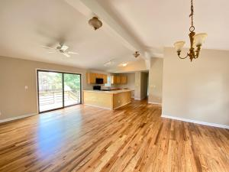
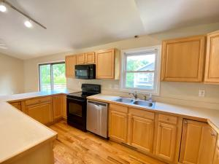
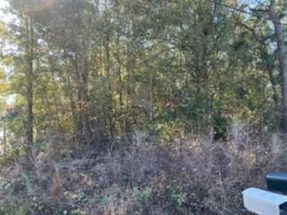
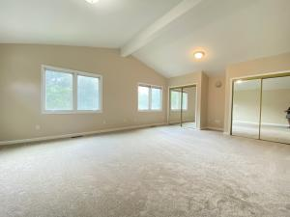
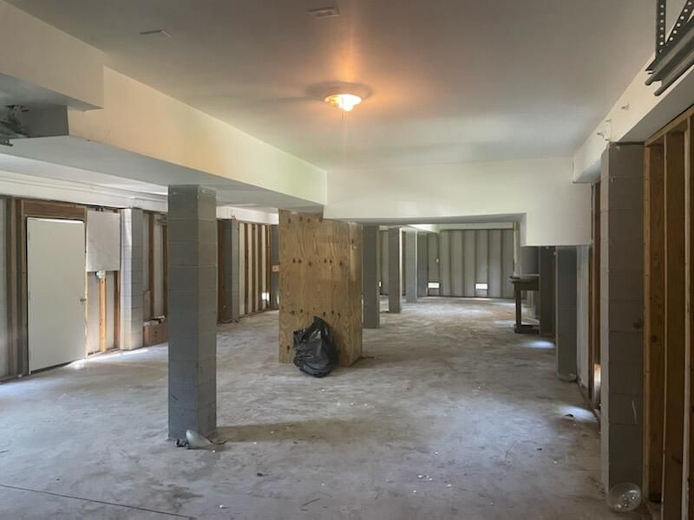


James Island Living
Move-in Ready!
1544 Inland Avenue
Bayfront · Charleston, SC 29412
MLS# 21016949 · $389,000
Michael Dew
O 843-769-5100
M 843-870-7000
michaeledew@gmail.com
www.michaeldewrealestate.com
No HOA ~ Great Location
Elevated 3 bed 2 bath home on James Island. Open floor plan. Refinished hardwood flooring through out main living areas. New carpet in bedrooms. Exterior and interior freshly painted. Kitchen with breakfast bar open to family room. Nice deck overlooking large yard. HUGE garage. Great for storage or flex space. Convenient to Folly Beach and Downtown.
Must see!
AgentOwned Charleston Group
902 Savannah Hwy
Charleston, SC 29407
Real Estate ● Mortgage Insurance ● Business Brokerage

