Slide 1
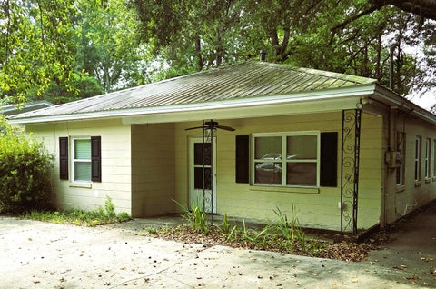
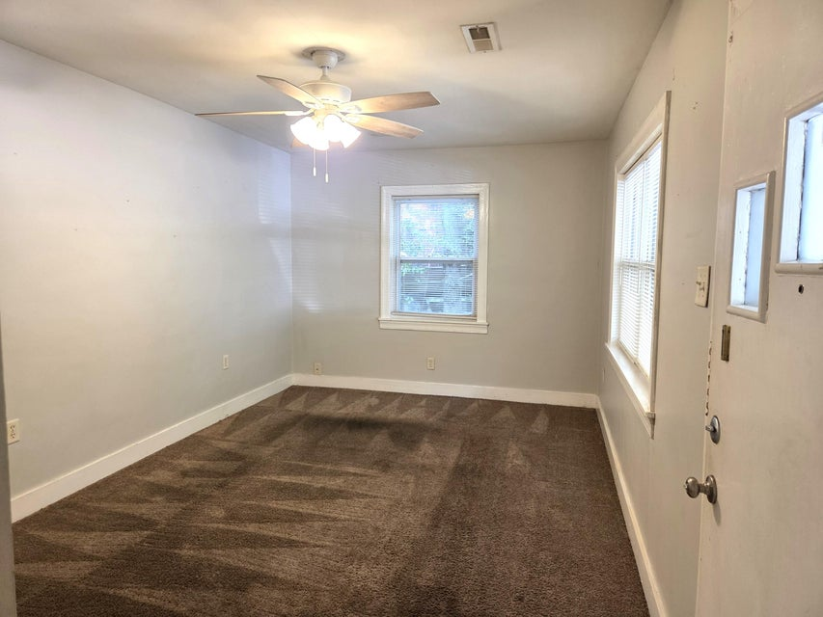
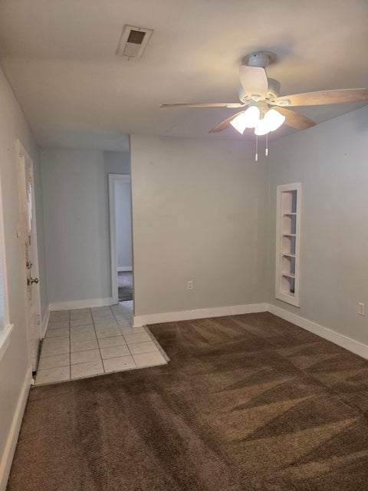
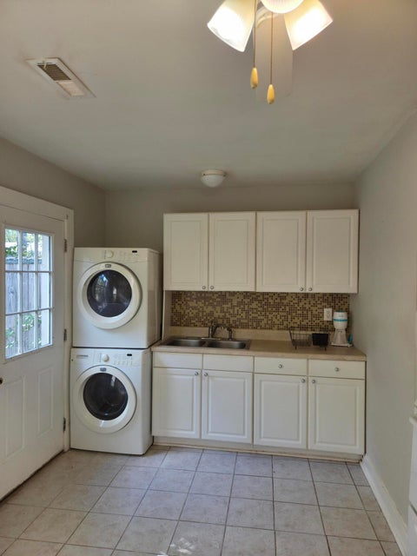
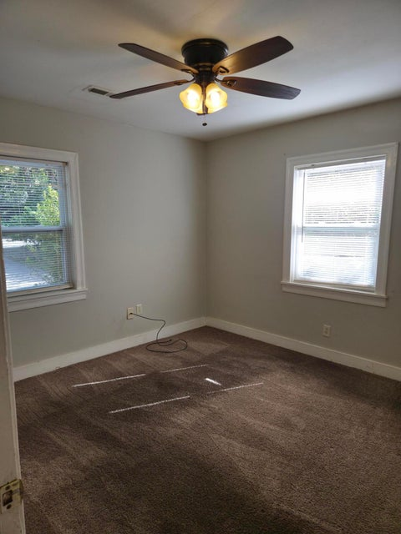
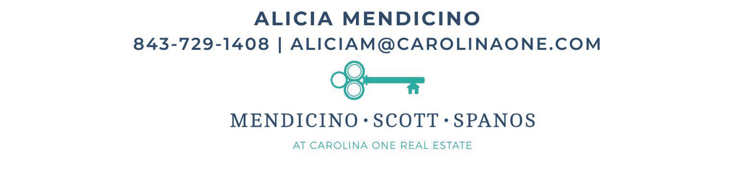
Investment Opportunity
1544 Orange Grove Road A & B
ORANGE GROVE ESTATES | CHARLESTON, SC 29407 | MLS# 25023134 | $459,900
4 BEDROOM | 2 BATH | 1,344SF
Well located investment opportunity in the heart of West Ashley with easy access to downtown Charleston and Charleston International airport. The front unit is currently vacant and easy to show. Unit B has a long-time tenant who is on a month-to-month lease. The metal roof was added in 2018 and one of the HVAC units was installed in 2022. If updated, these units could likely rent for $1400-$1600 per month according to the property manager. Each unit has 2 bedrooms, 1 bath, a nicely sized living room and eat-in kitchen. All this is situated on a .23 acre lot with plenty of off-street parking.

