Slide 1

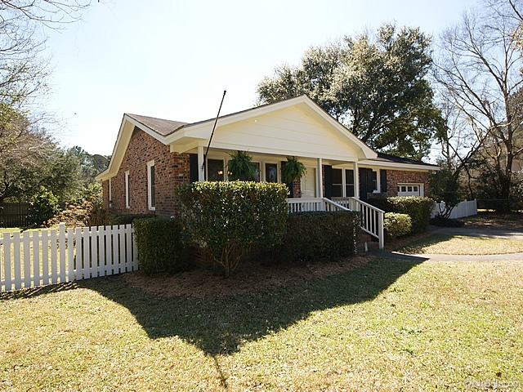
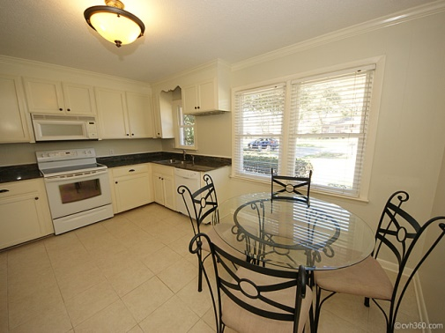
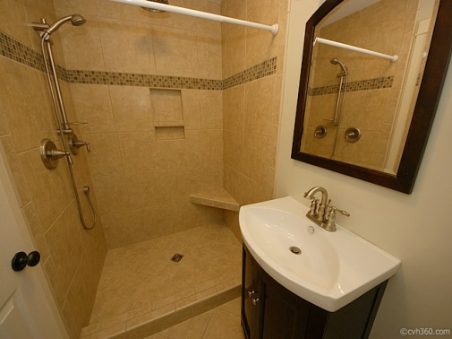
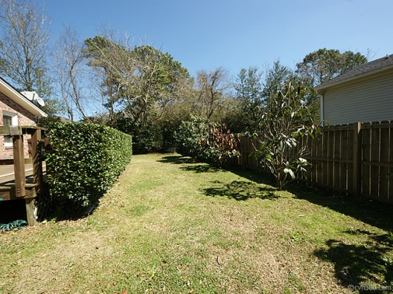



OPEN HOUSE
1545 BROOKBANK DRIVE
Saturday, Jan 31 from 2-4P
Home Features
• JUST REDUCED TO $210,000
• Minutes to downtown Charleston
• 3BR Brick Home with White Picket Fence
• 1,456 Square Feet includes Bonus Room
• Large Eat-in Kitchen with Granite
• Updated Master Bath
• Updated Hall Bath
• New Carpeting in Family Room
• Hardwood Flooring in DR & Bedrooms
• Spacious Backyard with Arbor
• Large Deck & Storage Shed in backyard
Why rent, when you can own? Awesome 3BR brick home just minutes to downtown Charleston & Folly Beach! Move in ready with lots of upgrades including new Master Bathroom with rain shower as well as upgraded Hall Bath! Bright, eat-in Kitchen provides lots of cabinet space with granite counters and pass thru to Family Room with new carpeting. All three bedrooms boast hardwood flooring. Don't miss the huge bonus/media room that you access from the garage. This room is versatile and could be used for just about anything especially as it has its own entry through the backyard. The home is situated on an ideal lot with white picket fencing. Awesome back deck and arbor which is great for Summer BBQ's with friends. Square footage includes utility/bonus room (271SF). Storage shed in backyard is wonderful extra space! This house is priced to sell!
Margaret Hekker
BIC, Owner
Lighthouse Realty Group, LLC
Cell-843-296-7520
margaret@lighthouserealtygroupsc.com
mhekkerrealestate@gmail.com

