Slide 1
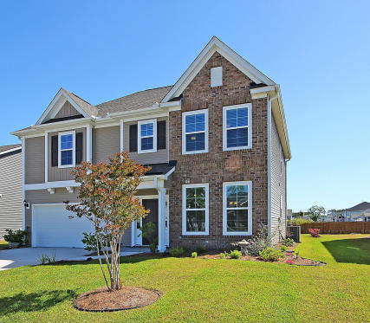
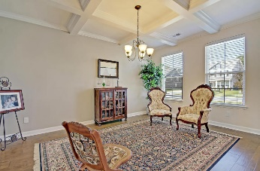
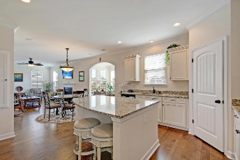
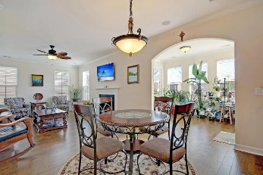
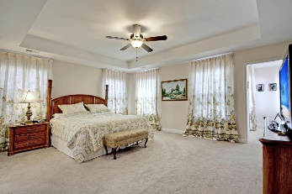
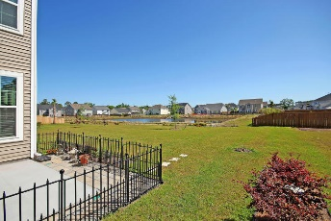


Price Cut! Seller is MOTIVATED!
$15,000 Agent Bonus
with ratified contract by 4/15/18
1545 Fishbone Drive
Fenwick Woods
Johns Island, SC 29455
MLS# 18012755
$344,900
This Incredible fully detached home is situated on a quiet street and surrounded by a large landscaped yard with surprising water views. This Amazing home with gorgeous wood/laminate flooring, 9' & 10' foot smooth ceilings, expensive moldings and offers 3 spacious bedrooms upstairs including the exclusive master bedroom suite with trey ceilings, a huge walk-in closet, a distinctive master bathroom with a large soaking tub, separate walk-in shower and double vanity with granite countertops. There are several large rooms on the main level including a Charming dining room with selected wood/laminate flooring, coffered ceiling and quality moldings. The Butler Pantry with granite counter tops and Glass Cabinets doors is ideally located adjacent to the Dining Room and the Kitchen.
The family-sized eat-in kitchen is appointed with beautifully crafted wood cabinets, granite counter tops, upgraded stainless built-in appliances, center Island breakfast bar, large pantry and beautiful wood- laminate flooring. The huge family room with a classic ceiling fan, a working fireplace and the stylish wood-laminate flooring is perfect for entertaining. The stunning sunroom is located adjacent to the family room and offers private views of the rear yard and the neighborhood pond. There is a private walk-out to the oversized patio that is perfect for cook-outs, or relaxing. This home is loaded with upgrades and is priced for a quick sell. RECOGNIZE A GREAT BUY? Opportunity Knocks! Bring your checkbook. Age, sqft, taxes, acreage, HOA dues, and schools are approximate buyer to verify any and all information deemed necessary.
Mason Thurber
(843) 709-5109 – C
(843) 576-2699 – O
mason@theeverettgroup.net
RE/MAX Pro Realty, 9209 University Blvd, Charleston, SC 29406

