Slide 1
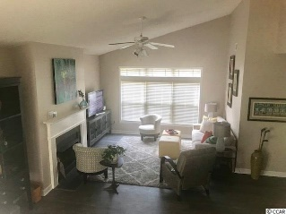
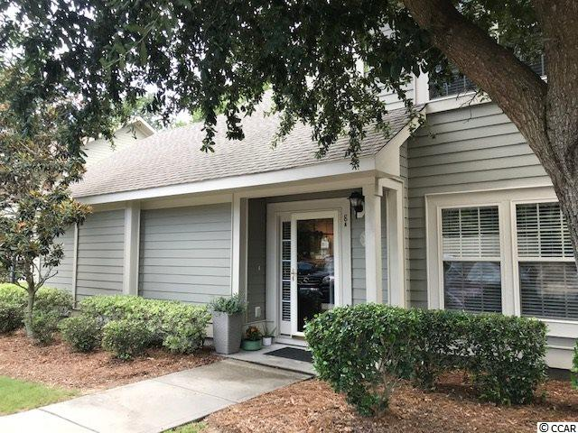
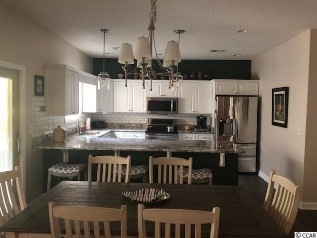
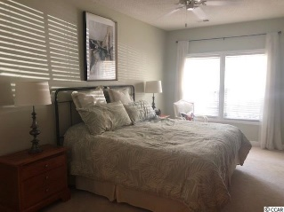
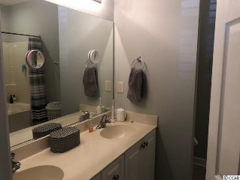
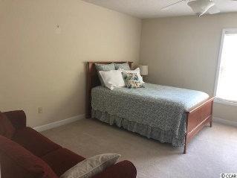
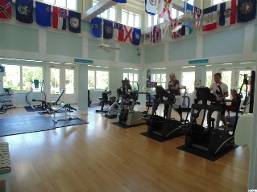
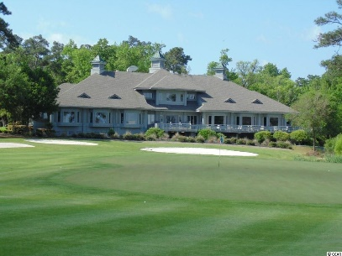
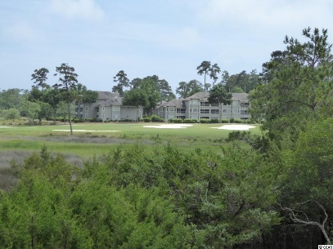
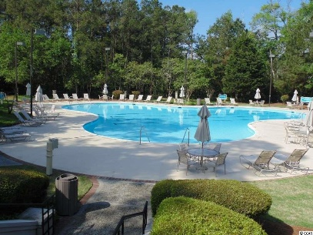
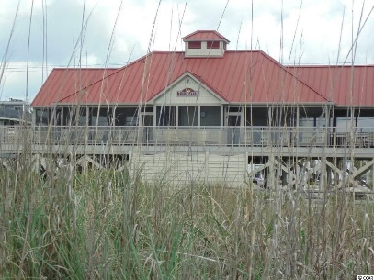
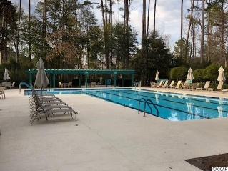
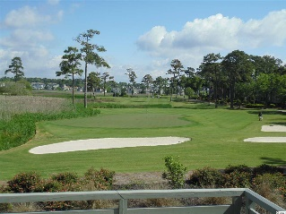
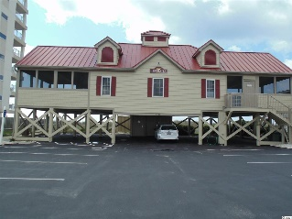


Beautiful Townhouse Extra Large Bedrooms
1545 Spinnaker Drive #8A
North Myrtle Beach, SC 29582
Tidewater Ridge
MLS#1917296 | $245,000
Tidewater Golf Plantation, beautiful 3 bedroom 2 and half bath located on the 18th green. Granite counters with stainless appliances. Bedrooms are extra large.
Master on the first floor. Townhouse has fireplace with lots of living space. Side screen porch gives you a view of #18 green.
Tidewater offers golf, tennis, pro-shop, fitness center 2 pools. Also ocean front beach cabana for the use of homeowners.
Donna Fortney 703-624-3517
dofortney@aol.com
Robert Jacoby 843-455-7075
NEW WAY PROPERTIES MYRTLE BEACH

