Slide 1
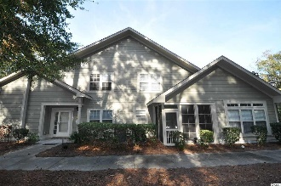
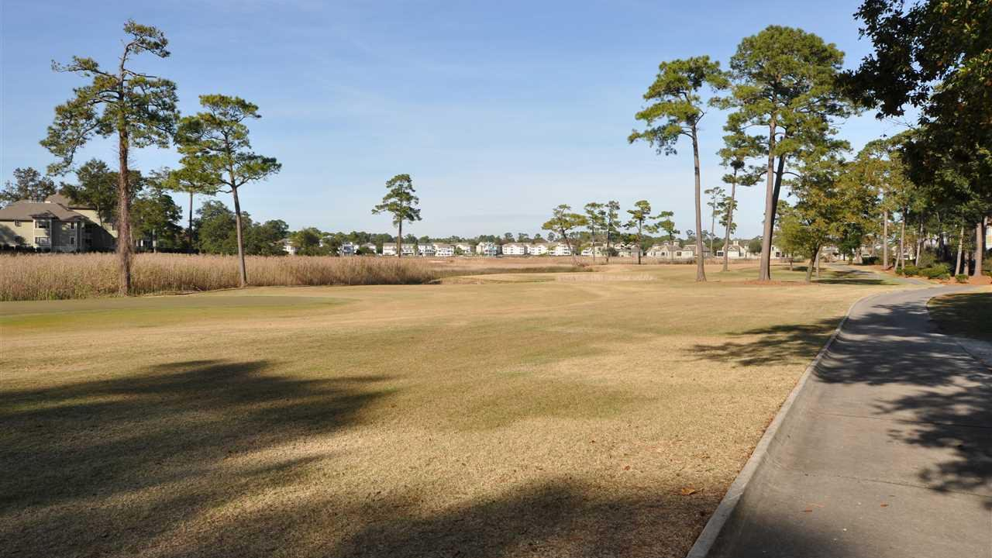
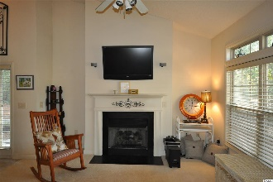
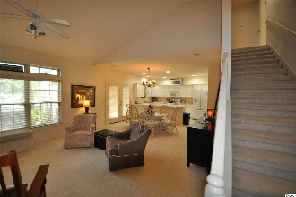
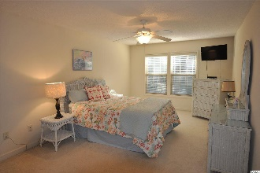
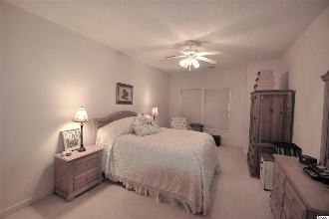
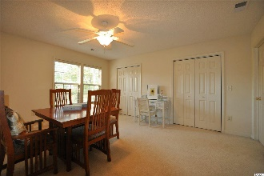
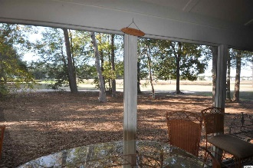
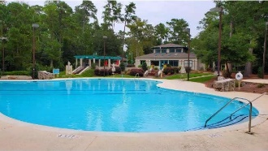
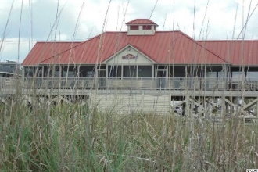


Welcome To The Best Of The Beach
1545 Spinnaker Dr #9C
Tidewater Plantation | North Myrtle Beach, SC 29582
MLS# 2026052 | $248,000
Tidewater Plantation's newest community is Tidewater Ridge, nine uncrowded townhouse buildings with four units each. The three-bedroom townhouses are just a short walk to golfing facilities at the Tidewater Clubhouse and the fitness/swimming/tennis recreation areas at the Amenity Center. The approximately 2000-square-foot units each have a great-room living area, master bedroom suite, and a screened porch on the first floor and two additional large bedrooms with a full bathroom upstairs. Unit 9C is, however, even more inviting because of its completely secluded location, private entrance and breathtaking views from an oversized screened porch off of the great room/kitchen areas, featuring views of the signature 18th hole of world-class Tidewater Golf Course, the marsh and even the boats navigating the Intracoastal Waterway! Views! Views! Views! This rare town home is truly a serene sanctuary for enjoying the ever-changing scenery of the marsh and its plentiful wildlife as well. Inside is so lovely and livable, too; enter into the big great room with wonderful cathedral ceilings, windows for natural light, ceiling fan and warming fireplace. The living space goes straight through to the open u-shaped kitchen with window looking out on the golf course from the screened porch, breakfast bar and a full cadre of cabinets and plenty of counter space. There is informal dining under a pretty, period-piece chandelier between the living and kitchen spaces. The porch is conveniently accessed from the dining area. To the right is a spacious master bedroom with full en suite bath. Its generous size and location in the home create a private enclave but easy ingress and egress on the first floor near the kitchen. There is a guest 1/2 bath and laundry room on the first floor also; so the second floor, featuring a wide staircase up from the front door, can be reserved for friends and family or to use the second story as a separate mancave and/or office with full bath, lots of flex in this floor plan! Parking is likewise close, adjoining the front of the building. In addition to golf and being in an ICW community, Tidewater boasts many other rich, upscale amenities nearby 9C, including owners' beach cabana on the Cherry Grove Beach named the 11th best in the nation, pools & spas, clay & hard-surface tennis courts, pickle ball, bocce, horseshoes, amenities center, fitness center, driving range and putting green, 24-hour gated manned security, and clubhouse with bar & restaurants. There is even a complimentary gated storage yard for boats, campers, recreational vehicles and the like. The on-site, convenient HOA building has rooms for business and other meetings and events and a lending library. There are many clubs and activities year round. In Tidewater, you can do it all, or just relax in the luxurious Tidewater lifestyle. Tidewater itself is on a tree-lined road to oceanfront Anne Tilghman Boyce Coastal Reserve, a nature conservancy, including Waties Island, with access for managed recreational use. Tidewater, a historic plantation, is on an elevated peninsula of live oaks and southern pines between the Intracoatal Waterway and the Cherry Grove Inlet to the Atlantic Ocean. The plantation also preserves the distinctive look of its own origins. It is close to the beach, shopping, entertainment, medical services, outstanding schools and parks and access to major highways. The jewel in the crown of the development is that private owners' beach cabana on the wide, white sands of the Cherry Grove Beach, just a few minutes drive. This charming town home enjoys a lovely, indigenous peaceful environment, along with the excellent reputation of the Tidewater Golf Course, the Pebble Beach of the East. Tidewater Plantation, in one of the U.S.'s top-10 beach towns, North Myrtle Beach, reflects a "way of life." Do not let this singular Tidewater Ridge town home with VIEWS! get away. Welcome to the best of the beach in Tidewater Plantation Resort.
Video Tour: https://www.youtube.com/embed/EueEPc3Uj4Y
Deborah Collins
843-424-9013
dctidewater@yahoo.com
Connie Ross-Karl
702-306-2643
conniesross@aol.com
NEW WAY PROPERTIES MYRTLE BEACH

