Slide 1
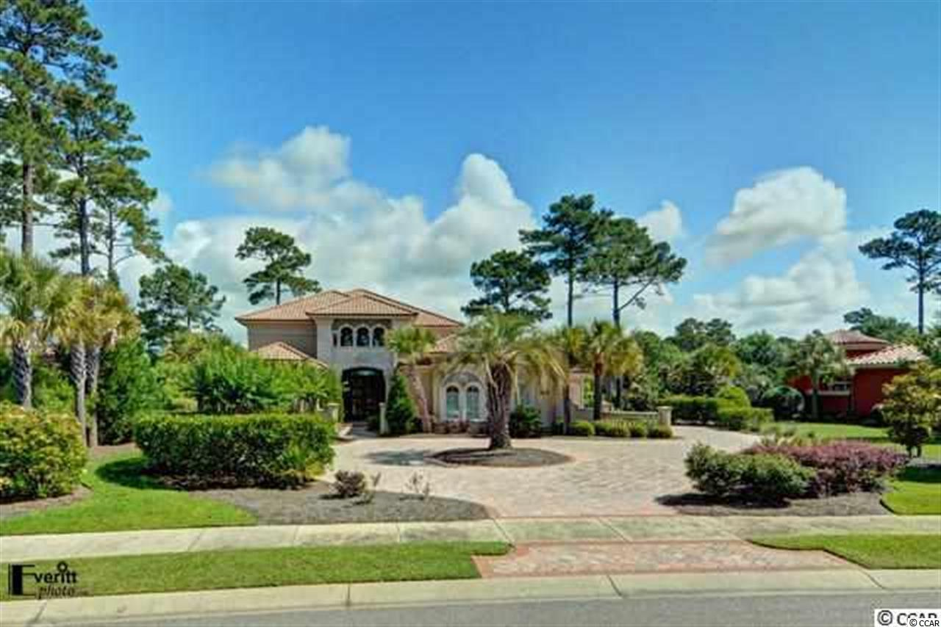
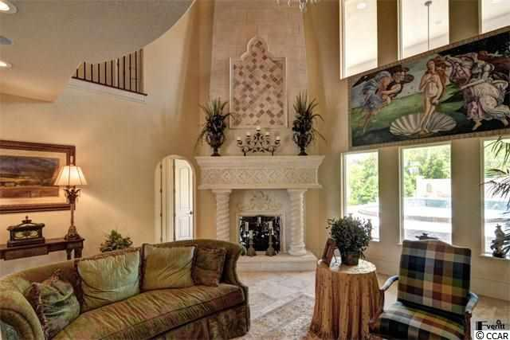
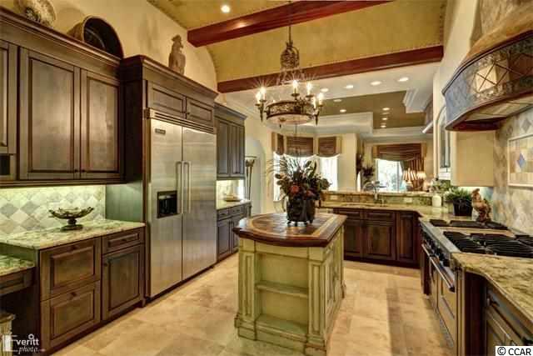
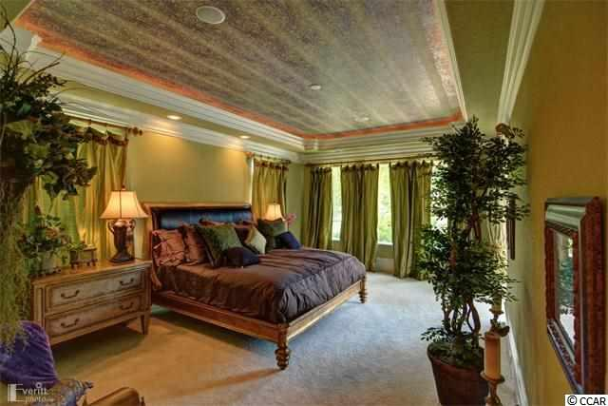
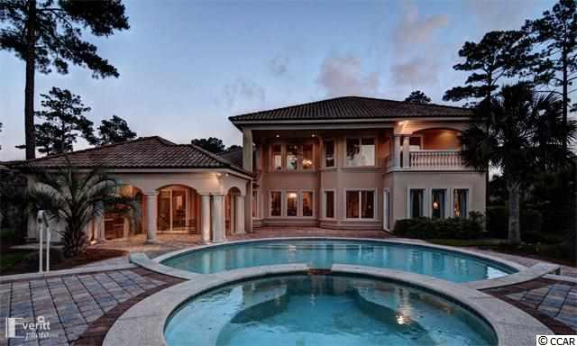

1548 Chianni Ln
Myrtle Beach, SC 29579 ~ MLS #1705553
Original List Price $2.1 Million Now Listed At $1,184,900
Grand Dunes
Former Model Home
$599,900
$10,000 Buyer Agent Bonus
for accepted contract by 9/30/18
Designer decorated and furnished home with 4 bedrooms including master and guest suites on the ground floor. 5 full and 1 half baths. Appointments include gourmet kitchen with Viking stainless steel appliances, chilled wine cellar, office with fireplace, media room, loft with library, large laundry room equipped with whirlpool washer and dryer. Outside features include a 2-car garage, and another 1-car side load garage, pool, hot tub and covered summer kitchen. Screened cover lanai closes and opens with remotes. ICF concrete wall construction. Must see to believe it. Impeccable quality.
M.A. Peedin 843-385-3931 |  | builderpeedin@wmconnect.com www.peedinrealestate.com
Peedin Real Estate | 876 Antigua Dr | Myrtle Beach, Sc, 29572

