Slide 1
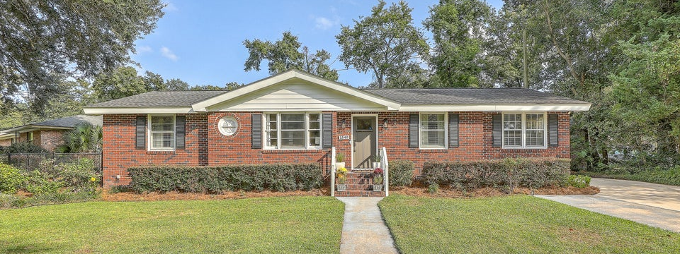
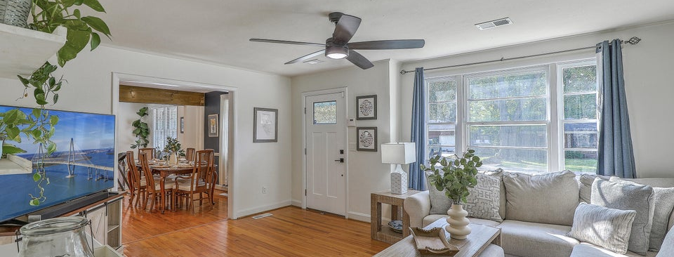
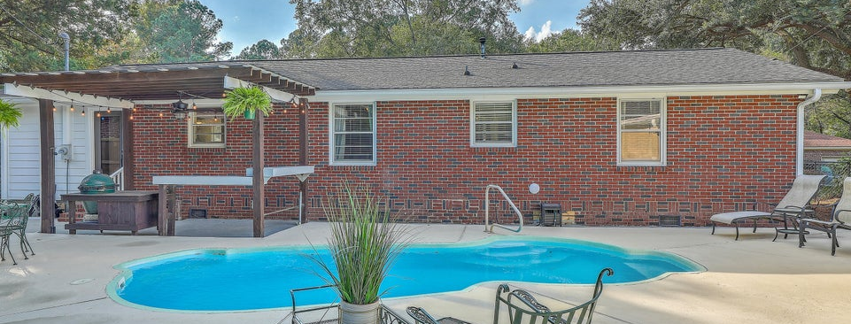

JUS
9714 ROSEBERRY STREE
MOTIVATED SELLER!
/
7
1/
ii
Just Listed
1549 Downing Street | Ashley Hall Manor
Open House 10/11 4-6pm and 10/12 12-3pm
�
$619,990
3 BED
2 BATH
1,609 SQ_FT
0.2 ACRES
Located in the high-demand, centrally located Ashley Hall Manor neighborhood, this stunning brick ranch home has been updated throughout and features a beautiful pool and pool house in the private fenced-in backyard. The stunning curb appeal and grand oak tree will catch your eye as you first approach. There is ample parking on the extra wide extended driveway. Entering the home, you will see gleaming wood floors throughout, and appreciate the flowing, open floorplan with the primary den opening into dining area and the spacious kitchen plus secondary living space. The open kitchen features refinished white cabinetry, granite counters with an island, stainless steel appliances, and recessed lighting. There are 3 bedrooms, 2 full bathrooms, and over 1600 SF of space. Moving out back to the entertainer's space, you will find the covered patio with space to grill, the in-ground pool, beautiful landscaping, and the detached pool house. This pool house has cooled space to hang out plus a half bathroom, and behind the roll-up door is great storage for lawncare equipment. The roof ~2017 and HVAC plus ductwork ~2018 have been replaced, and the kitchen and baths have been updated. All of this in a quiet established neighborhood with no HOA, and easy access to all parts of town. 10 minutes to downtown Charleston, 20 minutes to Folly Beach, 15 mins to CHS airport, 10 mins to Mt Pleasant, and very convenient to multiple grocery stores, breweries, restaurants, and walking distance to the upcoming transformation of the Sumar Street project that is expected to become the hub of West Ashley with shops, green space, and more. This neighborhood falls in the preferred lottery zone for Orange Grove Charter School. Reach out to the school for specific attendance questions.
Scott Baskin
THE SCOTT BASKIN TEAM
843-324-4139
scott@explorecharlestonrealestate.com
SCOTT BASKIN TEAM

