Slide 1
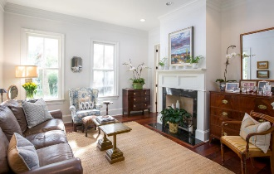
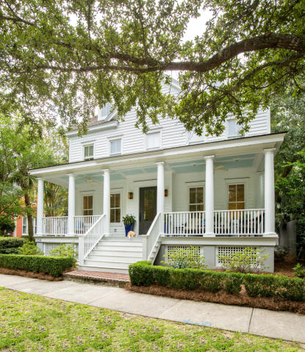
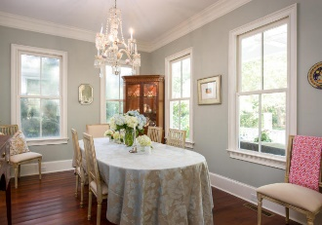
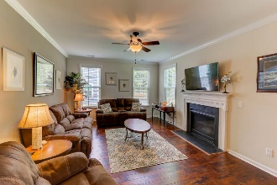
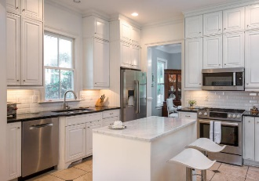
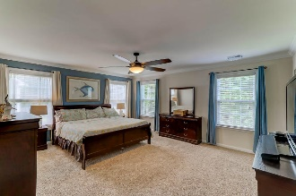
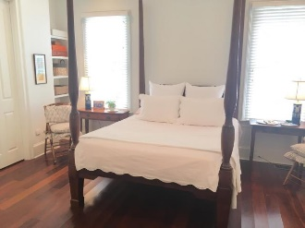
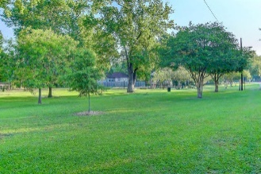
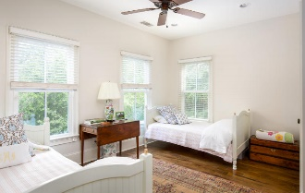
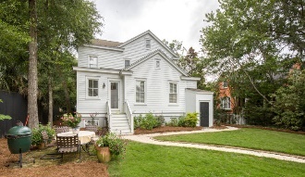


I’On Open House
Friday, October 13th – 11:30-1:30
154 N Shelmore Boulevard
Mount Pleasant, SC 29464 ~ MLS# 17023963 ~ $983,000
Looking for the perfect family home in the award winning neighborhood of I’On?
Location, location, location… a beautiful home with lots of curb appeal! Upon entering the gate, you are welcomed with a full front porch, the perfect place to watch the world go by, visit with neighbors or sit and read your favorite book. With over 3500 square feet, this beautiful traditional home boasts an entry hall full of natural light, formal living and dining spaces and a casual family room open to a bright kitchen nicely appointed with brand new Bosche appliances. There are five spacious bedrooms with the master located on the 1st floor, three on the second floor plus a flex room and one on the third floor with its own bath and full walk-in closet. The homeowners have painted the exterior and interior as well as trim work. Other features include irrigation, invisible fence and Rinai water heaters. NO flood insurance required.
Ariel Trouche
(843) 568-0595 | charlestonaddress@yahoo.com
www.LoCountry.com
Carolina One Real Estate | 1265 Folly Rd | Charleston, SC 29412

