Slide 1
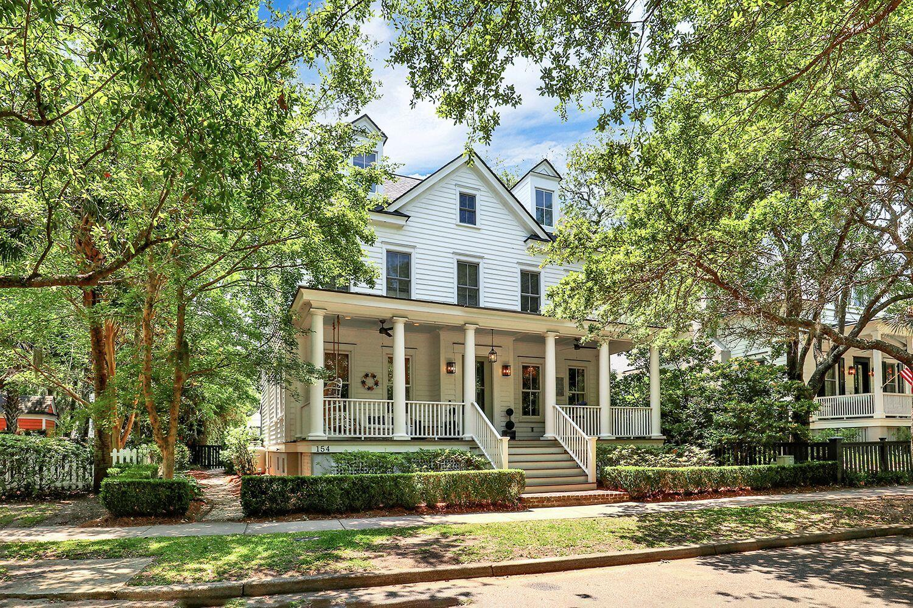
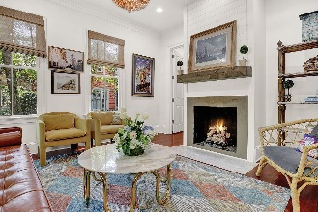
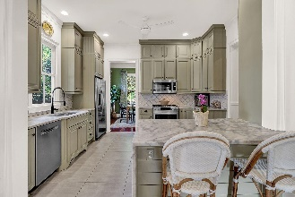
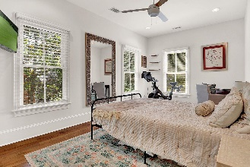
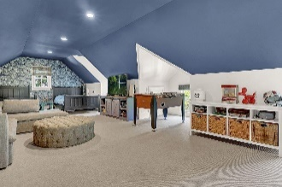
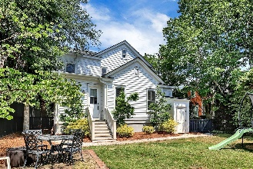

Broker Open House 7/13 10:30-11:30
154 N Shelmore Boulevard
I’On | Mount Pleasant, SC 29464 | MLS# 23010527 | $1,925,000
Charming Lowcountry home conveniently located in the award-winning neighborhood, I'On which is less than 15 minutes to downtown Charleston and the beaches! This home features Brazilian cherry wood floors, tall ceilings, detailed trim, and molding throughout the first floor. When you walk in, the family room is to your left and centered around a recently updated gas fireplace. Tucked beyond the family room is a quaint home office with lots of storage. To the right of the foyer is the formal dining room with plentiful natural light. The kitchen has been recently renovated and features stainless steel Bosch appliances, a beautiful tile backsplash, and new quartz counters featuring a waterfall edge.
Ceiling height custom cabinetry throughout, the kitchen looks onto the breakfast nook which has a newly built, custom banquette. The primary suite is on the main level with a walk-in closet. The primary master bathroom has travertine tile throughout, a soaking tub, a separate shower area, and two separate vanities. The newly added mudroom and updated laundry room complete the first floor. The second floor has four spacious bedrooms and a full bathroom. The third floor could be used as the sixth bedroom or playroom/media room and has its own full bath and walk-in closet. Fully encapsulated crawl space and the roof is less than a year old. This home features a fenced in backyard and includes plans to add a pool and garage.
Carolina One Real Estate
195 W Coleman Blvd
Mt Pleasant, SC 29464-3495
Jennie Hood Emerson (843) 327-0384
jennie@carolinaone.com
www.yourcharlestonhomes.com

