Slide 1
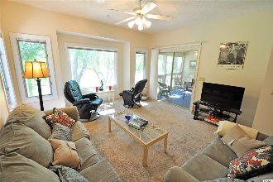
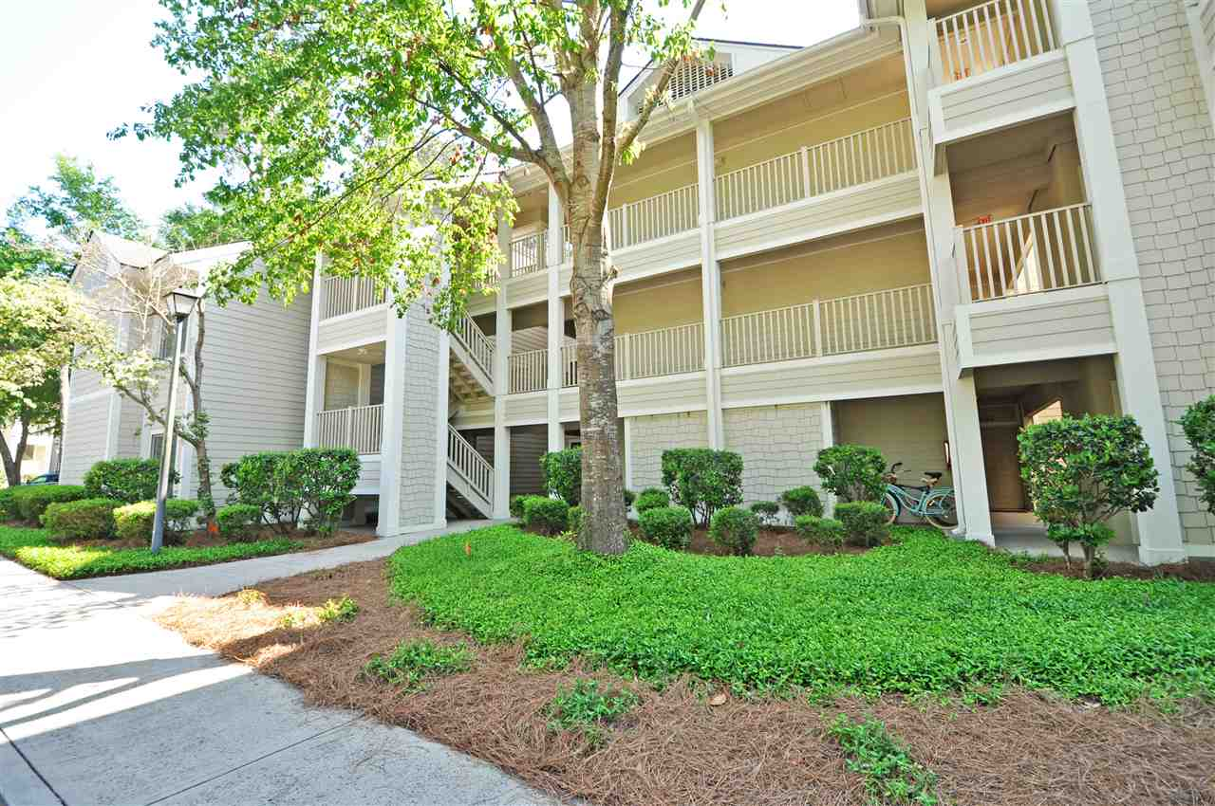
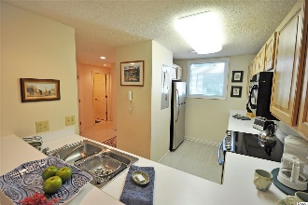
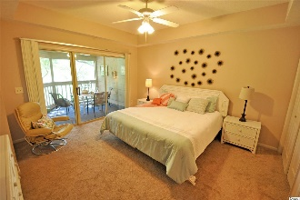
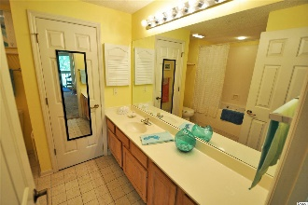
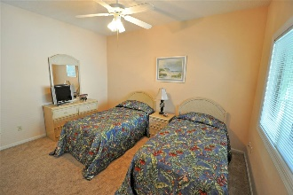
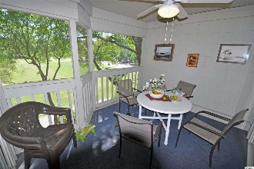
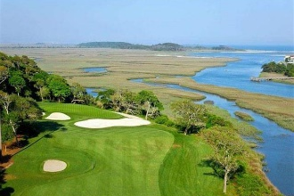
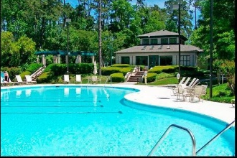
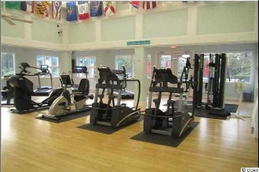
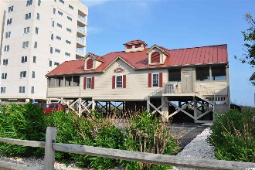


Turnkey Condo
1550 Spinnaker Dr #3135
North Myrtle Beach, SC 29582
MLS# 1810302
$149,900
NEW, NEW, NEW! HVAC, HOT WATER HEATER AND STAINLESS STEEL APPLIANCES! CONDO IS FULLY FURNISHED AND SOLD TURNKEY!
Much of the furnishings and decor are new. You can literally just walk into this condo and be living there, with its fun, whimsical golf and beach theme to its unique full view of the driving range from a wonderful, private and serene 3rd-floor-penthouse perspective. Color scheme is neutral with pops of color, pleasantly coordinated throughout. Collectible golf memorabilia stays! Convenient elevator close by. This 2 bedroom/2bath floor plan offers the best of simple beach living, complete with an owners' ocean front beach cabana, superbly accommodating a family or a foursome! Amenity-rich Tidewater is a 24-hour, manned gated community on a tree-lined road to oceanfront Anne Tilghman Boyce Coastal Reserve, a nature conservancy, including Waties Island, with access for managed recreational use. Tidewater itself is on an elevated peninsula of live oaks and southern pines between the Intracoatal Waterway and the Cherry Grove Inlet to the Atlantic Ocean. The plantation also preserves the singular look of its own historic origins. It is minutes from the beach, shopping, medical services, entertainment and access to major highways. The development boasts that private owners' beach cabana on the wide, white sands of the Cherry Grove Beach. It is one of the highest-rated golf courses in not only the Carolinas but in the U.S. Amenities include that oceanfront beach cabana for owners' use with open/screened porches, bathrooms, showers and kitchen. Residents enjoy the use of several pools/hot tubs. Other amenities include a driving range, golf shop, clubhouse with bar/dining and event facilities overlooking the 18th hole, clay and hard surface tennis courts, pickle ball court, fitness center overlooking a pool, bocce courts and amenity center for public/private events. Other group activities include an outdoor summer concert series, workout classes including water aerobics, weekly art classes, Happy Hours, dinner clubs, book clubs, bridge club, mahjong and holiday events, plus more! In addition, Tidewater has a gated storage yard for boats, jet skis, motorcycles and kayaks. Tidewater Plantation, with its full range of things to do and to enjoy, really reflects a "way of life," where friendly neighbors welcome you to your new casual beach, boating and golf lifestyle in North Myrtle Beach. Welcome!
Deborah Collins
843-424-9013
dctidewater@yahoo.com
Connie Ross-Karl
702-306-2643
conniesross@aol.com
NEW WAY PROPERTIES MYRTLE BEACH

