Slide 1
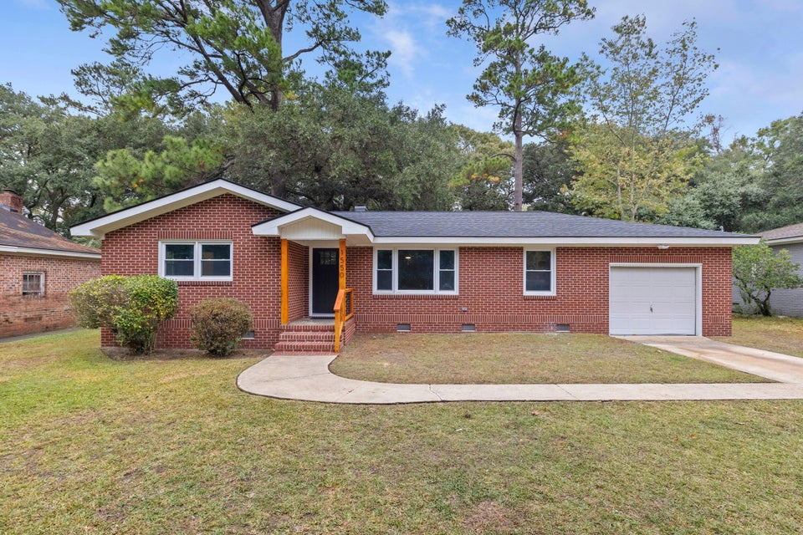
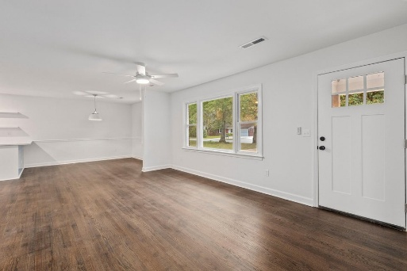
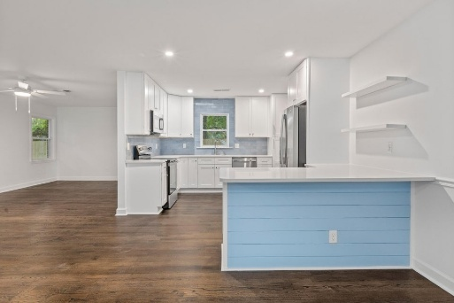
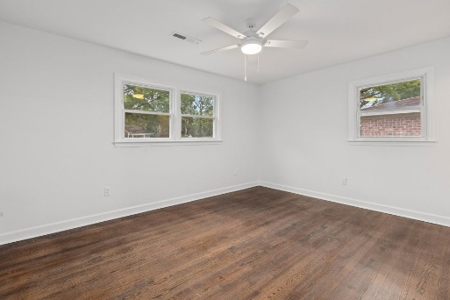


Roomy 3/2 In A Fantastic Neighborhood Interior West Ashley. New Everything, Come See It Today!
1550 Salisbury Street
Ashley Hall Manor | Charleston, SC 29407 | MLS# 25029135 | $625,000
Gorgeous, updated, home in a highly desirable part of West Ashley. Open layout with a large and very functional new kitchen. Freshly refinished real oak floors throughout, with the exception of the bathrooms, which have fresh designer tiled floors and showers. New tankless hot water heater and new electrical panel upgrade. Roof and HVAC both replaced within the last several years. Huge backyard with full privacy fence. Primary bedroom has a walk in closet. Very close to downtown Charleston and I26, even closer to the new "Ashley Landing" mixed use and green space destination around the corner. No HOA and no flood insurance required. List agent is part of ownership LLC.
Justin Natale
843-437-9739 | jnatale1982@gmail.com
www.theblvdcompany.com
The Boulevard Company, LLC | 806 Johnnie Dodds Blvd Ste 100 | Mt Pleasant, SC 29464

