Slide 1
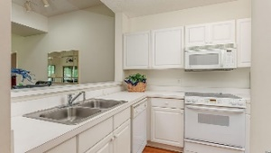
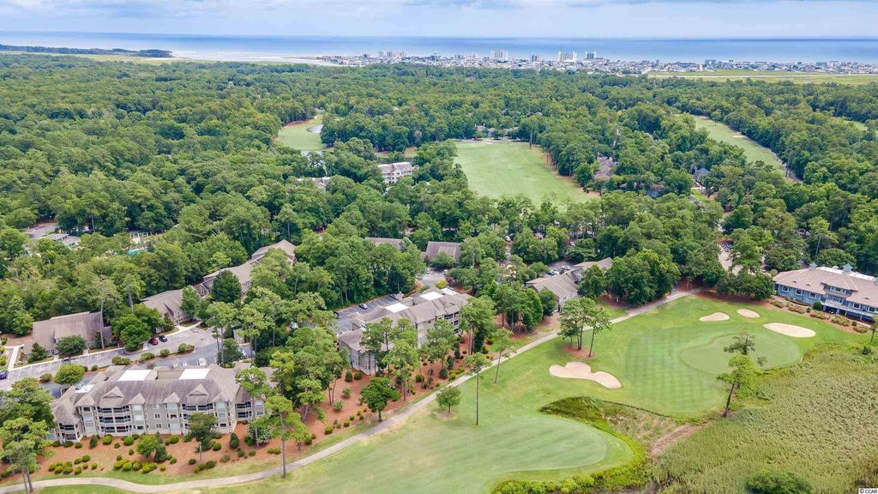
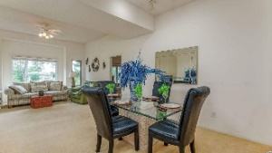
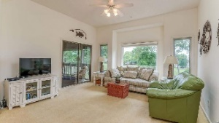
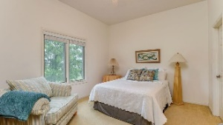
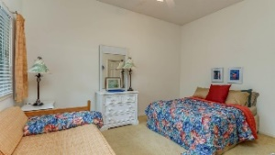
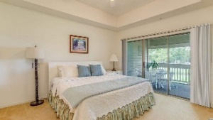
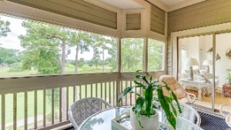
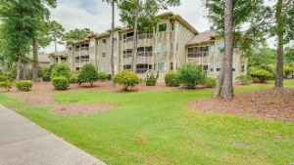
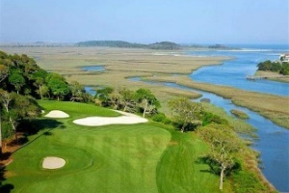
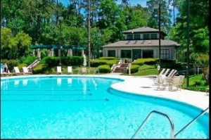
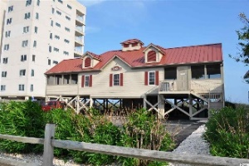


Welcome To The The Best Of The Beach
1551 Spinnaker Dr #5334
North Myrtle Beach, SC 29582
MLS# 2116167 ~ $284,500
Prepare to be pleased with this truly rare opportunity: Clubhouse Villas of Tidewater Plantation Resort features low-rise 2- and 3- bedroom luxury residential condominiums in a safe, secluded and peaceful environment. This spacious 3-bedroom/3-full-bath unit is on the third, penthouse-floor and is convenient to the elevator and parking. It is handicap accessible as well. It is clean, uncluttered, attractive & ready for personalization. It is being sold furnished. Notice first, though, upon entering is that it is bathed in light from an enormous picture window and adjoining screened porch. There is even a fun, garden window in the kitchen with natural light. The floor plan is unique in Tidewater, comfortable and livable. There are two dedicated masters, both with en suites and walk-in closets. All rooms have ceiling fans. The second master has a large window, too, overlooking those singular, lovely views. The primary master has a double-sink vanity, stand up shower and garden, jetted tub. It shares the same views as the living area and adjoins the screened-in porch also, perfect for morning coffee or for a bedtime glass of wine, watching the golfers or the boats going by. The hallway from the bedroom to the kitchen has storage, dedicated washer/dryer space and guest bath which can also be locked out for yet another en suite from the over-sized guest, third bedroom. There is an owners lockout closet and another one for storage. A big kitchen panty adds more storage space. The kitchen itself is nice and functional, with lots of cabinet space, breakfast bar and more views. The dining room conjoins the kitchen; and the living space and is large and truly inviting, for a quick bite or for a formal dinner, perfect for a family or a foursome! This condo is a prime candidate for a permanent or vacation home or for an investment property. The heart of the home are the VIEWS, some say one of, if not the best, of the condos in Tidewater. In addition to golf & being in an ICW community, Tidewater boasts many other rich, upscale amenities, including owners' beach cabana on the Cherry Grove Beach named the 11th best in the nation, pools & spas, clay & hard-surface tennis courts, pickle ball, bocce, horseshoes, amenities center, fitness center, driving range & putting green, 24-hour gated manned security, and clubhouse with bar & restaurants. There is even a complimentary gated storage yard for boats, campers, recreational vehicles and the like. The on-site, convenient HOA building has rooms for business and other meetings and events and a lending library. There are many clubs and activities year round. In Tidewater, you can do it all, or just relax in the luxurious Tidewater lifestyle. Tidewater itself is on a tree-lined road to oceanfront Anne Tilghman Boyce Coastal Reserve, a nature conservancy, including Waties Island, with access for managed recreational use. Tidewater, a historic plantation, is on an elevated peninsula of live oaks and southern pines between the Intracoatal Waterway and the Cherry Grove Inlet to the Atlantic Ocean. The plantation also preserves the unique look of its own origins. It is close to the beach, shopping, entertainment, medical services, outstanding schools and parks and access to major highways. The jewel in the crown of the development is that private owners' beach cabana on the wide, white sands of the Cherry Grove Beach, just a few minutes drive. This charming condo enjoys a lovely, indigenous peaceful environment, along with the excellent reputation of the Tidewater Golf Course, the Pebble Beach of the East, and the VIEWS, VIEWS, VIEWS -- of the signature 8th, 9th and 18th holes; boats along the Intracoastal Waterway and the dynamic natural beauty of the marsh. Tidewater Plantation, in one of the U.S.'s top-5 beach towns, North Myrtle Beach, truly reflects a "way of life." Do not let this singular condo get away. Welcome to the the best of the beach in Clubhouse Villas in Tidewater Plantation Resort.
Take a Virtual Tour: https://my.matterport.com/show/?m=9k5eNGwnTWg
Deborah Collins
843-424-9013
dctidewater@yahoo.com
Connie Ross-Karl
702-306-2643
conniesross@aol.com
NEW WAY PROPERTIES MYRTLE BEACH

