Slide 1
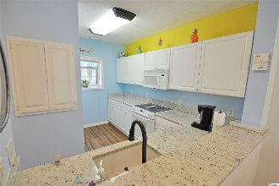
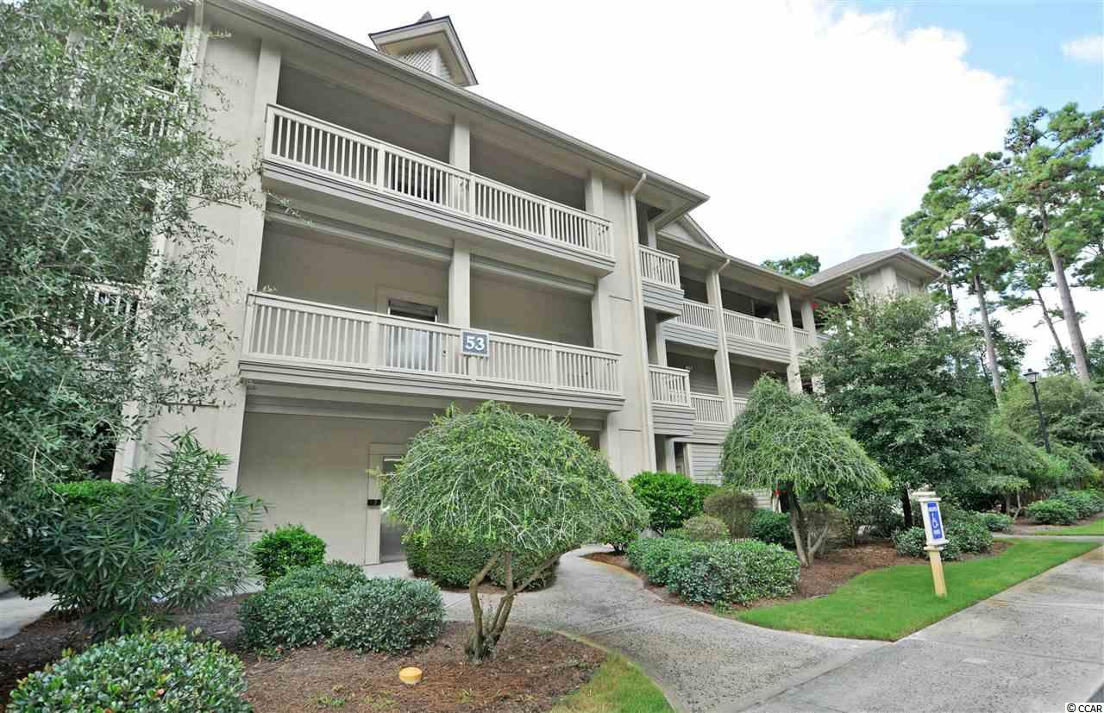
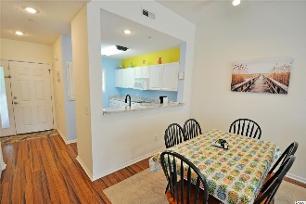
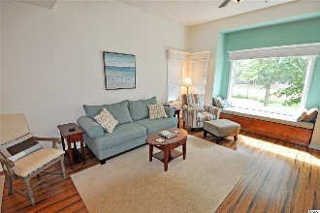
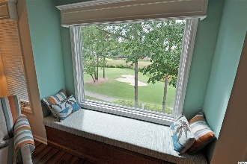
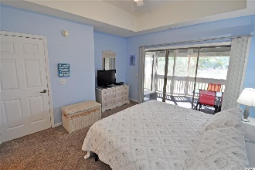
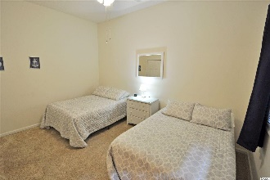
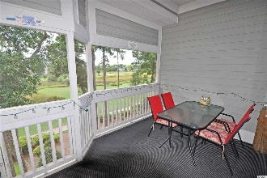
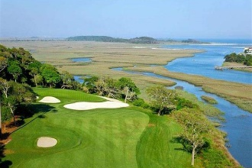
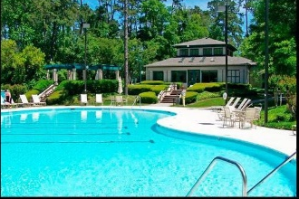
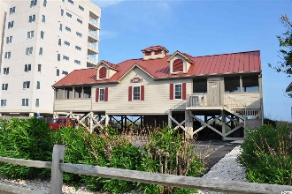


New Unbelievable Price!
Upscale Condo Living
1551 Spinnaker Dr #5335
North Myrtle Beach, SC 29582
MLS# 2006647
$169,900
Clubhouse Villas of Tidewater Plantation Resort is one of the most popular locations on the North Strand for spacious, beautiful and upscale condo living at unbelievable value prices. They live large and have some of the most sought-after golf, marsh and Intracoastal Waterway panoramas anywhere. Start with 24-hour manned, gated security with ease of access to a private enclave of detached homes and popular, distinctive condominiums in natural surroundings. Clubhouse Villas skirts the Waterway and the worl-class Tidewater Golf Course. The 53 Building is an end building, with Unit 5335 on the low-rise 3rd, penthouse floor, overlooking the signature 18th hole, spectacular! There is ease of access also to adjacent, plentiful parking which is ADA compliant and near the building and elevator. Entry to the home is through a new storm door, then wide hallways and a lovely foyer adjoined by the kitchen, guest bath, entry & laundry closets, guest-second bedroom and the grand open living/dining space. See literally everything from the foyer and be immediately mesmerized and cooled by the remote-controlled upgraded ceiling fan in the living space. To the left is the gorgeous kitchen with custom-made cabinet doors, deliciously upscale granite counter tops, airy window with planter, decorative space and a large pantry; breakfast bar and, of course, views. To the left is the second en suite or guest bath and a big guestroom with 2 full-sized beds. Four plentiful closets provide space for beach paraphernalia, linens, household items and much more. The absolutely stunning bamboo hardwood floor captivates you immediately and enhances a pleasant, cozy, well coordinated living and dining area. A big, handsome, custom, hand-made hardwood window seat with storage and tailor-made cushion almost steals the show from the huge picture window and infinity views. Plus, window-box valence-cornices accent a cottage-like and very tasteful great-room. Its look is soft, pretty and truly inviting.There is a grand screened porch off of the living space as well as adjoining the huge master bedroom for even more contiguous indoor/outdoor living and certainly those never-ending views! The master is remarkable for its comfort, simplicity of style and amenities -- walk-in closet, tray ceiling, double-sink vanity, separate stand-up shower and jetted garden-soaking tub. The master and guest bedrooms are newly carpeted. Furniture, beds and mattresses are also newer, as are the appealing freshly painted ocean-inspired wall colors, interesting light fixtures and distinctive ceilings. Entertain, welcome family, relax or enjoy all that this lovely home and Tidewater have to offer. You can do as much or as little as you choose, and any choice is guaranteed perfect! Amenity-rich Tidewater is on a tree-lined road to oceanfront Anne Tilghman Boyce Coastal Reserve, a nature conservancy, including Waties Island, with access for managed recreational use. Tidewater itself is on an elevated peninsula of live oaks and southern pines between the ICW and the Cherry Grove Inlet to the Atlantic Ocean. The plantation also preserves the singular look of its own historic origins. It is minutes from the beach, shopping, medical services, entertainment and access to major highways. Amenities include an oceanfront beach cabana for owners' use with open/screened porches, bathrooms, showers, & kitchen. Residents enjoy the use of several pools/hot tubs. Other amenities include a driving range, golf shop, clubhouse with bar/dining and event facilities, clay & hard surface tennis courts, pickle ball court, fitness center overlooking a pool, bocce courts and amenity center for public/private events. Tidewater has a gated storage yard for boats, jet skis, motorcycles, & kayaks. Safe North Myrtle Beach was named a top-ten beach town in the U.S. & the Cherry Grove Beach was awarded the 11th best beach in the nation nod. Living in Tidewater makes it ALL perfect!
Deborah Collins
843-424-9013
dctidewater@yahoo.com
Connie Ross-Karl
702-306-2643
conniesross@aol.com
NEW WAY PROPERTIES MYRTLE BEACH

