Slide 1
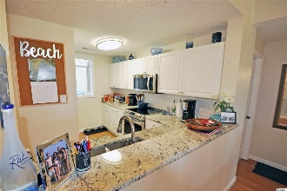
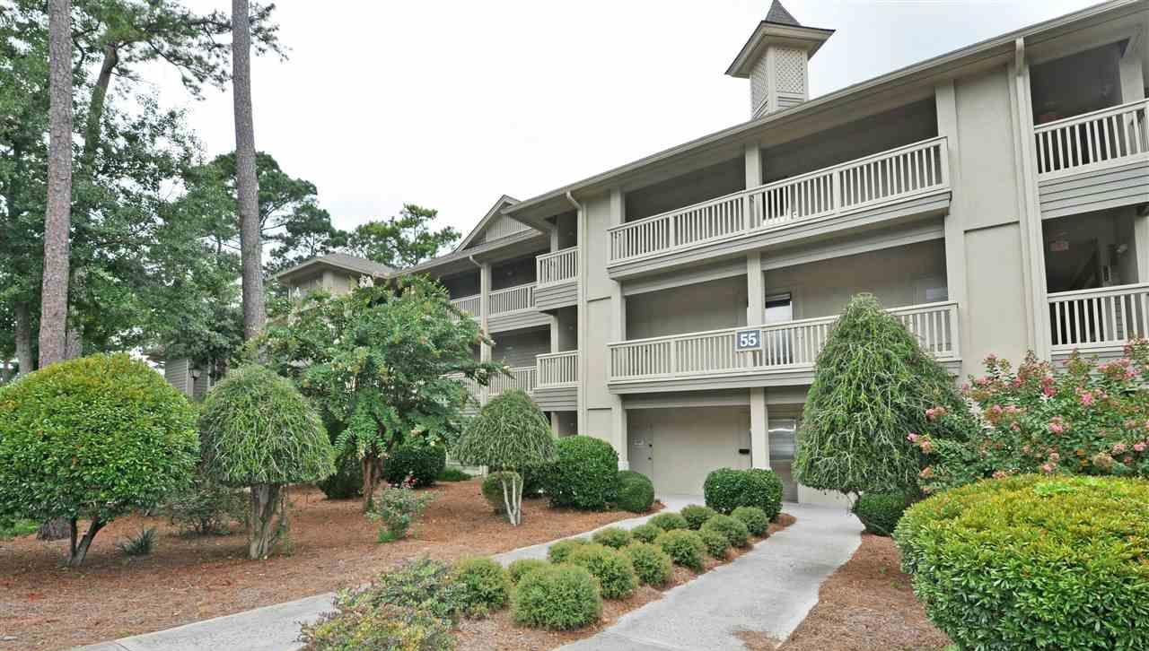
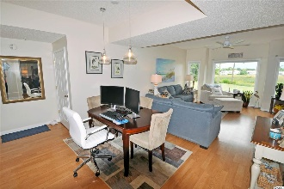
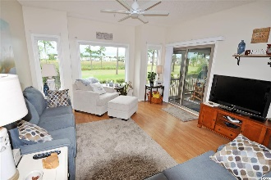
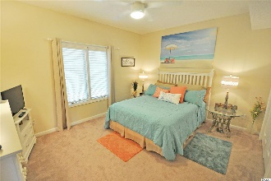
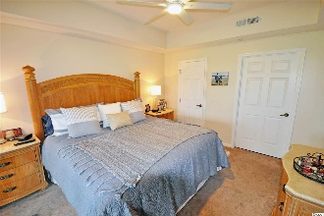
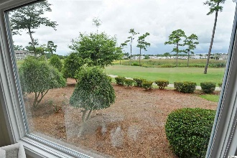
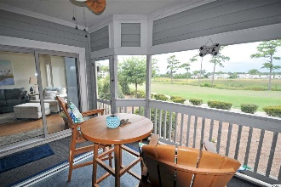
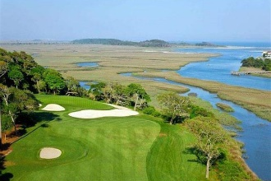
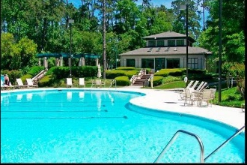
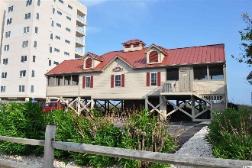


Must See!
1551 Spinnaker Dr #5513
North Myrtle Beach, SC 29582
MLS# 1917019
$219,500
When something is judged over time to be of the highest quality and of the most outstanding of its kind, it is called a CLASSIC! Welcome, therefore, to this highly desirable, upscale Clubhouse Villa. This unique condo offers a rare 3-bedroom/3 en suite-bath spacious split-bedroom classic beach-golf floor plan. It is the epitome of Southern Living; and the close-up views of the ICW, marsh and the signature 18th-hole-green vista of the world-famous Tidewater Golf Course are right out of Golf Digest. Moreover, it is located in the prestigious Tidewater Plantation Resort in popular North Myrtle Beach. Such unusual, impeccably decorated and beautifully upgraded properties are highly valued as homes, second homes, and investment properties. This is the unit everybody wants -- remarkable features outlined in the associated documents, parking adjacent to the building, handicap access & wide halls, tranquil open location, and FIRST-FLOOR one level with those incomparable GOLF COURSE VIEWS from several big windows, offering much natural light also! This building is set apart in a natural enclave -- in a secluded and peaceful setting, featuring additional opportunity to view the areas' abundant wildlife and lovely surprises SUCH AS BOATS GOING ALONG THE INTRACOASTAL WATERWAY and birds feeding in the marsh. Particularly enjoy the views from the light and airy over-sized living room and from the master off of the living area with an equally over-sized, inviting screened porch. The master easily accommodates large furnishings and a grand king bed to relish that incredible view, yet with perfect privacy. The master enjoys a walk-in closet, en suite with double-sink vanity topped by wonderful granite countertops, whirlpool garden tub and nice walk-in shower. The second bedroom in its own wing off of the kitchen has an en suite, a big closet and privacy also; the third, front bedroom has a spacious en suite full-bath which opens to the living space for ease of use for guests. There is lots of storage, including a convenient pantry in the kitchen and hall owners' closets for laundry, entry items, linens, and household supplies. There is a big additional closet in the second guest wing hallway not found in other models. This impressive unit is sold unfurnished except for the front bedroom. It is in classic condition, used only as an incomparable, well-loved home. The kitchen has nice, new stainless steel appliances, wonderful granite countertops and new upgraded backsplash. There are both a breakfast bar and gathering-sized dining/living room, perfect for a family or foursome, and incomparable for entertaining. It lives luxuriously. At this established-value price, do not let this singular Tidewater beauty slip away! Amenity-rich Tidewater is on a tree-lined road to oceanfront Anne Tilghman Boyce Coastal Reserve, a nature conservancy, including Waties Island, with access for managed recreational use. Tidewater itself is on an elevated peninsula of live oaks and southern pines between the ICW and the Cherry Grove Inlet to the Atlantic Ocean. The plantation also preserves the singular look of its own historic origins. It is minutes from the beach, shopping, medical services, entertainment and access to major highways. Amenities include that oceanfront beach cabana for owners' use with open/screened porches, bathrooms, showers, and kitchen. Residents enjoy the use of several pools/hot tubs. Other amenities include a driving range, golf shop, clubhouse with bar/dining and event facilities, clay and hard surface tennis courts, pickle ball court, fitness center overlooking a pool, bocce courts and amenity center for public/private events. Tidewater has a gated storage yard for boats, jet skis, motorcycles, and kayaks. Safe North Myrtle Beach was named a top-ten beach town in the U.S. & the Cherry Grove Beach was awarded the 11th best beach in the nation designation. Tidewater is tops too. How about this impressive COMBINATION for CLASSIC!
Deborah Collins
843-424-9013
dctidewater@yahoo.com
Connie Ross-Karl
702-306-2643
conniesross@aol.com
NEW WAY PROPERTIES MYRTLE BEACH

