Slide 1
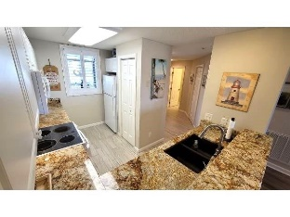
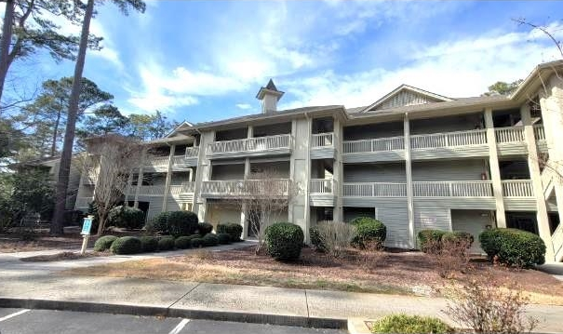
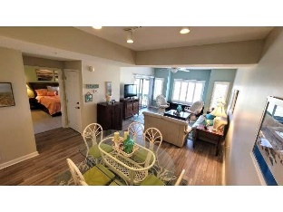
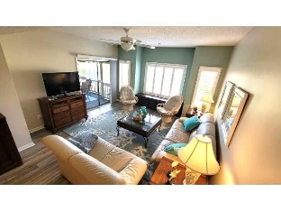
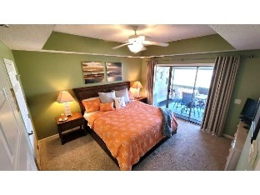
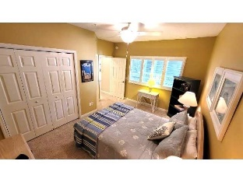
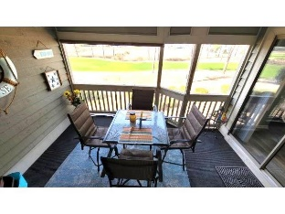
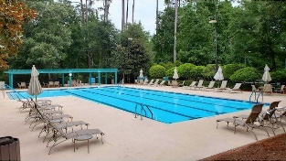
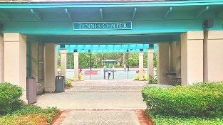
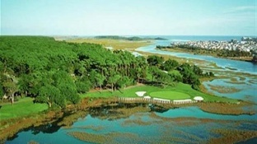
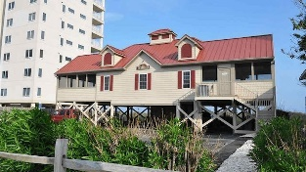



Spacious and upgraded 2-bedroom, 2-bath condo with the most beautiful views of the Intra-coastal Waterway and #18 fairway, with panoramic views also of #8 and #9.
1551 Spinnaker Dr #5522
Clubhouse Villas of Tidewater Plantation Resort
North Myrtle Beach, SC 29582 | MLS# 2403552 | $349,900
On world-class Tidewater Plantation Golf Course, move-in ready, and turnkey furnished with a scant does not convey list. Spacious and upgraded 2-bedroom, 2-bath condo with the most beautiful views of the Intra-coastal Waterway and #18 fairway, with panoramic views also of #8 and #9. The kitchen features granite counter tops, tile floors and pantry. Living room/dining combo gives you an oversized, open-living concept with beautiful plank flooring. Enjoy all views from the living room with a sliding door to the screened-in porch which gives you an outdoor view of the golf course and spectacularly beautiful sunsets. Master bedroom has walk-in closet, sliding doors to the screened porch, with updated master bath/double sinks, walk-in shower and jetted tub. A second home, it has never been rented and only used as a vacation getaway. 2nd bedroom has adjoining bath with upgraded vanity. Do not let this singular Tidewater beauty slip away! Amenity-rich Tidewater is on a tree-lined road to oceanfront Anne Tilghman Boyce Coastal Reserve, a nature conservancy, including Waties Island Tidewater itself is on an elevated peninsula of live oaks and southern pines between the ICW and the Cherry Grove Inlet to the Atlantic Ocean. The plantation also preserves the singular look of its own historic origins. It is minutes from the beach, shopping, medical services, entertainment and access to major highways. Amenities include an oceanfront beach cabana for owners' use with open/screened porches, bathrooms, showers, and kitchen. Residents enjoy the use of several pools/hot tubs. Other amenities include a driving range, golf shop, clubhouse with bar /dining and event facilities, clay and hard surface tennis courts, pickle ball court, fitness center overlooking a pool, bocce courts and amenity center for public/private events. Tidewater has a gated storage yard for boats, jet skis, motorcycles, and kayaks. Tidewater Resort reflects the CLASSSIC Beach-golf lifestyle. This unique find reflects the best of the beach in safe, affordable North Myrtle beach, a Top-5 Beach Town in the U. S.!
Video Tour
Connie Ross-Karl
702-306-2643
conniesross@aol.com
Ronnie Nichols
Realtor / BIC
ronnienichols8@aol.com
NEW WAY PROPERTIES MYRTLE BEACH

