Slide 1
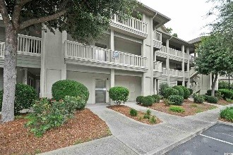
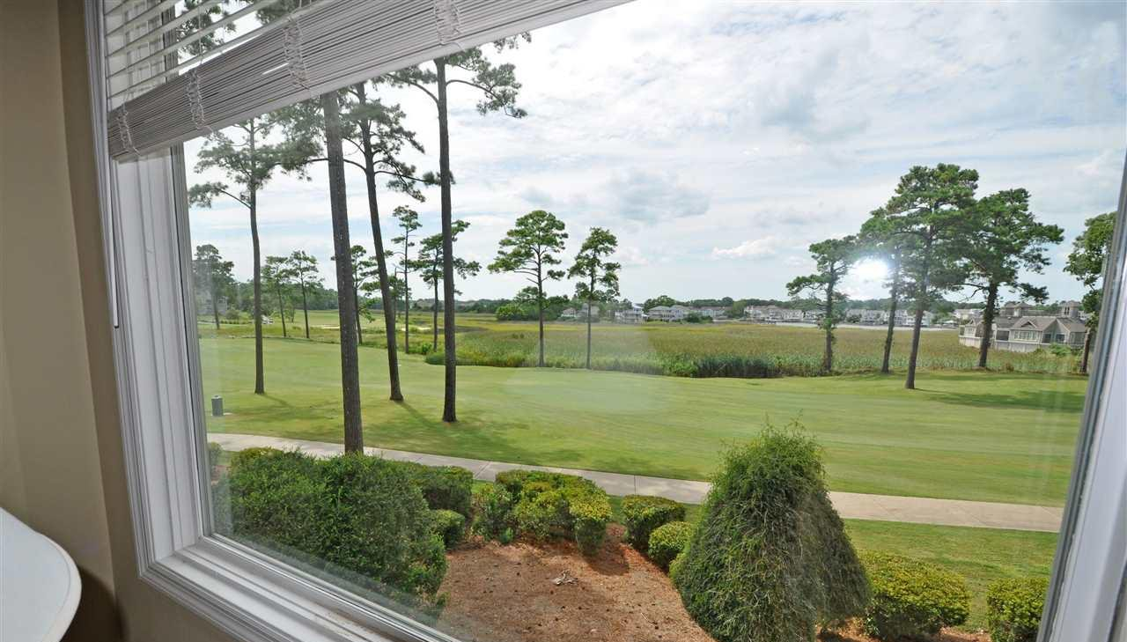
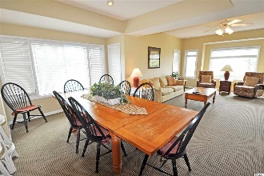
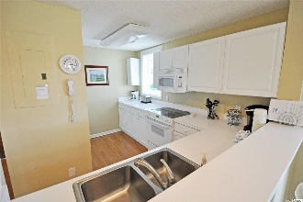
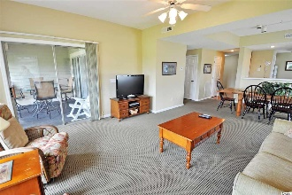
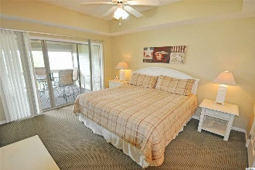
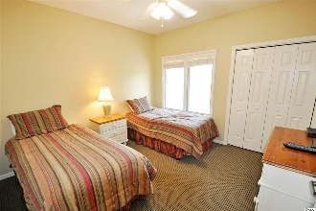
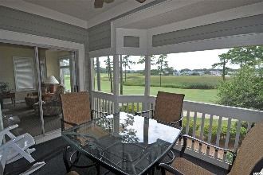
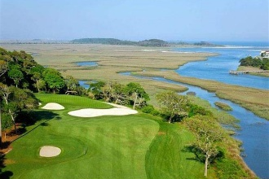
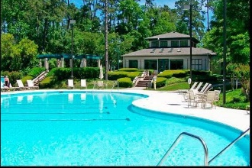
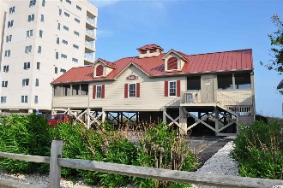


1551 Spinnaker Dr #5726
North Myrtle Beach, SC 29582
MLS# 1917001
$209,900
Views! Views! Views!
There are no bad views in Tidewater; however, this may be one of the very best! This remarkable top-floor (2nd) end unit has great views from the dining and living areas, as well as from the screened-in back porch and the master bedroom. See the panoramic 18th fairway of world-class Tidewater Golf Course, the marsh, and the most spectacular vista of the ICW from any vantage point in this community, which boasts some of the best views anywhere of the Intracoastal Waterway. This is the Best of the Best! There is so much to do in amenity-rich Tidewater and in the surrounding North Myrtle Beach and the Grand Strand areas, but you may never want to leave this home or vacation home, as watching the boats travel the waterway, the golfers and the breath-taking birds and wildlife of the marsh is mesmerizing. So linger and just relax and rejuvenate in these peaceful surroundings. Equally a reason to settle in is the absolute comfort and easy-living of this well-maintained condo, being sold turnkey furnished. It has been a loved second home and lucrative rental property since its purchase by the current owners. Their extended families have loved its wonderful floor plan of 3 bedrooms and 3 full baths for lengthy stays seasonally, plus the space and privacy to invite friends and golfing buddies to share its simple beauty and charm, and being close to dining, entertainment, shopping and fun for all ages. Do as much or as little as you want, as this condo is to stay and to play in style! It is in an elevator building with ease of access to parking and handicapped accessible. It is clean, well-loved and inviting from the first entry into a wide foyer and hallway. The kitchen with all appliances, side view window and pantry is ahead. It also has a breakfast bar and is very workable in design. It looks out to the view through the picture window in the living room which adds to its feeling of spaciousness. To the right is the beautiful dining room, over-sized for a family or a foursome to gather, and the large living room with a captivatingly grand picture window. You see that infinity view immediately upon entry. The master bedroom with views is off the living room; both have access to the big screened porch. The master is private and has a walk-in closet and en suite bath featuring a whirlpool tub, double sink vanity and walk-in shower. There is bunches of storage, a laundry area, and a hallway to two more bedrooms in a split-bedroom floor plan, each with en suites, one of which also opens to the hallway for use by guests. The popular lay-out is also multi-functional. Amenity-rich Tidewater is on a tree-lined road to oceanfront Anne Tilghman Boyce Coastal Reserve, a nature conservancy, including Waties Island, with access for managed recreational use. Tidewater itself is on an elevated peninsula of live oaks and southern pines between the ICW and the Cherry Grove Inlet to the Atlantic Ocean. The plantation also preserves the singular look of its own historic origins. It is minutes from the beach, shopping, medical services, entertainment and access to major highways. Amenities include that oceanfront beach cabana for owners' use with open/screened porches, bathrooms, showers, and kitchen. Residents enjoy the use of several pools/hot tubs. Other amenities include a driving range, golf shop, clubhouse with bar/dining and event facilities, clay and hard surface tennis courts, pickle ball court, fitness center overlooking a pool, bocce courts and amenity center for public/private events. Tidewater has a gated storage yard for boats, jet skis, motorcycles, and kayaks. Safe North Myrtle Beach was named a top-ten beach town in the U.S. & the Cherry Grove Beach was awarded the 11th best beach in the nation designation. Tidewater is tops too. At this established value price, do not let this home, vacation home or investment property with the best of the best views in Tidewater Plantation Resort get away. See it today!
Deborah Collins
843-424-9013
dctidewater@yahoo.com
Connie Ross-Karl
702-306-2643
conniesross@aol.com
NEW WAY PROPERTIES MYRTLE BEACH

