Slide 1
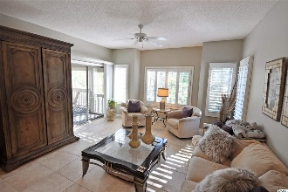
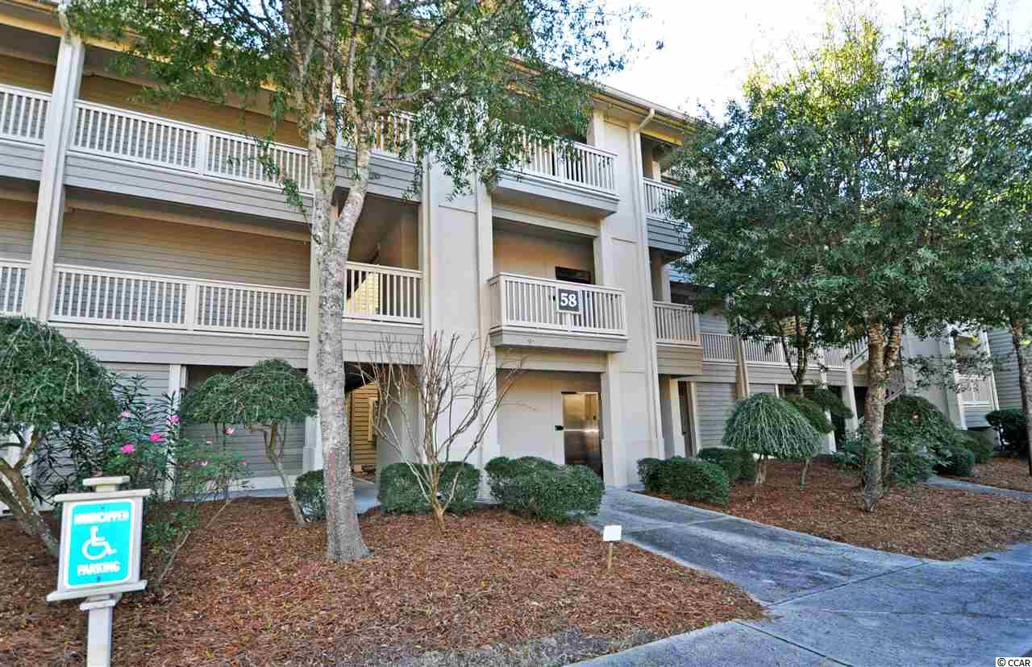
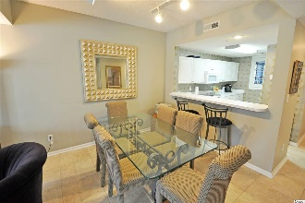
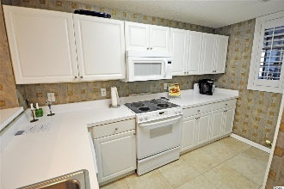
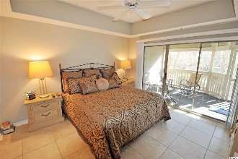
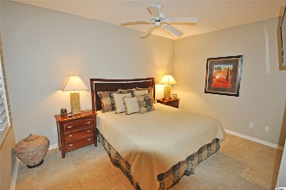
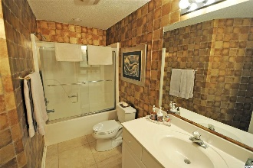
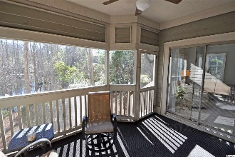
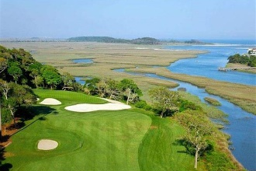
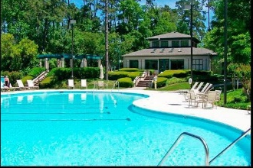
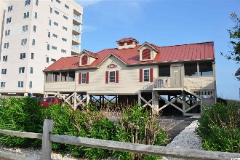


This Is The Unit Everybody Wants!
1551 Spinnaker Dr #5812
North Myrtle Beach, SC 29582
MLS# 2002714 ~ $164,900
First Floor lake view! This is the unit everybody wants -- Parking adjacent to building, handicap access and wide halls, tranquil, First FLOOR WITH VIEWS OF THE RARE CYPRESS LAKE NATURE ENCLAVE and lots of open space surrounding the building. See giant red-headed woodpeckers, heron, egrets and so much more. The 58 Building of Clubhouse Villas is set apart, secluded and peaceful! This first-floor unit walks out to a small yard (perfect for pets). It has the most requested Tidewater Plantation 2-bedroom/2-bath-condo floor plan -- split bedrooms with master off the great-room area and featuring an over-sized, inviting screened porch from the comfortable living room and cozy luxury master bedroom with that serene lake view and more privacy. The master enjoys a walk-in closet, en suite with double-sink vanity, separate walk-in shower and jetted garden tub. The big second bedroom has a spacious en suite full-bath which also opens to the living space for ease of use for guests. Large-tile floors and highly desired PLANTATION SHUTTERS THROUGHOUT. The decor and artwork is equally memorable. There is lots of storage, too, including a convenient pantry in the kitchen and hall owners' closets for laundry, entry items, linens, and household supplies. Newer top of the line HVAC and hot water heater. Nonetheless, an Old Republic Ultimate Home Warranty with HVAC is being offered. Magnificently furnished, upscale unit in wonderful condition, a well-loved second home, never rented. The multi-functional living area is bathed in natural light and offers infinity views to that lake from entry, kitchen, dining and living rooms. There is a breakfast bar and gathering-sized dining/great room, perfect for a family or foursome and great for entertaining. This impeccably maintained unit walks to pool and other amenities and is perfect for an investment, home or vacation home. At this price, AND BEING SOLD FULLY FURNISHED, do not let this singular Tidewater bargain slip away! Amenity-rich Tidewater is on a tree-lined road to oceanfront Anne Tilghman Boyce Coastal Reserve, a nature conservancy, including Waties Island, with access for managed recreational use. Tidewater itself is on an elevated peninsula of live oaks and southern pines between the Intracoastal Waterway and the Cherry Grove Inlet to the Atlantic Ocean. The plantation also preserves the singular look of its own historic origins. It is minutes from the beach, shopping, medical services, entertainment and access to major highways. Amenities include that oceanfront beach cabana for owners' use with open/screened porches, bathrooms, showers and kitchen. Residents enjoy the use of several pools/hot tubs. Other amenities include a driving range, golf shop, clubhouse with bar/dining and event facilities overlooking the 18th hole, clay and hard surface tennis courts, pickle ball court, fitness center overlooking a pool, bocce courts, horseshoes, and amenity center for public/private events. Tidewater has a gated storage yard for boats, jet skis, motorcycles and kayaks. Tidewater Plantation, with its full range of things to do and to enjoy, really reflects a "way of life" in safe, popular, affordable North Myrtle Beach.
See it today; enjoy it tomorrow!
Deborah Collins
843-424-9013
dctidewater@yahoo.com
Connie Ross-Karl
702-306-2643
conniesross@aol.com
NEW WAY PROPERTIES MYRTLE BEACH

