Slide 1
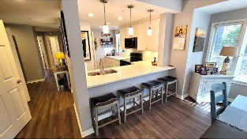
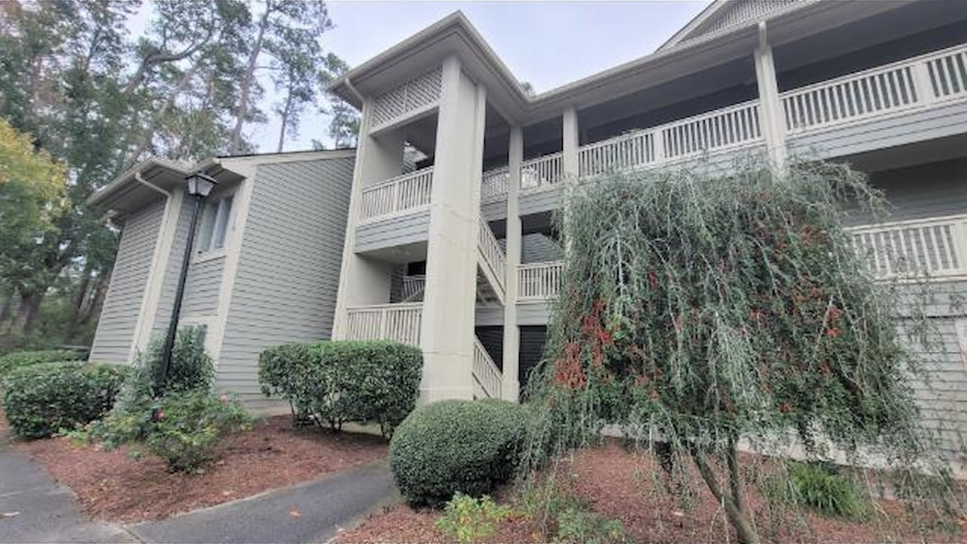
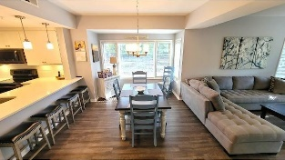
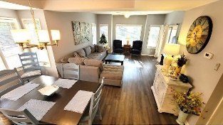
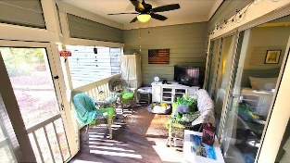
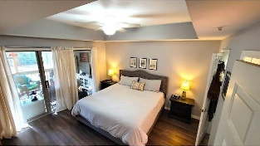
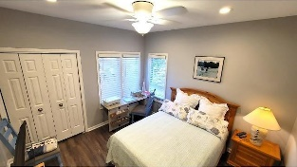
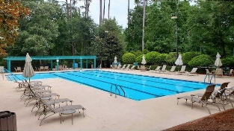
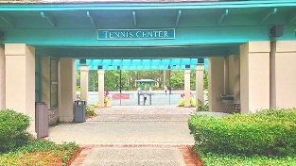
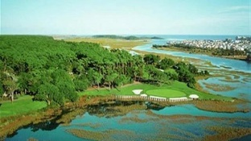
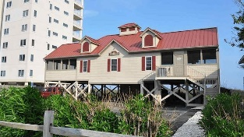



Very Short Walk To Two Pools, Tennis, Fitness And More! This Memorable 3 Bd/3 Ba Condo Is Completely Renovated
1551 Spinnaker Dr #5816
Clubhouse Villas of Tidewater Plantation Resort
North Myrtle Beach, SC 29582 | MLS# 2325846 | $340,500
A very short walk to two pools, tennis, fitness and more, this memorable condo is completely renovated and in the distinctive and popular Tidewater Plantation. This irreplaceable, 3 bedroom 3 bath completely renovated condo is in the highly sought after Tidewater Clubhouse Villas community. It is sold unfurnished; and nothing is omitted in the redo: LVT wood-look flooring, painted a sought-after light gray with white trim, new water heater, smooth flat ceilings, crown molding, plantation blinds, recessed lighting, ceiling fans, breakfast bar with pendant lighting, new black stainless steel appliances, smooth flat top range, built-in microwave, refrigerator with ice & water door dispenser, new kitchen cabinets, new quartz counter tops, in-unit washer & dryer, master bedroom has sliding glass door with access to the screened in porch, master bath comes complete with custom walk-in shower, each bathroom has its' own en suite with new vanities with quartz counter tops, sliding glass door which opens up to the screened-in porch with new flooring and proximity to the pond. Storage is plentiful, utility closet with recessed full-size stackable units, linen closet and owners' closets all add to extra storage space. The Tidewater Clubhouse Villas community amenities also include cable TV along with access to wifi and a 24-hour manned gated security entrance. This condo provides you close proximity to all the attractions and amenities of North Myrtle Beach and Myrtle Beach, with fine dining, wonderful world-class entertainment, fishing piers, and exciting shopping experiences. Just a short drive to medical centers, doctors' offices, pharmacies, schools, parks, banks, post offices, and grocery stores. It is nestled in safe, affordable North Myrtle Beach, a Top-5 Beach Town in the U.S. and its beach cabana is on the Cherry Grove Beach, a top 11th beach in the nation. With this top neighborhood, rich amenities and desired renovated, it is easy to tout this condo as one of the best of the beach!
Video Tour
Connie Ross-Karl
702-306-2643
conniesross@aol.com
Ronnie Nichols
Realtor / BIC
ronnienichols8@aol.com
NEW WAY PROPERTIES MYRTLE BEACH

