Slide 1
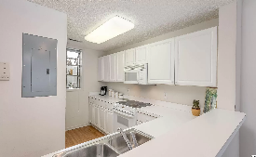
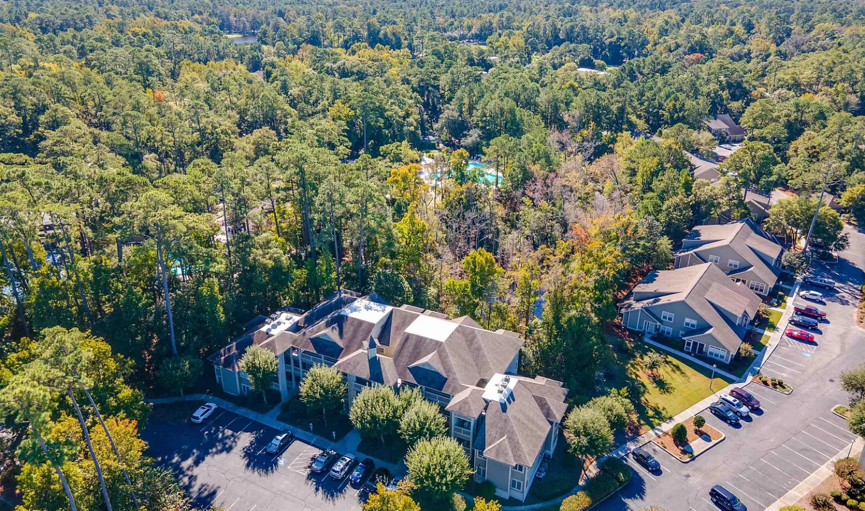
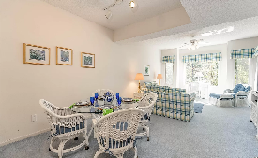
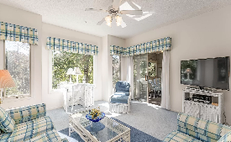
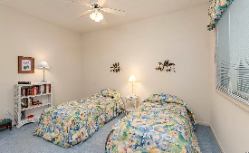
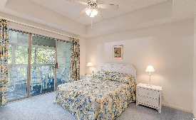
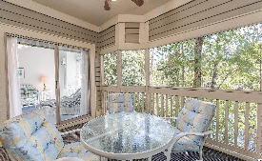
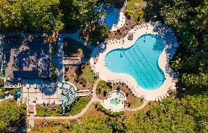
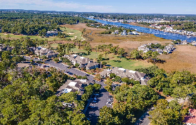
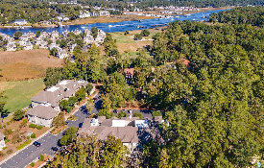
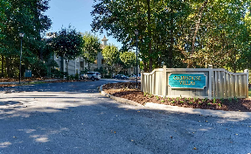
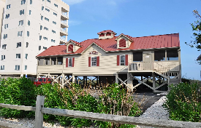



Second Floor With A Spectacular Cypress Lake Vista
Immaculate And Never Rented!
1551 Spinnaker Dr #5823
Clubhouse Villas @ Tidewater Plantation
N Myrtle Beach SC 29582 | MLS# 2124313 | $199,000
Second floor, close to elevator and with a spectacular Cypress Lake vista and up-close view! Immaculate and never rented! This is the unit everybody wants -- plentiful parking adjacent to building, handicap access and wide halls, tranquil, with never-ending VIEWS OF THE RARE CYPRESS LAKE NATURE ENCLAVE and lots of open space surrounding the building. See giant red-headed woodpeckers, heron, egrets and so much more. The 58 Building of Clubhouse Villas is set apart, secluded and peaceful -- with small back and side yards, perfect for pets and for birding. Owners enjoy an oceanfront beach cabana, also with plenty of parking, located on the wide, white sands of Cherry Grove Beach, named the 11th best in the nation. The unit has the most requested Tidewater Plantation 2-bedroom/2 -bath-condo floor plan, too -- split bedrooms with master off the great-room area and featuring an over-sized, inviting screened porch from the comfortable living room and cozy luxury master bedroom with that serene lake view and more privacy. The master enjoys a walk-in closet, en suite with double-sink vanity, tray ceiling for spaciousness, separate walk-in shower and jetted garden tub. The big second bedroom has a large window for extra light and a large en suite full-bath which also opens to the living space for ease of use for guests. There is lots of storage, too, including a convenient pantry in the kitchen and hall owners' closets for laundry, entry items, linens, and household supplies. Newer HVAC, nonetheless, an Old Republic Ultimate Home Warranty with HVAC coverage is being offered. Clean, retro, fun furnishings. Good use of cheerful colors and proportion for roominess. Original owner, second home. Well loved! The multi -functional living area is bathed in natural light and offers infinity views to that lake from entry, kitchen, dining and living rooms. There is a breakfast bar and gathering-sized dining/great room, perfect for a family or a foursome and great for entertaining. The dining area has a tray ceiling as well. This impeccably maintained unit easily walks to pool and other amenities and is perfect for an investment, primary or vacation home. At this inviting price, AND BEING SOLD FURNISHED, do not let this singular Tidewater bargain slip away! Amenity-rich Tidewater is on a tree-lined road to oceanfront Anne Tilghman Boyce Coastal Reserve, a nature conservancy, including Waties Island, with access for managed recreational use. Tidewater itself is on an elevated peninsula of live oaks and southern pines between the Intracoastal Waterway and the Cherry Grove Inlet to the Atlantic Ocean. The plantation also preserves the singular look of its own historic origins. It is minutes from the beach, shopping & dining, medical services, entertainment and access to major highways. Amenities include that oceanfront beach cabana for owners' use with open/screened porches, bathrooms, showers and kitchen. Residents enjoy the use of several pools/hot tubs. Other amenities include a driving range, golf shop, clubhouse with bar/dining and event facilities overlooking the 18th hole, clay- and hard-surface tennis courts, pickle ball court, fitness center overlooking a pool, bocce courts, horseshoes, and amenity center for public/private events. Tidewater has gated and roving security and a gated storage yard for boats, jet skis, motorcycles and kayaks. Tidewater Plantation, with its full range of things to do and to enjoy, really reflects a "way of life" in safe, popular, affordable North Myrtle Beach, a Top 5 Beach Town in the nation. See it today; enjoy it tomorrow!
3D Virtual Tour: https://my.matterport.com/show/?m=qag4sqDrvnU
Video Tour: https://youtu.be/ZrwxrcKCcIo
Connie Ross-Karl
702-306-2643
conniesross@aol.com
Ronnie Nichols
Realtor
Broker in Charge
NEW WAY PROPERTIES MYRTLE BEACH

