Slide 1
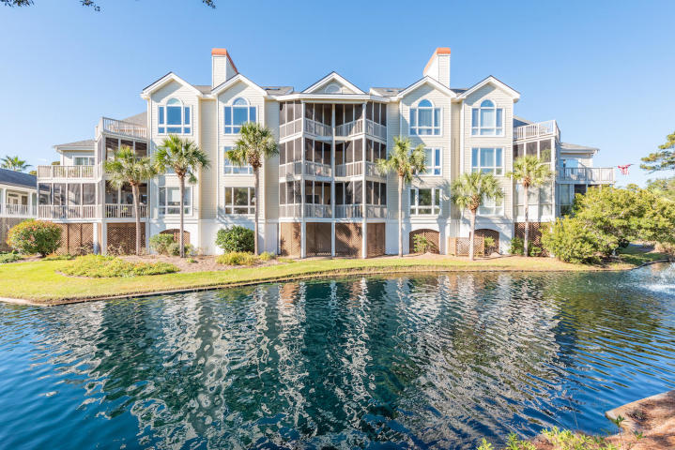
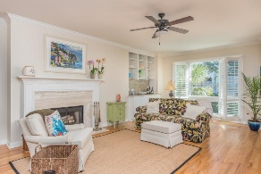
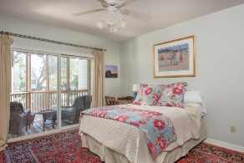
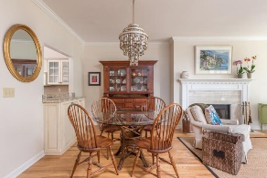
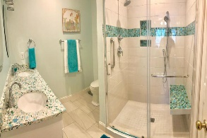
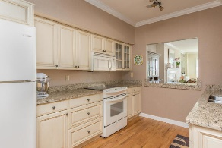
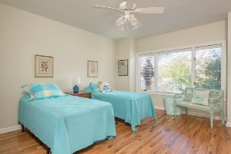
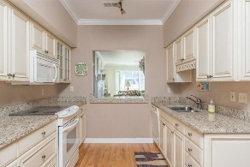
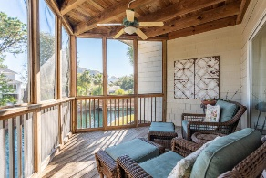
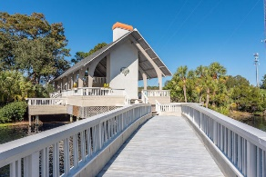
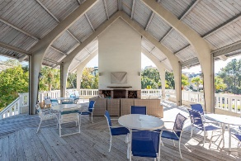
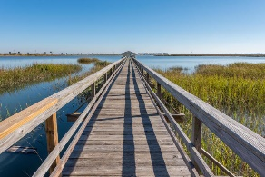
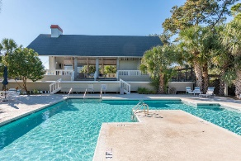
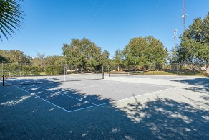

PRICE REDUCED
$260,000
1551 Ben Sawyer Boulevard #5C
Simmons Pointe · Mount Pleasant, SC 29464 · MLS# 18031163 · $515,000
Resort style living located less than 2 miles to Sullivan's Island beaches. Convenient to shopping, dining, and downtown Charleston. Spacious and open 2 bedroom, 2 bath lagoon front condo with peeks of the Sullivans Island lighthouse. Relax on your screened porch while listening to the fountains and watching the lagoon wildlife. Recent renovations include new hardwood floors in the bedrooms for gleaming hardwoods throughout the unit except newly tiled bathroom floors and gorgeous master bath. Master bath boasts a custom shower with glass tiles with high end fixtures and custom vanity made from recycled glass and oyster shells. Second bath updated with new vanity and tiled floor. Large master bedroom with lagoon front views and access to screened porch with walk-in closet. Living and dining areas are open and perfect for entertaining. Granite countertops in the kitchen with pass through to dining room. Unit includes two covered parking spots and ample parking for guests with an additional storage unit with built-in shelves. Elevator conveniently located to parking and unit. Simmons Pointe is a gated community with many amenities including, neighborhood pool, two tennis courts, dock with covered pier head, kayak launch, and newly renovated clubhouse with outdoor fireplace perfect for community social gatherings. Fish, crab, or launch your kayak to paddle through winding creeks with access to the Intracoastal Waterway or just sit on the community dock and take in the stunning views. There is also a second gated entrance at the back of community for easy access to the Old Village. Regime/hoa fee includes exterior of unit, grounds maintenance, water and sewer, and flood insurance. HOA/regime is sound and well-managed and there are no special assessments projected at this time. Minimum of 6 months rental
Rhonda Browning
(843) 276-4870
rhondabrowningrealtor@gmail.com
The Carolina Agent Group - Lowcountry
1240 Winnowing Way Ste 102
Mt. Pleasant, SC 29466

