Slide 1
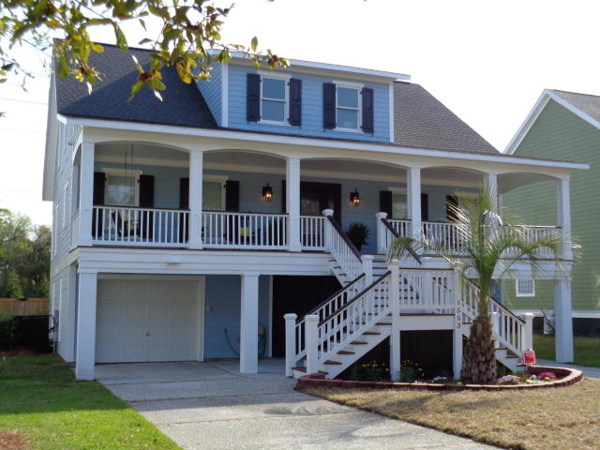
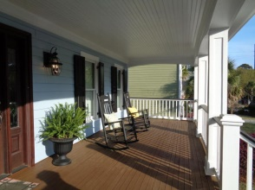
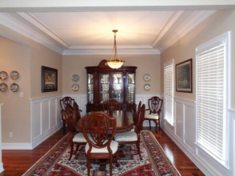
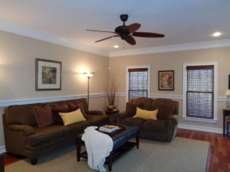
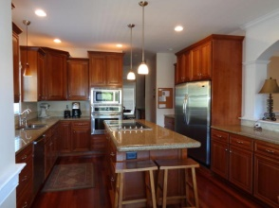
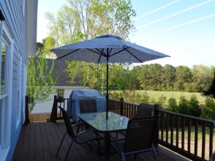
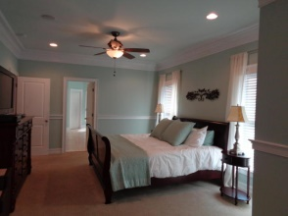
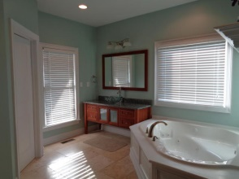
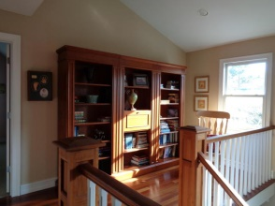
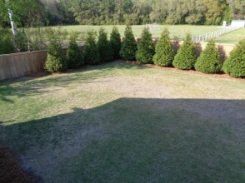
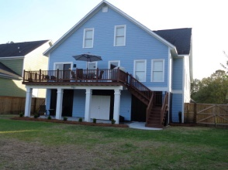


Price Reduction Of $10,000!
1553 Appling Drive
Shellpoint · Mount Pleasant · MLS# 15008500 · $649,900
$5,000 Buyer's Agent Bonus at Closing!
Beautiful custom built & designed elevated home in desirable and centrally located Mt. Pleasant neighborhood. 4BRs, 3.5 Baths, 3050 sq ft. Many custom finishes and details throughout; crown molding, chair rail, wainscoting, custom lighting and plumbing fixtures, Brazilian Cherry hardwood flooring, natural travertine marble stone floors in bathrooms just to name a few. Gorgeous kitchen with hand-finished American Cherry cabinets, granite counters, large island with cook top and pop-up exhaust, stainless appliances, extra-large side-by-side refrigerator/freezer. Just off the kitchen is a built-in bar with sink and wine cooler. Downstairs master BR with sitting area, luxurious master bath featuring large walk-in shower, jetted tub for two, programmable heated floor walk-in closet with Sapele Mahogany shelving. Upstairs are 3 generous sized bedrooms (one is large enough for game/rec room, office/study, etc) and 2 full baths, lots of attic storage. Speakers w/volume controls in Kit, DR, & Master BR/bath and CAT5 wired throughout, security system. Separate HVAC units for up and downstairs, 2 water heaters. Full length covered front porch, rear deck . Ground level patio, large back yard with wooden privacy fence (perfect yard to add a pool). In ground programmable 7-zone irrigation system which connects to well (save on water bill). Almost 2000 sq ft of garage large enough for 4 cars, workshop, etc. IMMACULATE! A MUST SEE!
Teresa Porter
(843) 300-5822
teresa.porter@agentownedrealty.com
www.agentownedrealty.com
AgentOwned Preferred Group · 824 Johnnie Dodds Blvd · Mt Pleasant, SC 29464

