Slide 1
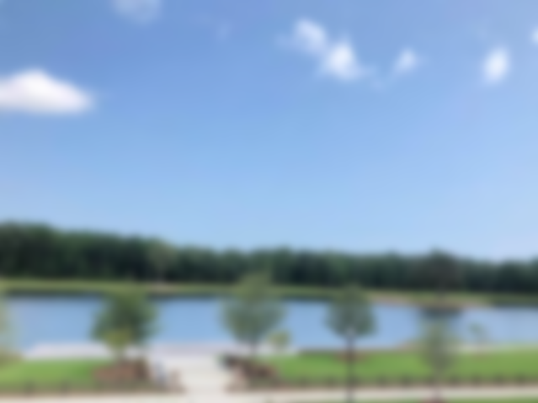
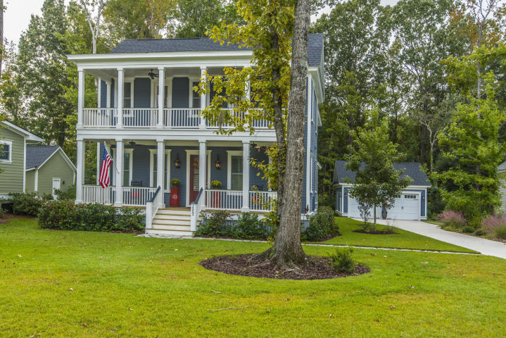
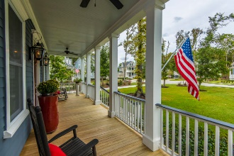
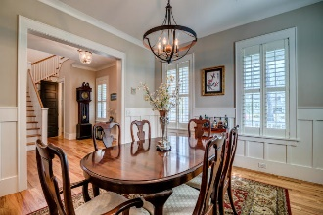
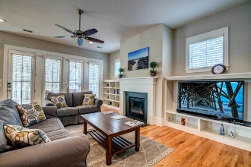
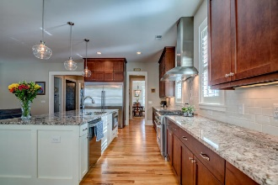
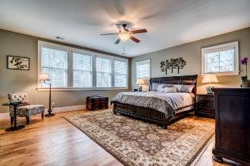
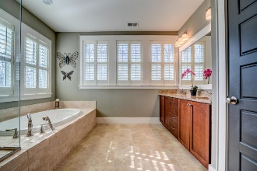
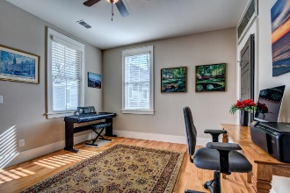
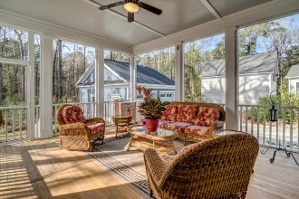
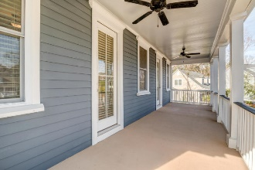
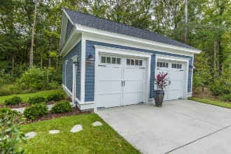
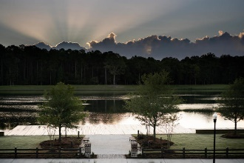
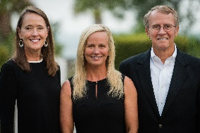

1553 Lindsey Creek Drive
Mount Pleasant, SC 29466 | MLS# 18029460 | $745,000
Major Price Reduction. Motivated Seller.
Nestled into a classic Lowcountry setting, this beautiful custom residence in prestigious Riverside at Carolina Park will welcome you home with double stacked piazzas, perfect for afternoons relaxing in rocking chairs or decking with holiday greenery! With so many custom features, such as plantation shutters, extensive mouldings and trim and hardwood floors, you'll notice the attention to detail the moment you enter the home.
With lush landscaping and mature trees, the yard has a decidedly park-like feel and is the perfect place for pets and children to play! Oversized two car garage. Located in desirable Carolina Park, you'll have access to luxury amenities such as a resort style swimming pool, tennis courts, children's play park, dog park, miles of walking/jogging trails, and a 20 acre lake with boardwalk and kayak launch. The new Carolina Park Elementary opened this year to join Wando High School, Wando Center for Advanced Studies, and Oceanside Academy. In addition, a brand new public library is slated to open later this year. All of this and still close to beaches, dining, shopping and all of the world-class offerings of historic downtown Charleston.
Asking $1,200,000
MLS# 17023051
3,692 SqFt
4 Bed/3½ Baths
Short Drive to Historic Downtown Charleston & Beaches
Don Dawson
843-514-0452
ddawson@carolinaone.com
Carolina One Real Estate • 2713 Highway 17 North • Mount Pleasant, SC 29466
www.TeamDawsonSC.com

