Slide 1
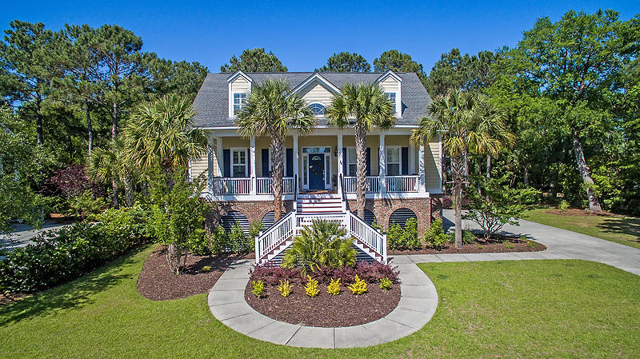
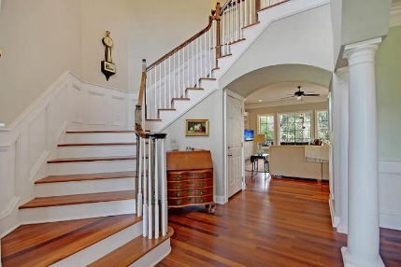
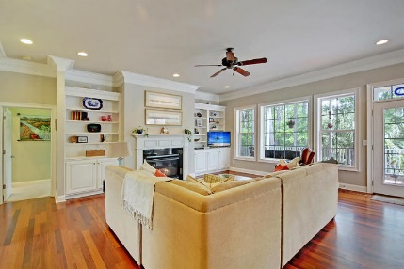
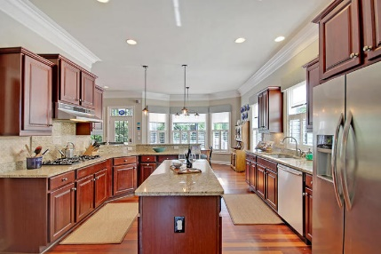
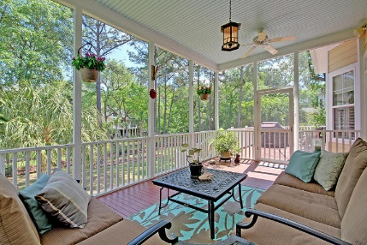
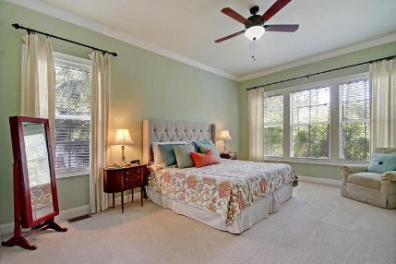
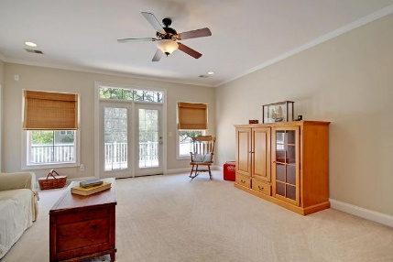
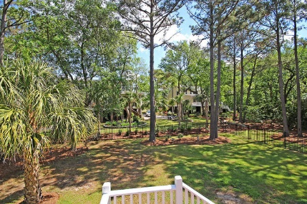
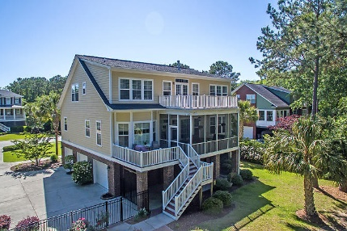


1554 Tidal Marsh Ln
Hamlin Plantation
Mt Pleasant, SC 29466
MLS# 18012509
$775,000
Open House Sunday 1-3
Send your buyers!
Price reduced!
Experience true Southern living & lowcountry style as you take in the smell of salt air every day! This well maintained & solid home, boasts tons of outdoor living space which includes a full covered front porch, large screened back porch & deck overlooking lush landscaping, 2nd floor patio & a lower level covered patio! Inside you'll find a great flow & use of space with the master on the main level & 2nd Mstr upstairs along with 3 additional bedrooms. 5th bedroom is currently used as a media room. The details in this home will WOW you & include: entire back of main level is windows, hardwood flooring, curved archway in foyer, wainscoting & extensive crown molding, plantation shutters, tray ceiling, recessed lighting, surround sound, updated light fixtures & an updated master bath.
A separate workshop is found in the 3 bay garage which can still hold up to 4 cars! Large laundry room off of kitchen with counter, sink microwave and FRIDGE! No going downstairs for your extra items while cooking! You'll find gorgeous views of the Hamlin Sound just at the end of the street & the neighborhood is 4 miles till your feet are in the sand at IOP beach!
Community amenities leave nothing to be desired: Jr. Olympic pool with water slide, full fitness center, walking/jogging path, nature trails, active tennis league & courts, playground and a clubhouse that can be used for private functions. Many social events throughout the year for adults and kids - It's just an overall great neighborhood!!
Lauren Zurilla
(843) 991-9149
laurenismyrealtor@gmail.com
LaurenZurilla.com
AgentOwned Premiere Group
824 Johnnie Dodds Blvd
Mt Pleasant 29464

