Slide 1
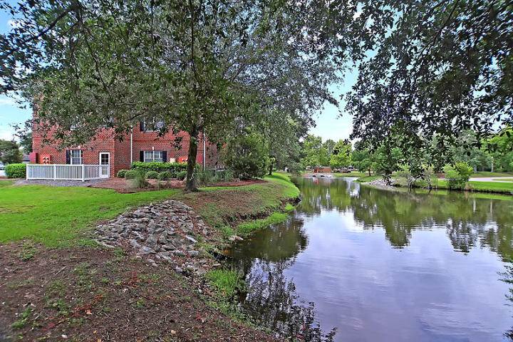
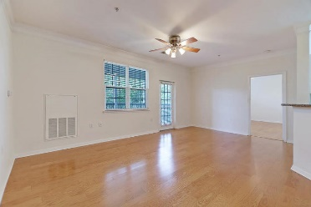
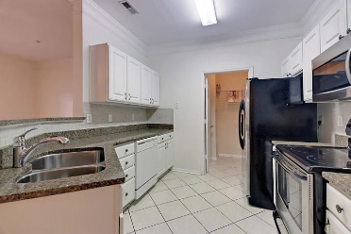
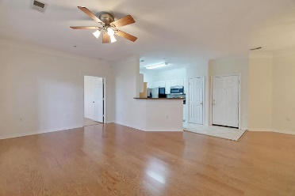
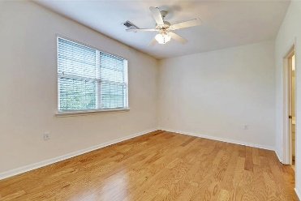
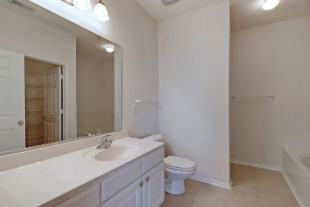
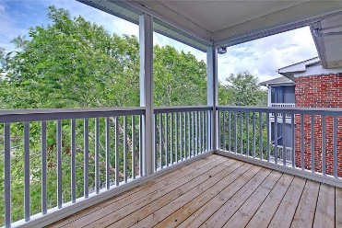
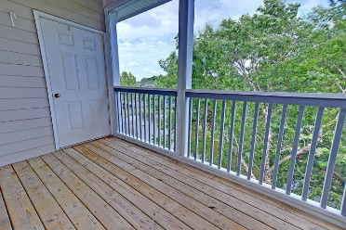
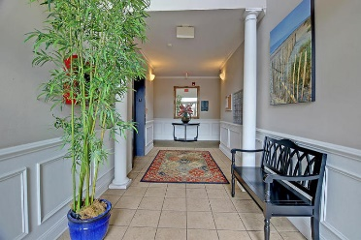

1557 Cambridge Lakes Drive 306D Cambridge Lakes · Mount Pleasant, SC 29464 MLS# 19022015 · $229,000
Gorgeous Listing
Desirable Third Floor Unit
Everyone wants a quiet 3rd floor unit that allows living with no neighbors above and views of the fountain below. The building has elevators and coded secured door access. This home has been freshly painted; kitchen has granite counter tops, tile backslash & stainless appliances!. The living areas have laminate wood flooring. Both baths have ceramic tile The split bedroom arrangement allows for privacy for guest or a perfect roommate situation. The home also has a laundry conveniently located off kitchen. The screened porch has additional storage. Water heater is approx. 5 yrs old & HVAC approx. 7 yrs old. Amenities include clubhouse, pool & gym. Regime covers upkeep of common areas, termite bond, building exterior.
Stan Huff
843-670-2835 stan.huff@agentowned.com
Jill Marcacci
843-297-5590 jill@agentowned.com
www.agentownedrealty.com
AgentOwned Realty Co. Preferred Group, Inc. | 824 Johnnie Dodds Blvd | Mt Pleasant, SC 29464

